Slide 1


Climate Finance for Sanitation
From Kyoto to Paris: The Evolution of Climate Finance
UPM Umwelt-Projekt-Management GmbH
June 2025

Slide 2

WHAT DOES CLIMATE FINANCE MEAN TO YOU?
Join menti.com
XXX
Training of Trainers on Climate-Sanitation Nexus – Climate Finance for Sanitation
2
Notes:
Activity:
Use Mentimeter to create a word cloud: each participant shall share key words that express what they associate with climate finance
Trainer will discuss the results, say what is covered and clear up misconceptions, if any

Slide 3
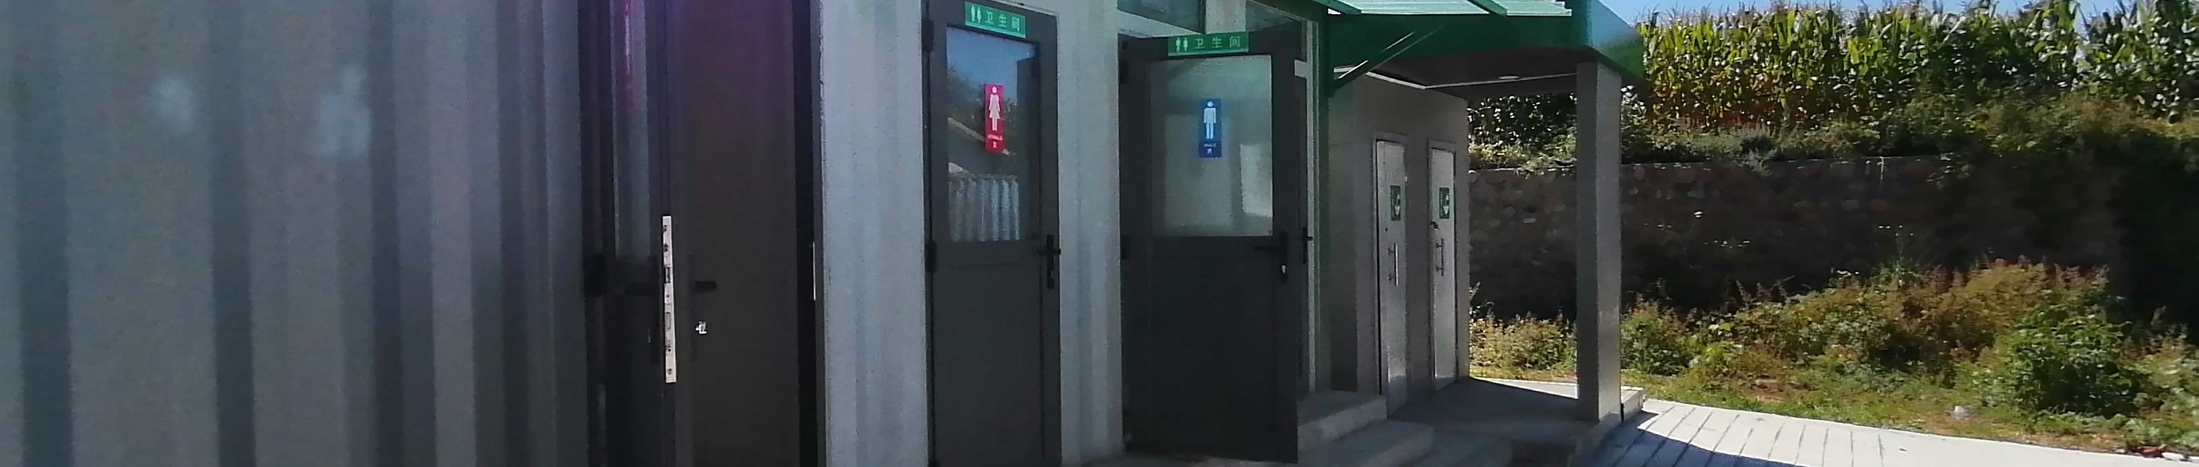
Agenda
What is Climate Finance?
How can Climate Finance impact sanitation?
How has Climate Finance evolved globally?
01
02
03
Training of Trainers on Climate-Sanitation Nexus – Climate Finance for Sanitation

Slide 4

01
WHAT IS CLIMATE FINANCE?

Slide 5
Climate finance can be defined as the financial instruments or assets that help to enable mitigation and adaptation actions to address climate change.
Training of Trainers on Climate-Sanitation Nexus – Climate Finance for Sanitation
5

Slide 6
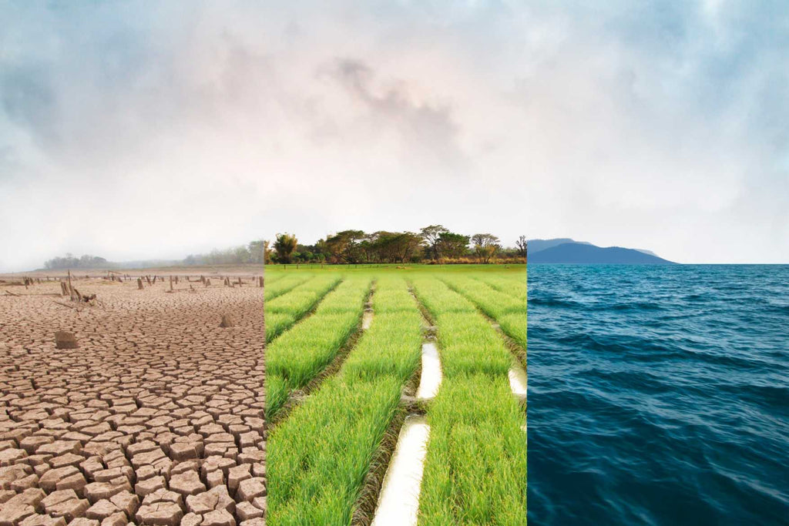
Water is the key indicator of climate change‘s impact
Droughts accelerate water scarcity and inhibit safe sanitation and hygiene practices.
Flooding leads to water contamination, thus spreading water-borne diseases within communities.
This extremely delicate relationship between climate change, water, and sanitation emphasizes the need to invest in climate-SMART WaSH services worldwide.
According to the African Union, every US$1 invested in climate-resilient water and sanitation returns at least US$7 in socio-economic gains through enhancements in health, food security, education, gender equality, and SDGs.
Training of Trainers on Climate-Sanitation Nexus – Climate Finance for Sanitation
6
Notes:
Waste water contribute around 1,3% to globla GHG emissions

Slide 7

02
HOW CAN CLIMATE FINANCE IMPACT SANITATION?

Slide 8
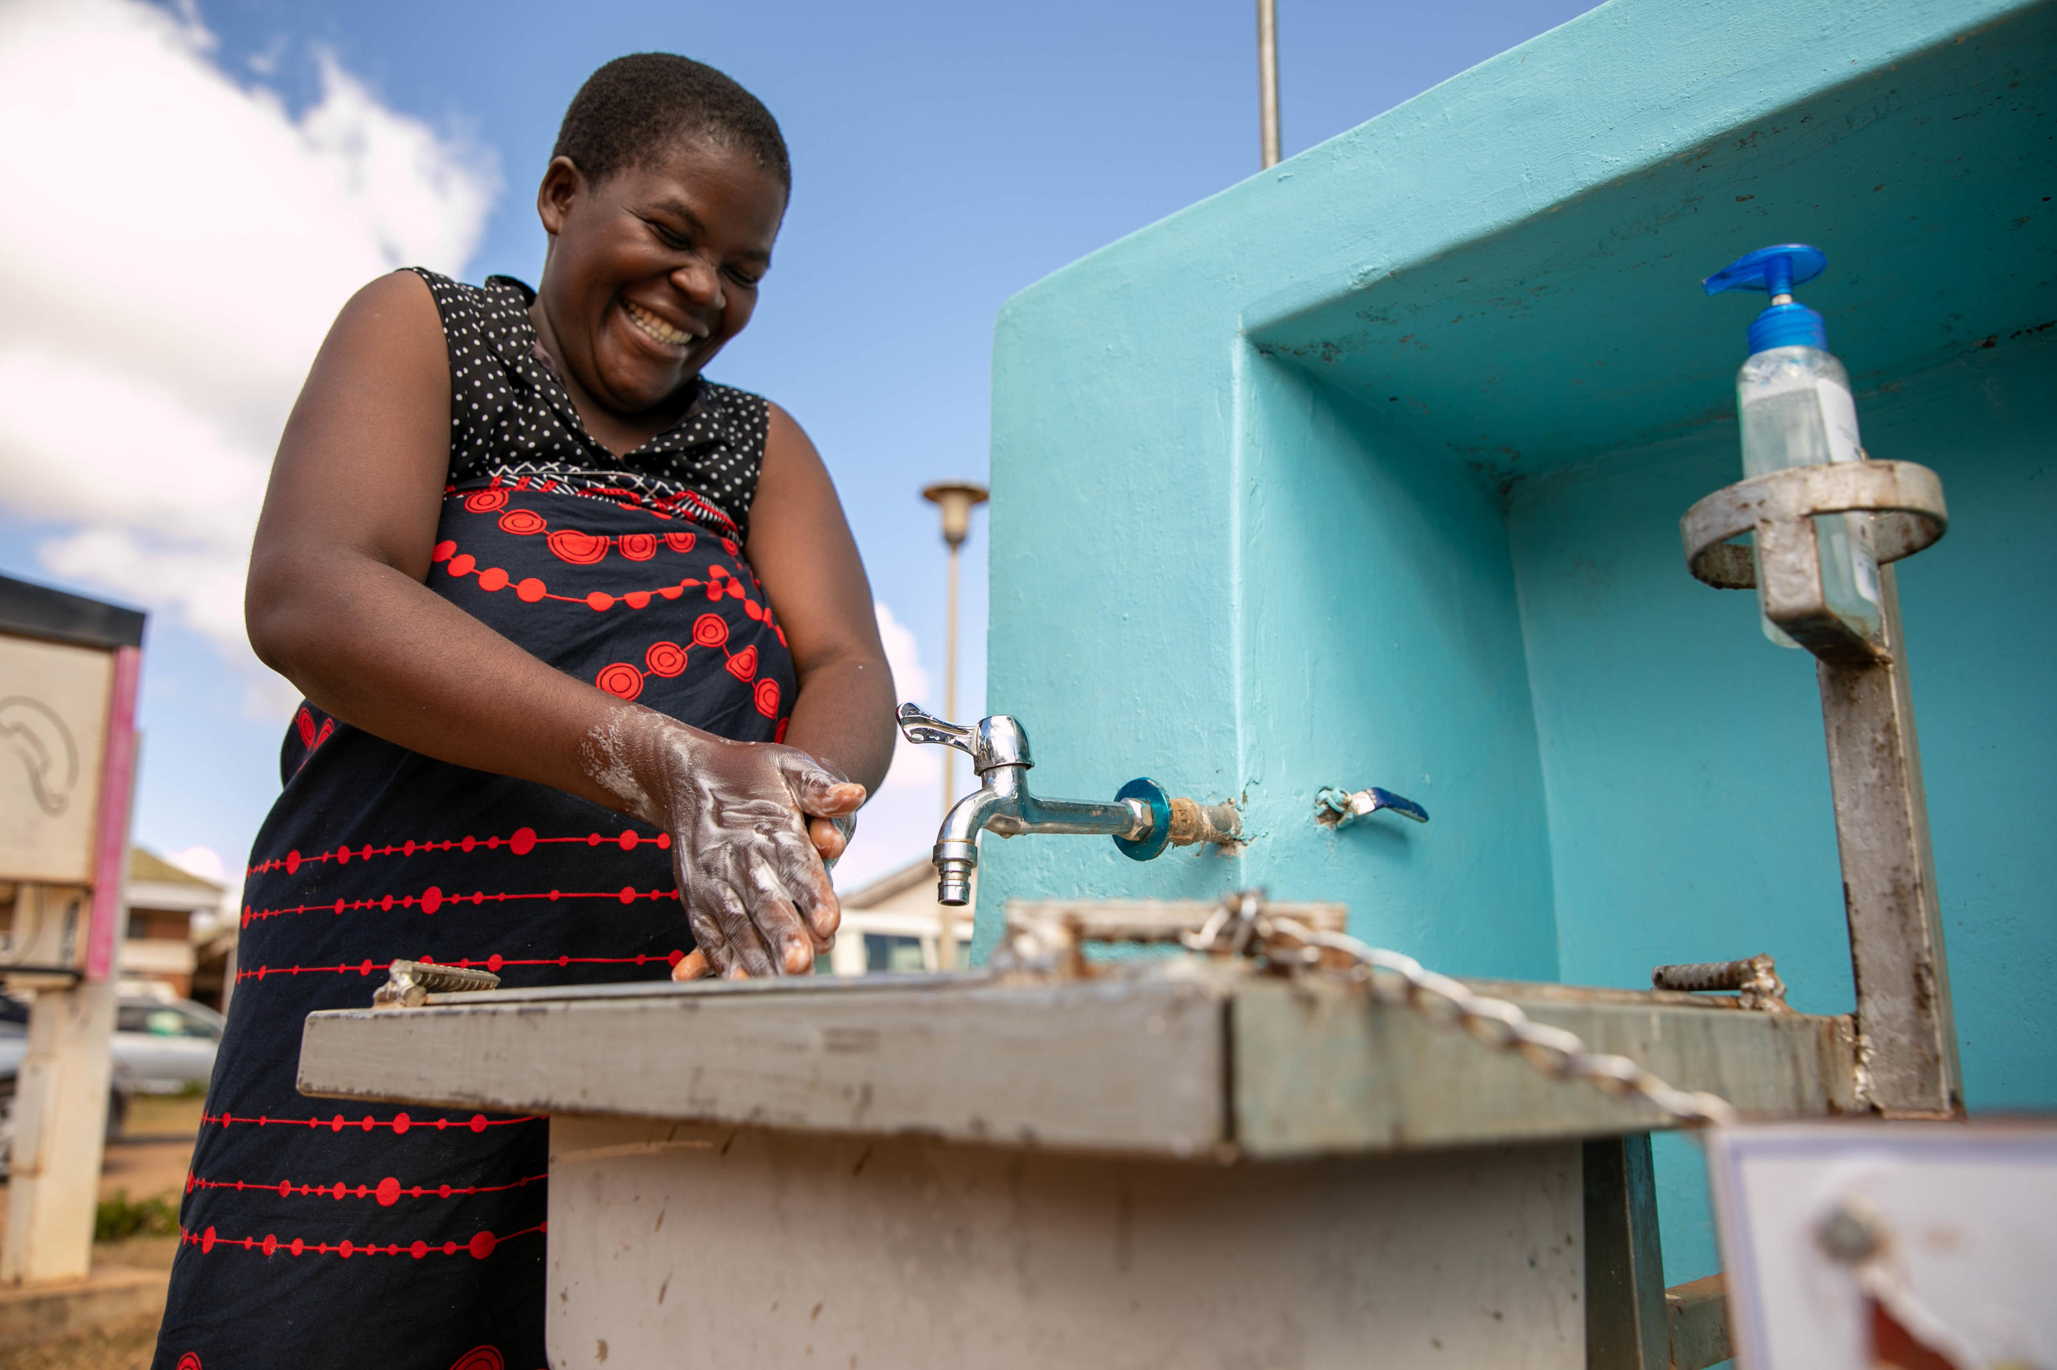
Benefits that climate finance can bring for sanitation
Establishment and access to dedicated climate funds to finance climate change mitigation and adaptation efforts in WaSH
Promotion of innovative sanitation technologies
Innovative climate financing methods can mobilize funds from public and private sources
Image: WaterAid/Dennis Lupenga
Training of Trainers on Climate-Sanitation Nexus – Climate Finance for Sanitation
8

Slide 9

Existing challenges concerning climate finance for sanitation
Climate finance provided in the form of conventional loans are unsuitable for water and sanitation services as the full costs are difficult to recover from users.
Climate finance has historically prioritized mitigation over adaptation, which is typically more impactful for sanitation, leaving a considerable gap in global adaptation finance. Although adaptation finance has increased in recent years, only 5% of global total climate finance went towards funding adaptation efforts.
Deficient incorporation of climate considerations in sanitation policies, and vice versa has resulted in the underfunding of sanitation initiatives from climate finance
Training of Trainers on Climate-Sanitation Nexus – Climate Finance for Sanitation
9

Slide 10
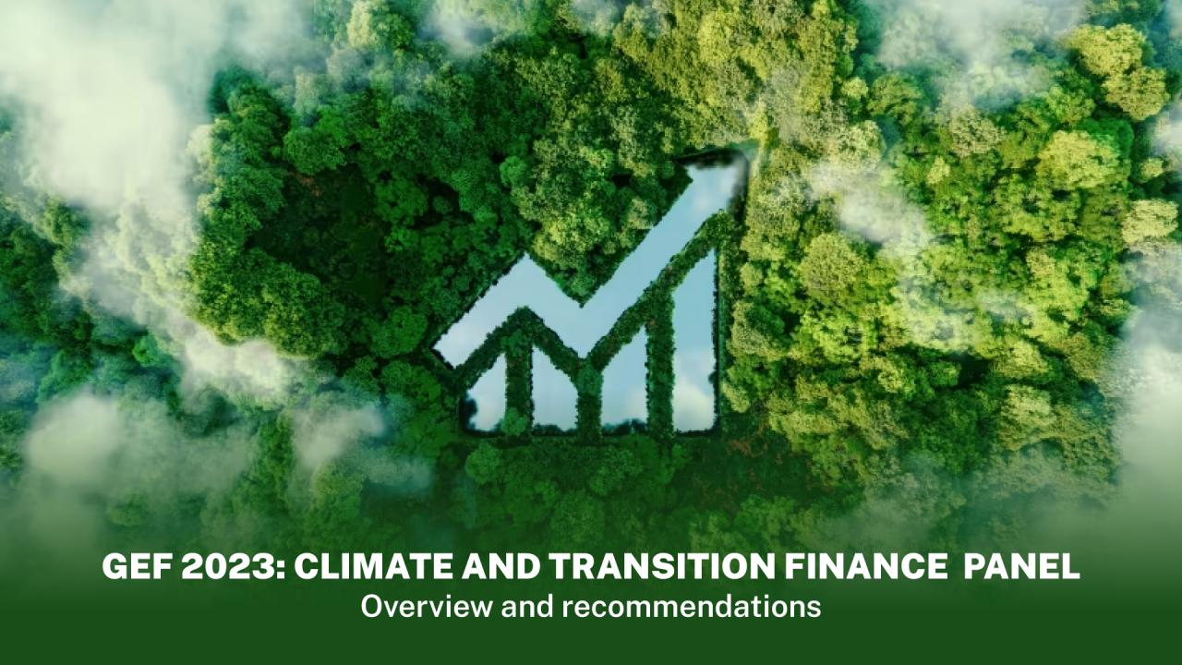
03
HOW HAS CLIMATE FINANCE EVOLVED GLOBALLY?

Slide 11
Evolution and Role of Climate Finance Over the Years
The Kyoto Protocol
1997 - 2020
Climate finance introduced primarily as a mitigation-focused mechanism to support the reduction of GHG emissions in industrialized countries
The Paris Agreement
2015 - present
Climate finance as a comprehensive adaptation-inclusive framework and enabler of climate mitigation and adaptation efforts, particularly in developing countries
Establishment of the Clean Development Mechanism (CDM) and Joint Implementation (JI)
Establishment of dedicated climate funds like the Green Climate Fund (GCF) and an emphasis on supporting developing countries shift to low-emission and climate-resilient pathways
Article 6 of the Agreement consists of a centralized crediting mechanism, the Paris Agreement Crediting Mechanism (Article 6.4), based on reducing GHG emissions whilst promoting sustainable development, and it is the successor of the CDM.
Training of Trainers on Climate-Sanitation Nexus – Climate Finance for Sanitation
11

Slide 12

Article 6 of the Paris Agreement and Climate Finance
Article 6 of The Paris Agreement allows nations to voluntarily cooperate with each other to achieve their emission reduction targets set in Nationally Determined Contributions (NDCs).
                Climate finance is fundamental for the achievement of a country’s NDCs as
  NDC implementation requires significant investment
            Climate finance can bridge the gap between what countries can finance themselves and what is required to fully implement their NDCs
The Paris Agreement Crediting Mechanism (PACM), or Article 6.4, can also be a source of climate finance for developing nations, with a share of the proceeds going towards adaptation funding, thus building resilience to the effects of climate change.
For further detail on Article 6 of the Paris Agreement and information on Carbon Markets for Sanitation, please refer to Module 4 of the manual.
Training of Trainers on Climate-Sanitation Nexus – Climate Finance for Sanitation
12

Slide 13
CDM to PACM (Article 6.4)
Clean Development Mechanism (CDM)
Established as part of the Kyoto Protocol international agreement, with a primary purpose of enabling industrialized countries to meet their emissions targets by funding emission-reduction projects in developing countries.
The operation of CDM ended along with the termination of the Kyoto Protocol in 2020.
Paris Agreement Crediting Mechanism (PACM)
Established under Article 6 of the Paris Agreement, with a primary purpose of enabling international cooperation to tackle climate change, achieve NDCs, and unlock financial support for developing countries.
In contrast to the CDM, the PACM requires greater host country involvement, as climate mitigation and adaptation activities must be approved by host countries, and are also mandated to be aligned with host countries’ NDCs,
Training of Trainers on Climate-Sanitation Nexus – Climate Finance for Sanitation
13

Slide 14
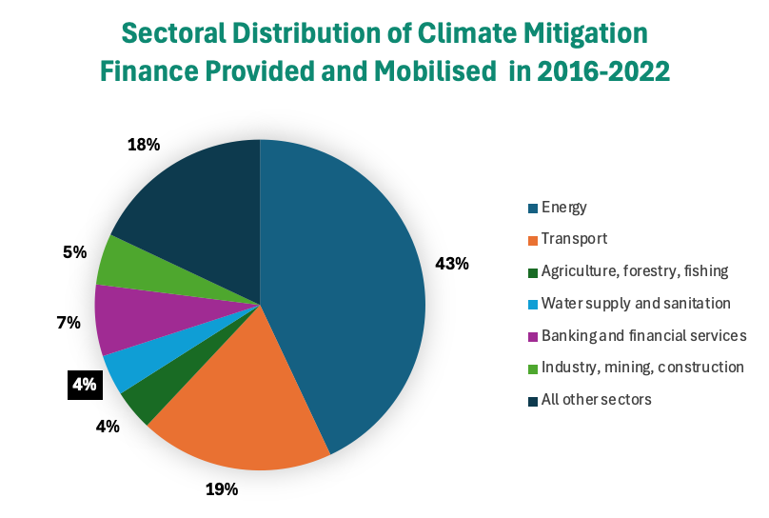
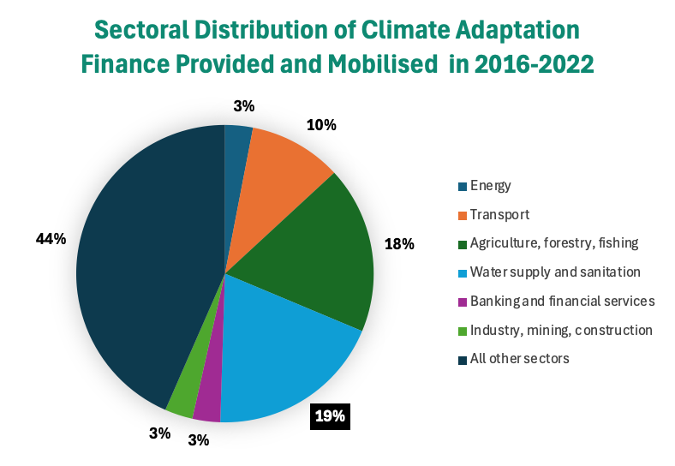
Global Climate Fund Allocation for Sanitation
Only 0.3% of global climate finance is put towards water supply and sanitation.
The majority of global mitigation finance focuses on activities in the energy and transport sectors with only 4% reaching the water and sanitation sector.
Although most of the global climate finance for sanitation is provided for adaptation-focused activities, the energy sector still receives the majority of climate adaptation finance.
Training of Trainers on Climate-Sanitation Nexus – Climate Finance for Sanitation
14

Slide 15

Climate finance is linked to national climate policies and strategies, including, in particular, the NDCs. Sanitation sector needs to be included in these documents to receive climate finance fundings. Actions are required by governments and other stakeholders in the country.
Training of Trainers on Climate-Sanitation Nexus – Climate-SMART Sanitation Approach
15

Slide 16

Q&A

Slide 17




19th Floor Jeongdong Bldg. 21-15,
Jeongdong-gil, Jung-gu, Seoul,
Republic of Korea 04518
www.gggi.org
@gggi_hq
@GGGIHQ
@GGGIHQ
@gggi_hq
@GGGIMedia

