Slide 1
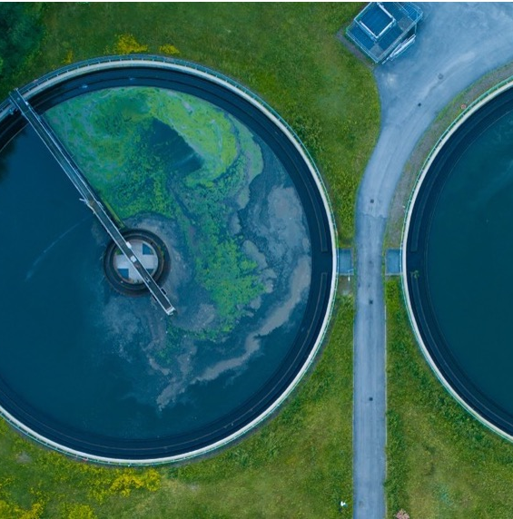

Training of Trainers on the Climate-Sanitation Nexus
Introduction and Opening Remarks from UPM
UPM Umwelt-Projekt-Management GmbH
June 2025

Slide 2

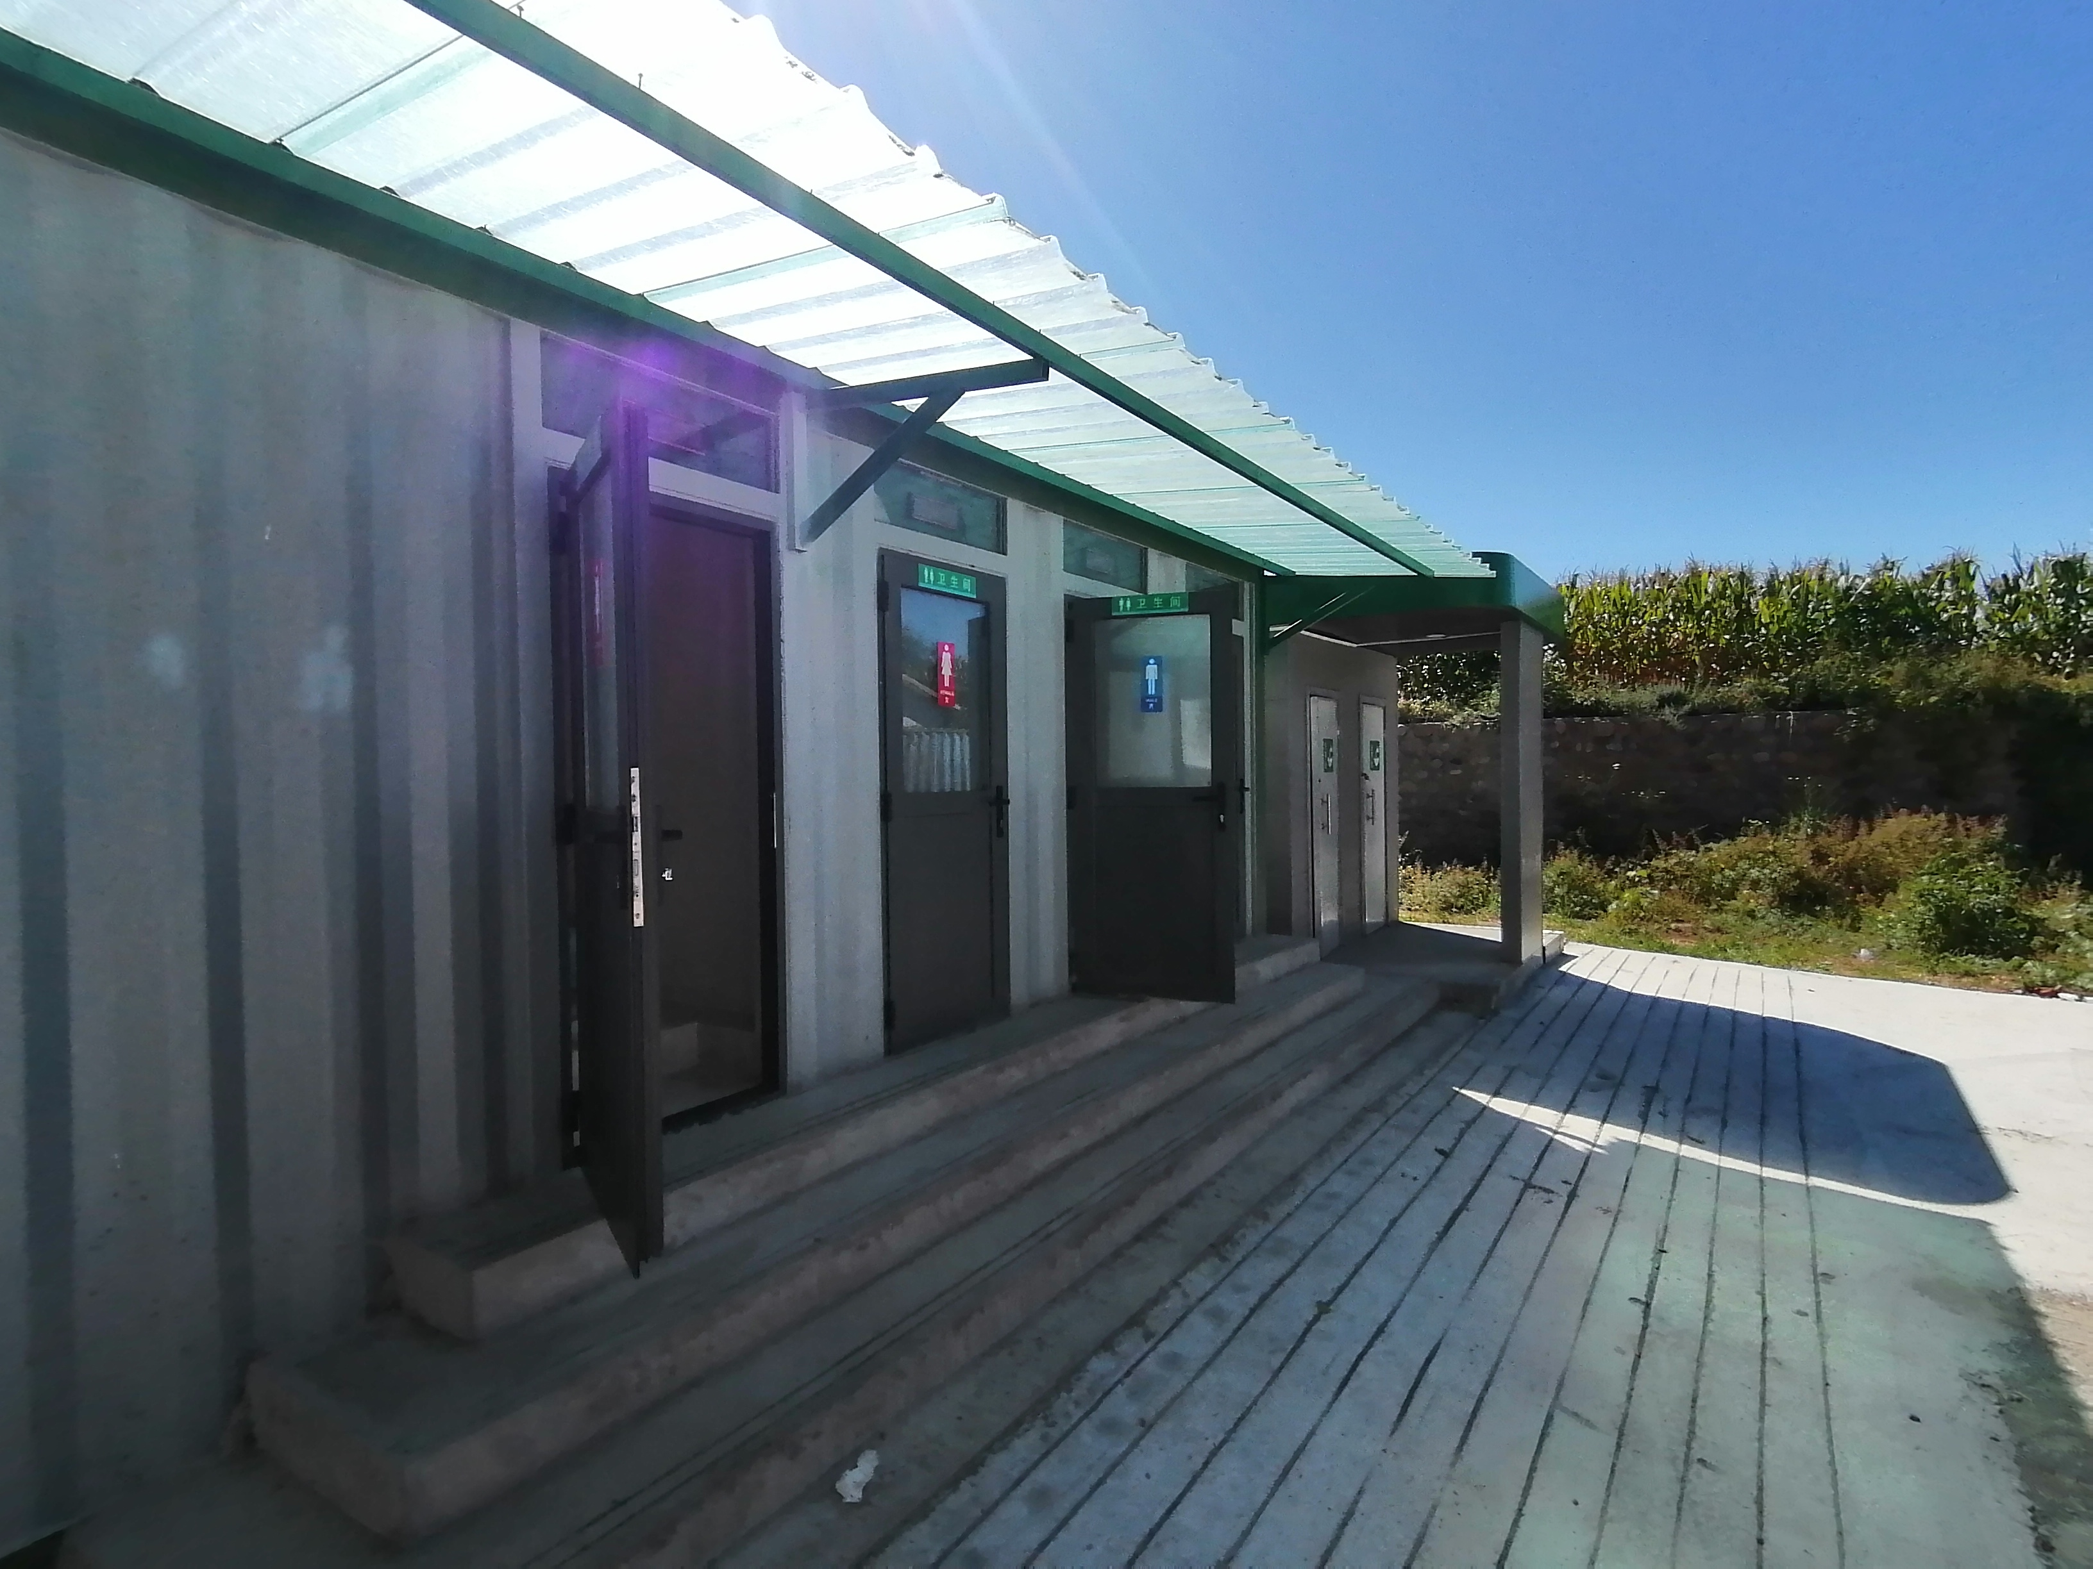
Agenda
About GGGI and UPM
About the Training
Training Agenda
Let’s get started!
01
02
03
04
Training of Trainers on Climate-Sanitation Nexus

Slide 3

01
ABOUT GGGI

Slide 4




ABOUT GGGI
VISION
A low-carbon resilient world
of strong, inclusive, and sustainable growth.
MISSION
GGGI supports its Member States in the transformation of their economies to a green growth economic model.
POSITION
A trusted advisor & development partner embeded in member & partner governments.

Slide 5
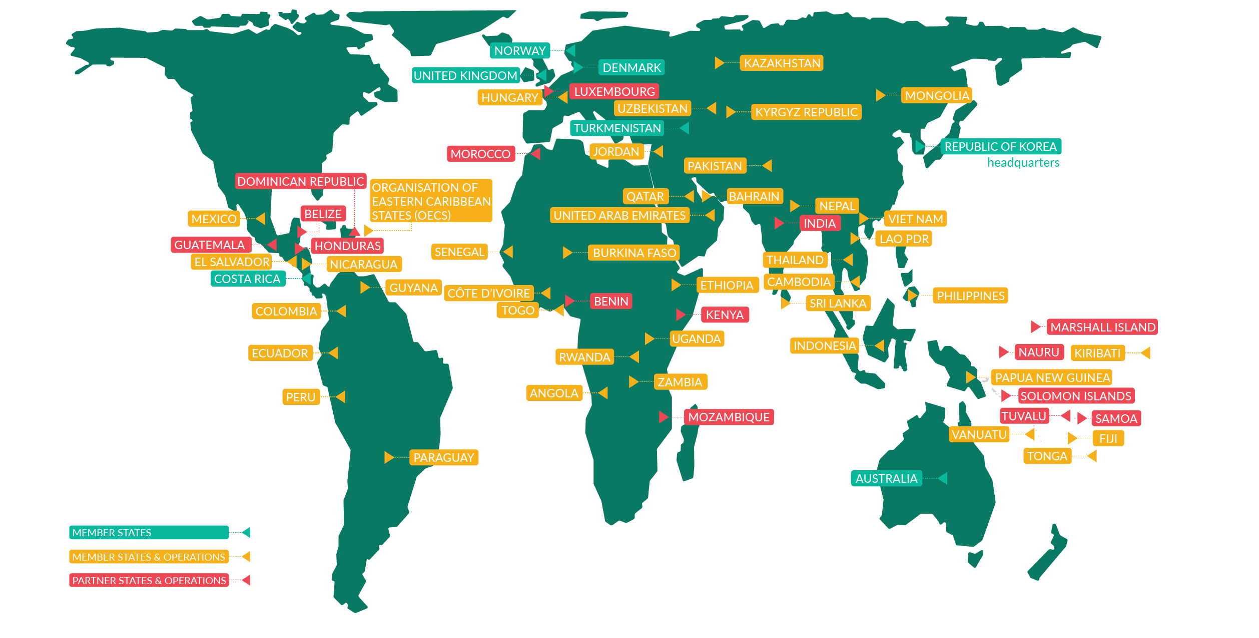
GGGI MEMBER STATES &
COUNTRIES OF OPERATION
Headquartered in Seoul, Republic of Korea GGGI currently has 48 Member States and operations in over 40 countries.

Slide 6





GGGI PROGRAMMATIC SOLUTIONS
Catalyzing and
accelerating access to climate
finance/ green investments for Members’ public and
private sectors
Supporting our Members in strengthening policy, planning and regulatory frameworks, and institutional capacity to achieve green growth outcomes
Achieving a sustainable and circular bioeconomy while securing healthy natural systems
Making cities and communities sustainable, livable, and resilient, supported through green jobs, services, and green infrastructure capital markets innovations
Accelerating progress in our country programs in poverty eradication and gender equality
Carbon pricing
Green Investments
Green bankable projects, investment proposals, national financing vehicles, green and climate instruments, carbon-focused engagements.
Climate Actions
Inclusive green growth plans, LT-LEDS, NDC support, MRV system design, climate diplomacy.
Climate Resilient Agriculture
Solar irrigations, renewable energy application in agri-value chain, resilient cropping practices, resource conservation
Circular Economy and Sustainable Waste Management
Cross cutting
in all programmatic solutions
Article 6
Article 6 readiness, policy design, transactions and trading
(1) Optimize resource use and product lifecycles, (2) promote industrial ecology and Extended Producer Responsibility, and (3) ensure sustainable waste management, value from waste, and address plastic pollution.
Sustainable Forests
REDD+, landscapes financing mechanisms, innovation of natural capital markets.
Sustainable Mobility
E-Mobility, Non-motorized transport
Coastal Resilience and Blue Economy
(1) Safeguard and strengthen coastal ecosystems resilience and biodiversity; (2) and promote a sustainable and innovative blue-economy.
Green Buildings
Green urban infrastructure norms/ standards/ policies, energy efficiency in residential and commercial buildings
Renewable Energy
Enhance policies, regulations, and access to sustainable energy infrastructure for a just transition towards (1) renewable heating, cooling, and power systems, (2) more efficient energy systems, and (3) cleaner heat and power generation, reducing greenhouse gas-intensive fuels.
Green Industries
Green industrial parks, green supply chains, energy eﬃciency in SMEs, labelling and standards.

Slide 7
01
ABOUT UPM

Slide 8

About UPM
UPM is dedicated to ensuring that global warming is kept within safe limits and striving to create a better Earth for both present and future generations.
UPM Umwelt-Projekt-Management GmbH (UPM) is a boutique consulting firm specialized in climate change mitigation, adaptation and sustainable development,
providing a service offering based on a unique combination of expertise, experience and dedication to fulfill our mission globally.
30⁺
Years of professional experience
Years of experience in Asia, Middle East, Africa & Latin America
15⁺
Training of Trainers on Climate-Sanitation Nexus – UPM Introduction and Opening Remarks
8

Slide 9

We offer
Technical Assistance, Advisory and Capacity Building for
Climate Action
Project Development
Carbon Trading &
Climate Strategy
Sustainable Sanitation - Waste - Energy Nexus
Training of Trainers on Climate-Sanitation Nexus – UPM Introduction and Opening Remarks
9

Slide 10
Highlights
55+
100+
30+
Millions
Assignments
Completed
GHG Emission Reduction Projects
Million Tons
of Beneficiaries
Impacted
within the last 8 years
Across different project types (RE, wastewater treatment, landfill gas, etc.)
GHG emissions expected to be reduced
across 25 countries & regions
Training of Trainers on Climate-Sanitation Nexus – UPM Introduction and Opening Remarks
10

Slide 11
Your Trainers for This Week
Heinz-Peter Mang
Martin Dilger
Marie Reysset
Expert for Sustainable and Climate-Resilient Sanitation
Expert for Climate Finance and Carbon Markets
Expert for Sustainability Project Management
Technical Director of UPM
Guest Professor at the University of Science and Technology Beijing (USTB)
More than 40 years of experience in biogas, waste, fecal sludge, ecological sanitation, etc.
Managing Director of UPM
More than 15 years of experience in climate protection project sourcing, financing, development and management
General Manager of UPM Beijing Co. Ltd.
Director of Consulting Services at UPM
More than 25 years of experience in project management, stakeholder engagement and capacity building
Training of Trainers on Climate-Sanitation Nexus – UPM Introduction and Opening Remarks
11

Slide 12
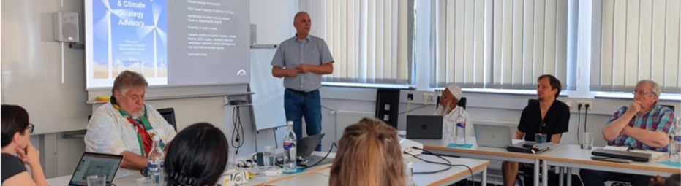
02
ABOUT THE TRAINING

Slide 13
Overall Objective
“Support the enhancement of the understanding of climate-resilience opportunities in the sanitation sector in the region and citywide-inclusive sanitation principles in Africa, and an understanding of the relevance and urgency of the topic.”
A user-friendly, interactive and participant-focused 4-Day Training-of-Trainers (ToT).
Training of Trainers on Climate-Sanitation Nexus – UPM Introduction and Opening Remarks
13

Slide 14
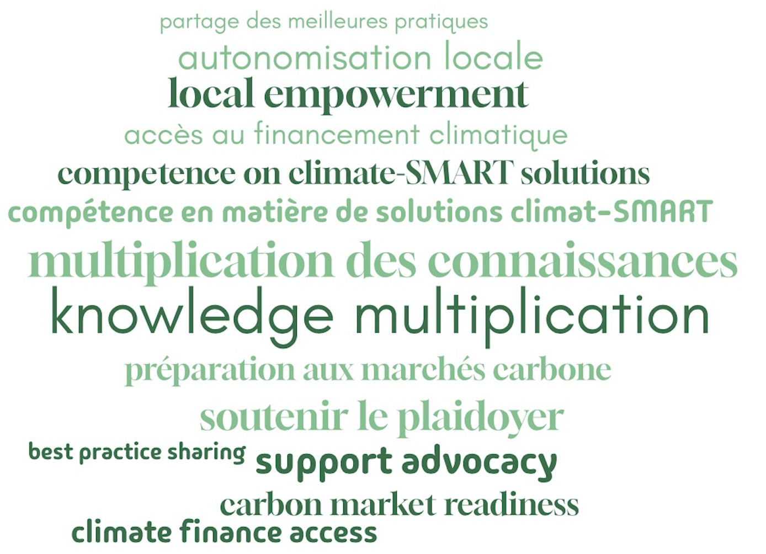
Why Training-of-Trainers on Climate and Sanitation?
Training of Trainers on Climate-Sanitation Nexus – UPM Introduction and Opening Remarks
14

Slide 15
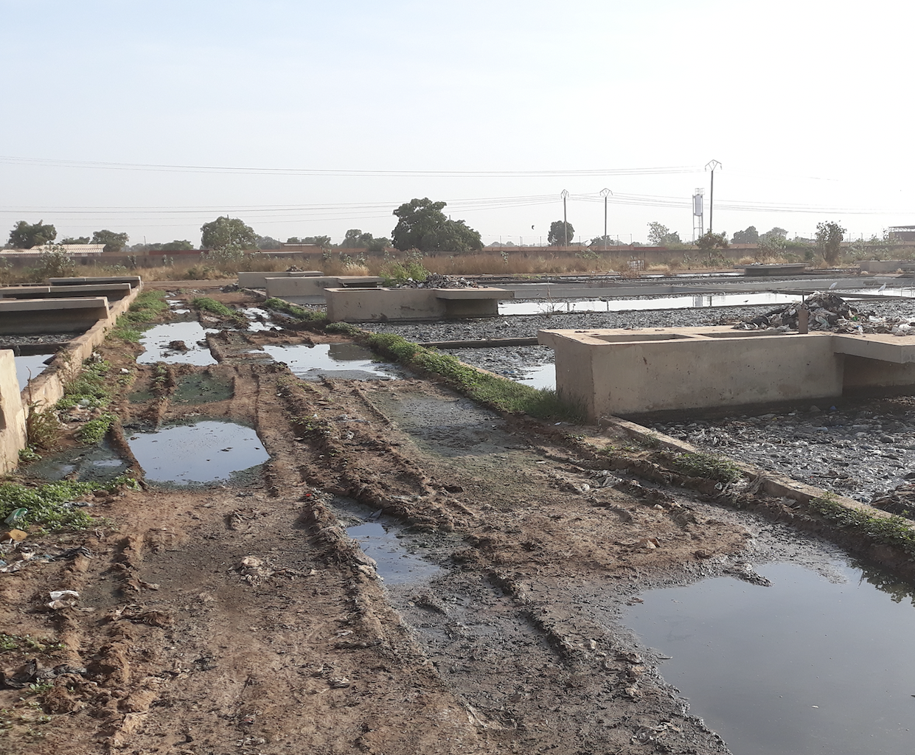
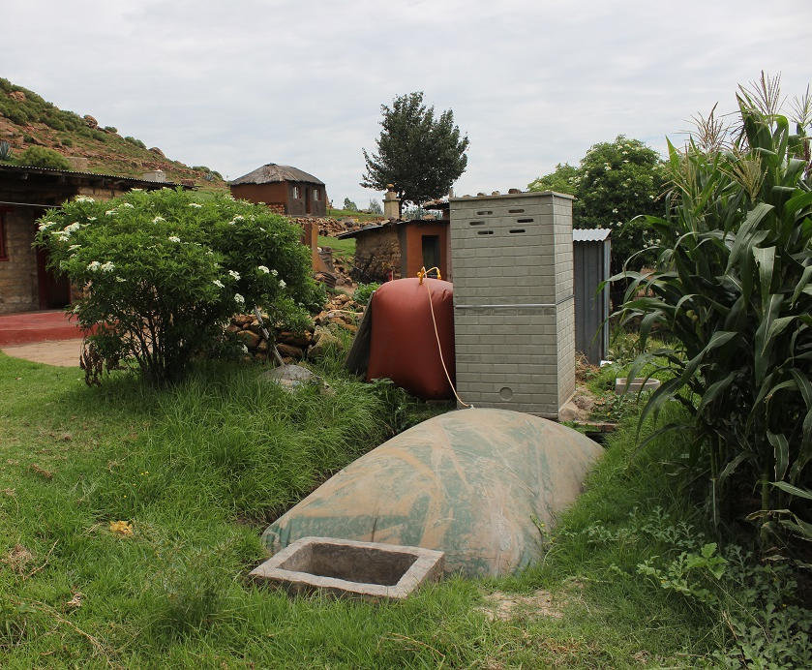
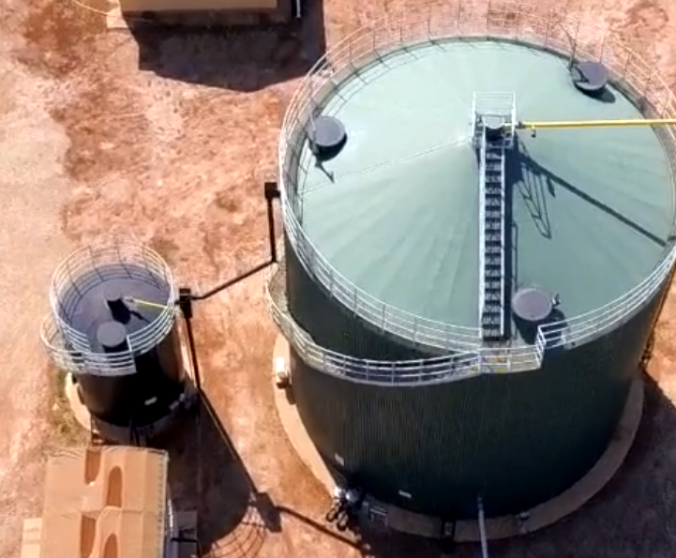
Key Content Areas & Modules
Module 1
Climate-Sanitation Nexus
Module 2
Climate-SMART Sanitation
Module 3
Climate Finance for Sanitation
Module 4
Climate Markets for Sanitation
Understanding the Climate-Sanitation Nexus
Understanding the relevance of Sustainable Development Goals and Nationally Determined Contributions
Understanding the implications of climate-SMART sanitation
Baseline assessment and design of climate-SMART solutions
Understanding the climate finance evolution
Awareness of existing climate financing tools for sanitation projects
Understanding carbon markets
Understanding carbon credits and carbon credit projects
Training of Trainers on Climate-Sanitation Nexus – UPM Introduction and Opening Remarks
15

Slide 16
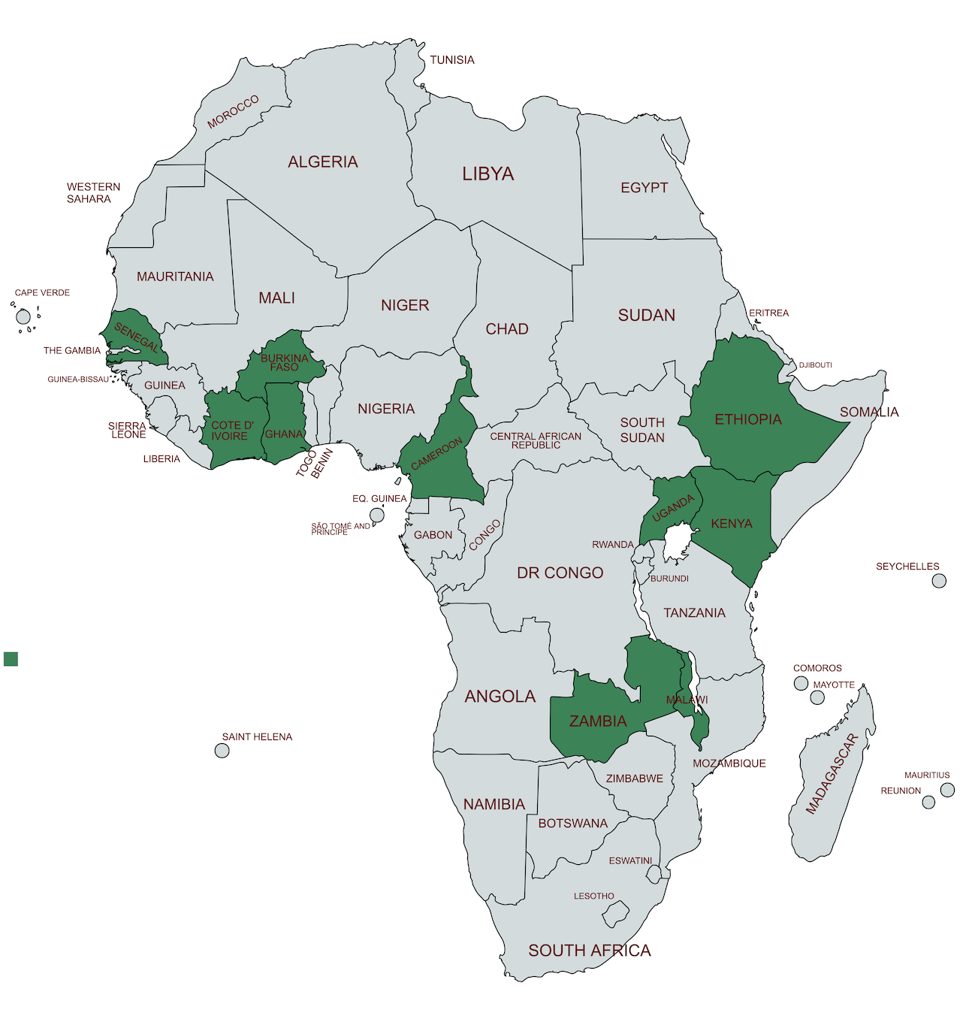
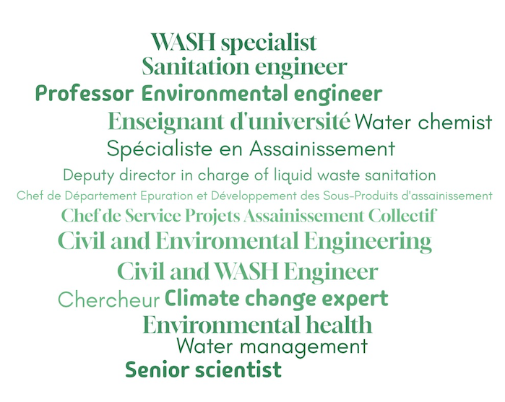
Target Audience
Sanitation and climate stakeholders from all over Africa
Represented countries
Represented professions
Training of Trainers on Climate-Sanitation Nexus – UPM Introduction and Opening Remarks
16

Slide 17
Insights from the Training Needs Assessment I
Very diverse knowledge background on climate-sanitation relation.
Low or average theoretical and practical knowledge on climate finance and carbon markets.
The training will focus on creating a common understanding of the climate-sanitation interlinkages.
For both climate finance and carbon markets a solid basic understanding needs to be created.
Training of Trainers on Climate-Sanitation Nexus – UPM Introduction and Opening Remarks
17

Slide 18
Insights from the Training Needs Assessment II
Participants are experienced trainers.
Training experiences up to now focused especially on pure sanitation topics.
Insights are necessary to prepare for trainings on sanitation-climate topics.
Training of Trainers on Climate-Sanitation Nexus – UPM Introduction and Opening Remarks
18

Slide 19
Training Documentation
The training material from the QR code/link, including:
Manual with trainer’s guidance and exercises
Presentations
Training of Trainers on Climate-Sanitation Nexus – UPM Introduction and Opening Remarks
19

Slide 20
03
TRAINING AGENDA

Slide 21
AGENDA
Training of Trainers on Climate-Sanitation Nexus – Climate-SMART Sanitation Approach
21

Slide 22
04
LET’S GET STARTED!

Slide 23
Introduce yourself!
What is your name?
Where are you from?
What is your current employment?
Training of Trainers on Climate-Sanitation Nexus – UPM Introduction and Opening Remarks
23

Slide 24
What are your main expectations for this Training-of-Trainers?
Connect to menti.com
Join xxxx
Training of Trainers on Climate-Sanitation Nexus – UPM Introduction and Opening Remarks
24

Slide 25
Exercise: Understanding the Climate-Sanitation Nexus
Find yourself in one of the three groups in front of one of the flipcharts.
Together with your group answer one of the three questions by creating an impact diagram.
You have 10 minutes.
Each group presents to the others and answers questions/remarks
Don’t forget to make use of the keywords that are provided for each group.
Training of Trainers on Climate-Sanitation Nexus – UPM Introduction and Opening Remarks
25

Slide 26
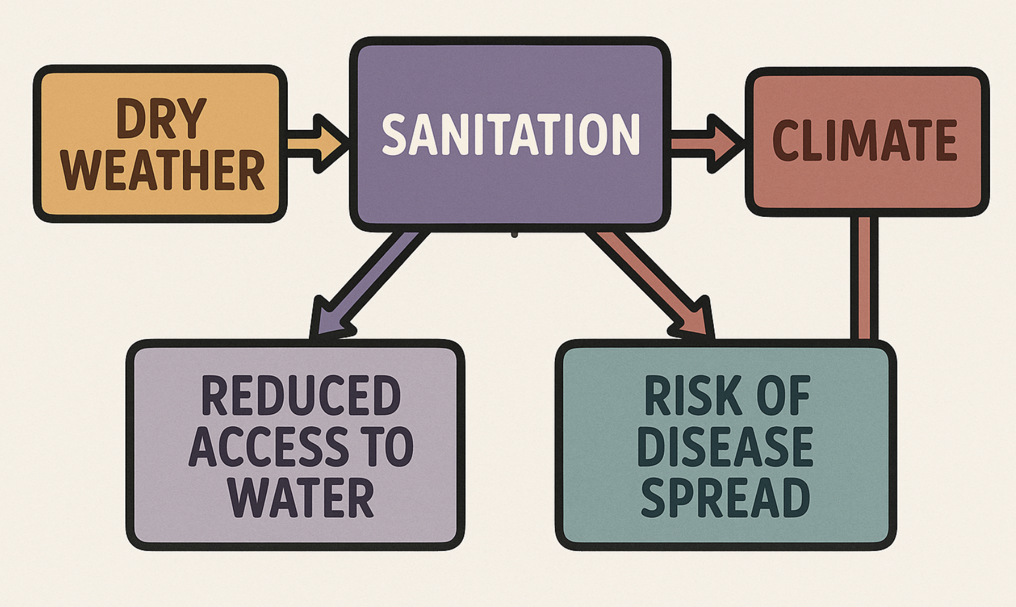
What is an impact diagram?
A simplified example
Training of Trainers on Climate-Sanitation Nexus – UPM Introduction and Opening Remarks
26

Slide 27
Exercise: Understanding the Climate-Sanitation Nexus
GROUP 1: Defining the Climate-Sanitation Nexus
Q: What are the key components and interactions that define the Climate-Sanitation Nexus
Keywords: interdependence, feedback loops, co-benefits, human health, environmental health, vulnerability, emissions, policy, resilience
GROUP 2: Climate’s impacts on Sanitation
Q: How does climate change affect sanitation infrastructure, access and health outcomes
Keywords: infrastructure damage, access disruption, contamination, health risks, displacement
GROUP 3: Sanitation’s impacts on Climate
Q: In what way does the sanitation sector contribute to climate change
Keywords: methane, nitrous oxide, carbon dioxide, energy consumption, treatment methods, open defecation
Training of Trainers on Climate-Sanitation Nexus – UPM Introduction and Opening Remarks
27

Slide 28




19th Floor Jeongdong Bldg. 21-15,
Jeongdong-gil, Jung-gu, Seoul,
Republic of Korea 04518
www.gggi.org
@gggi_hq
@GGGIHQ
@GGGIHQ
@gggi_hq
@GGGIMedia

