Slide 1
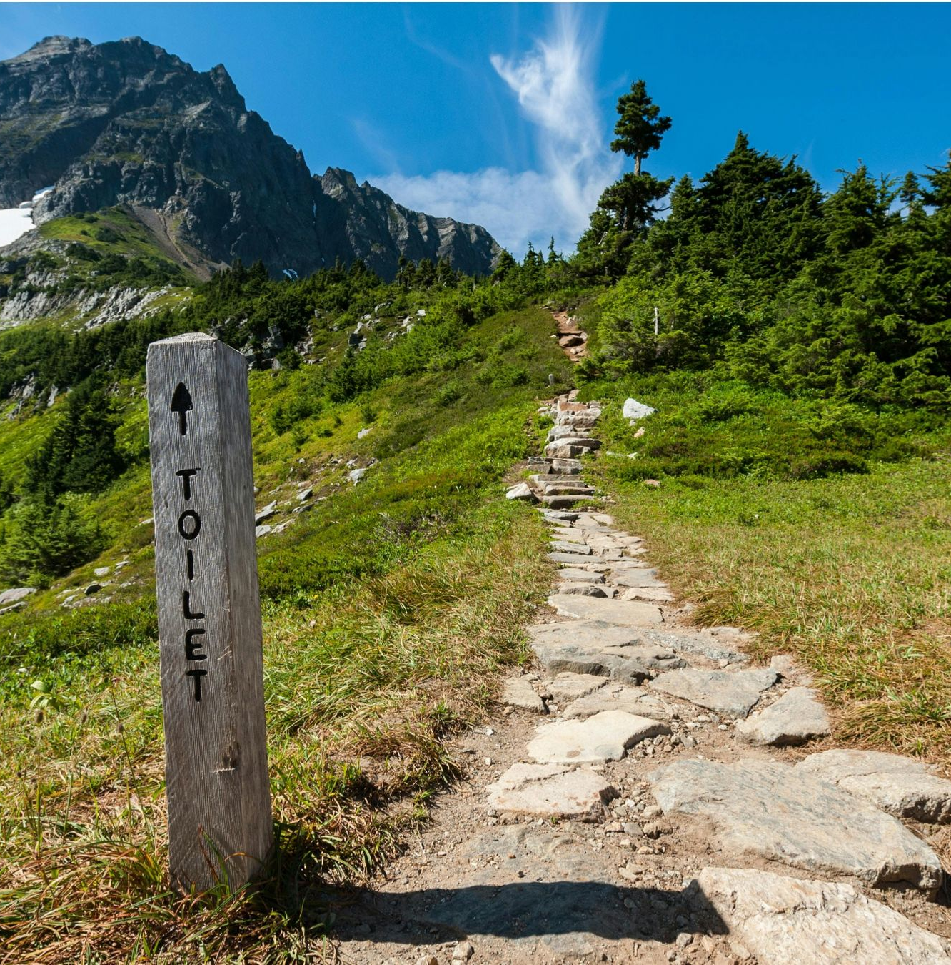

Climate-SMART sanitation
An Approach
UPM Umwelt-Projekt-Management GmbH
June 2025

Slide 2

Scenario and structure of the exercise
“You are a trainer/advocate for climate-SMART sanitation. You want to convince a decision-maker to consider sanitation in climate planning."
Form a group.
Agree on who is your target audience. Fill the training plan template accordingly. (25 minutes)
Presentation: Present your training plan and arguments to convince/train your target audience of the importance of sanitation-related climate action. (10 minutes)
Reflection and feedback. (10 minutes)
Training of Trainers on Climate-Sanitation Nexus – Scaling-up impact / Training Plan
2

Slide 3
Examples of Target Audience
Examples for Target Person | Perspective
NDC coordinator | „ We are revising our NDCs. But sanitation hasn‘t come up yet.“
Head of sanitation authority | „Our infrastructure is outdated. Climate is just another burden.“
Climate change officer | „Sanitation isn‘t my mandate – it‘s for WASH sector to handle“
Urban planner | „Sanitation infrastructure is too fixed – not adaptable to changing climate.“
Parliamentarian | « We need strong public demand before we prioritize it in legislation.“
Tip: Choose a target person based on your personal context and experience.
Training of Trainers on Climate-Sanitation Nexus – Scaling-up impact / Training Plan
3

Slide 4
RECAP DAY 1
Training of Trainers on Climate-Sanitation Nexus – Climate-SMART Sanitation Approach
4
Notes:
What were your key insight or takeaway from yesterday?
What did you find most interesting or surprising?
How has your understanding of the topic evolved?
What would you like to explore further?
What part of the session was most valuable or engaging for you?
Is there something you would do differently in your work based on yesterday’s discussion?
What questions do you still have moving forward?

Slide 5
EXPECTATIONS

Slide 6
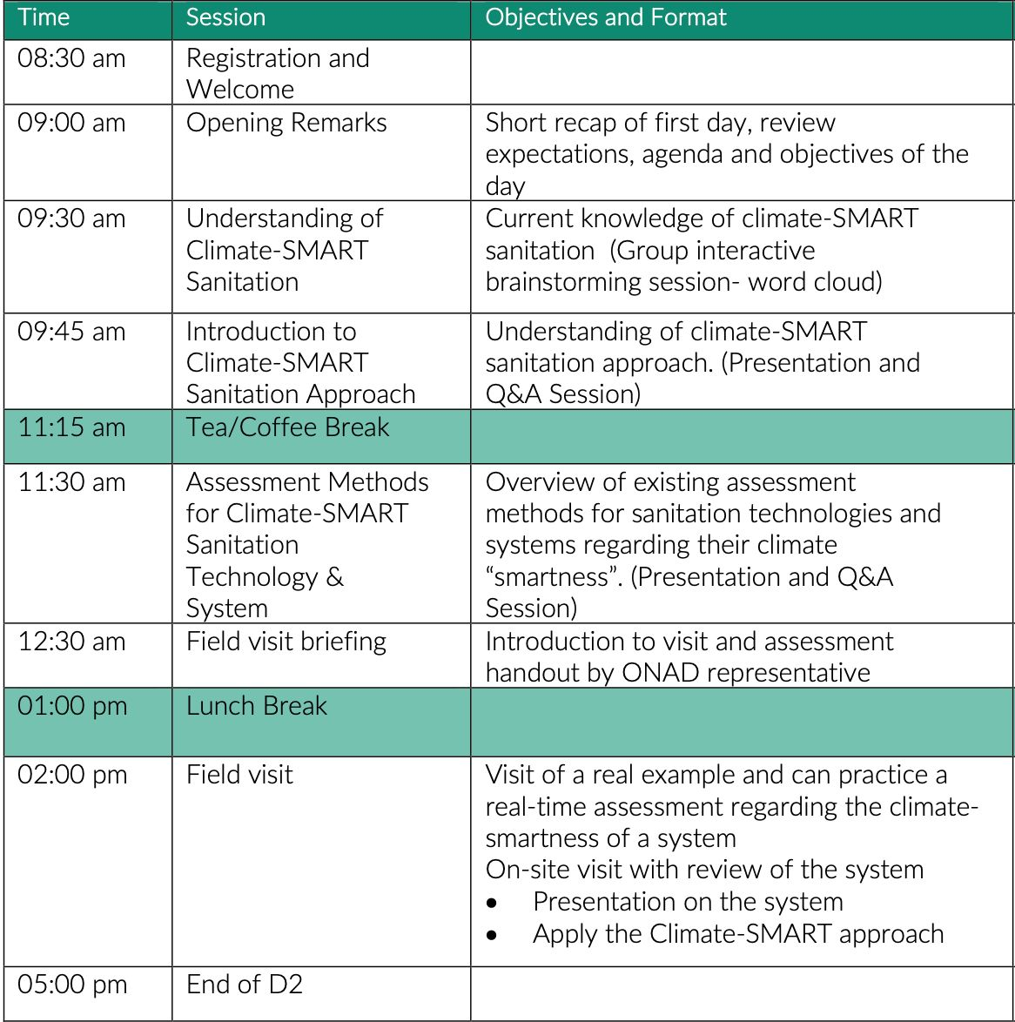
AGENDA
Training of Trainers on Climate-Sanitation Nexus – Climate-SMART Sanitation Approach
6

Slide 7
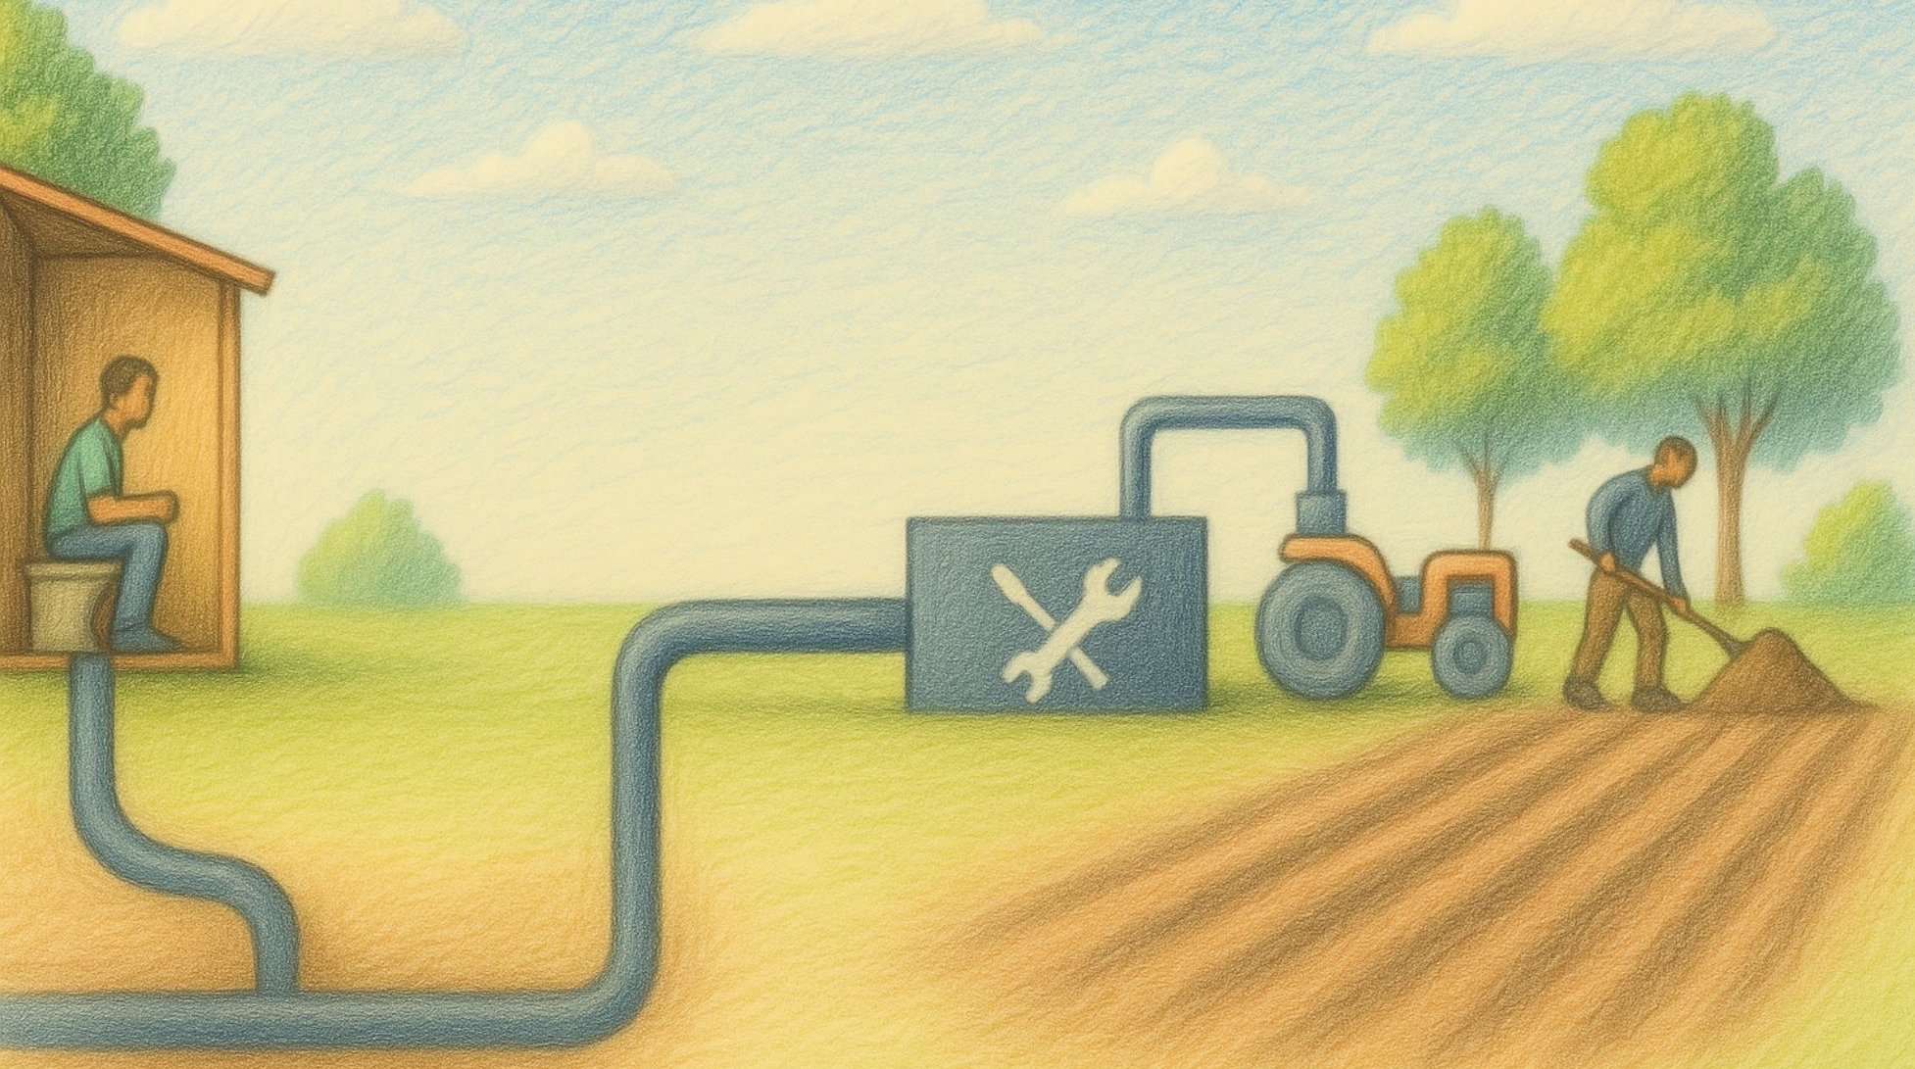
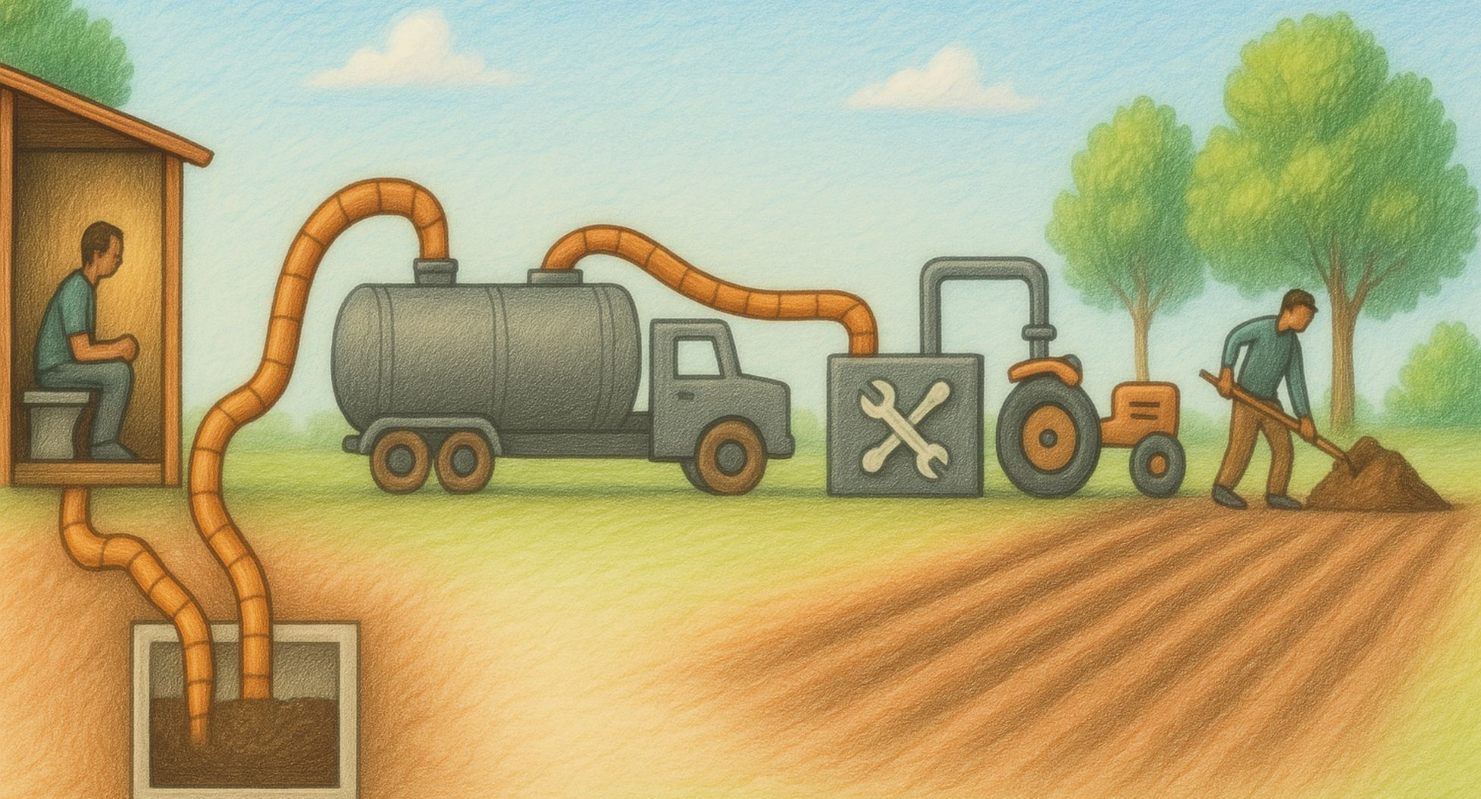
Interactive brainstorming session
What features and characteristics, according to your understanding, could define a climate-SMART sanitation value chain?
Activity Instructions
Each participant will contribute keywords or short phrases (word cloud).
Aim to identify at least 3 features of the Climate-SMART sanitation value chain.
Join menti.com
XXXX
Training of Trainers on Climate-Sanitation Nexus – Climate-SMART Sanitation Approach
7

Slide 8
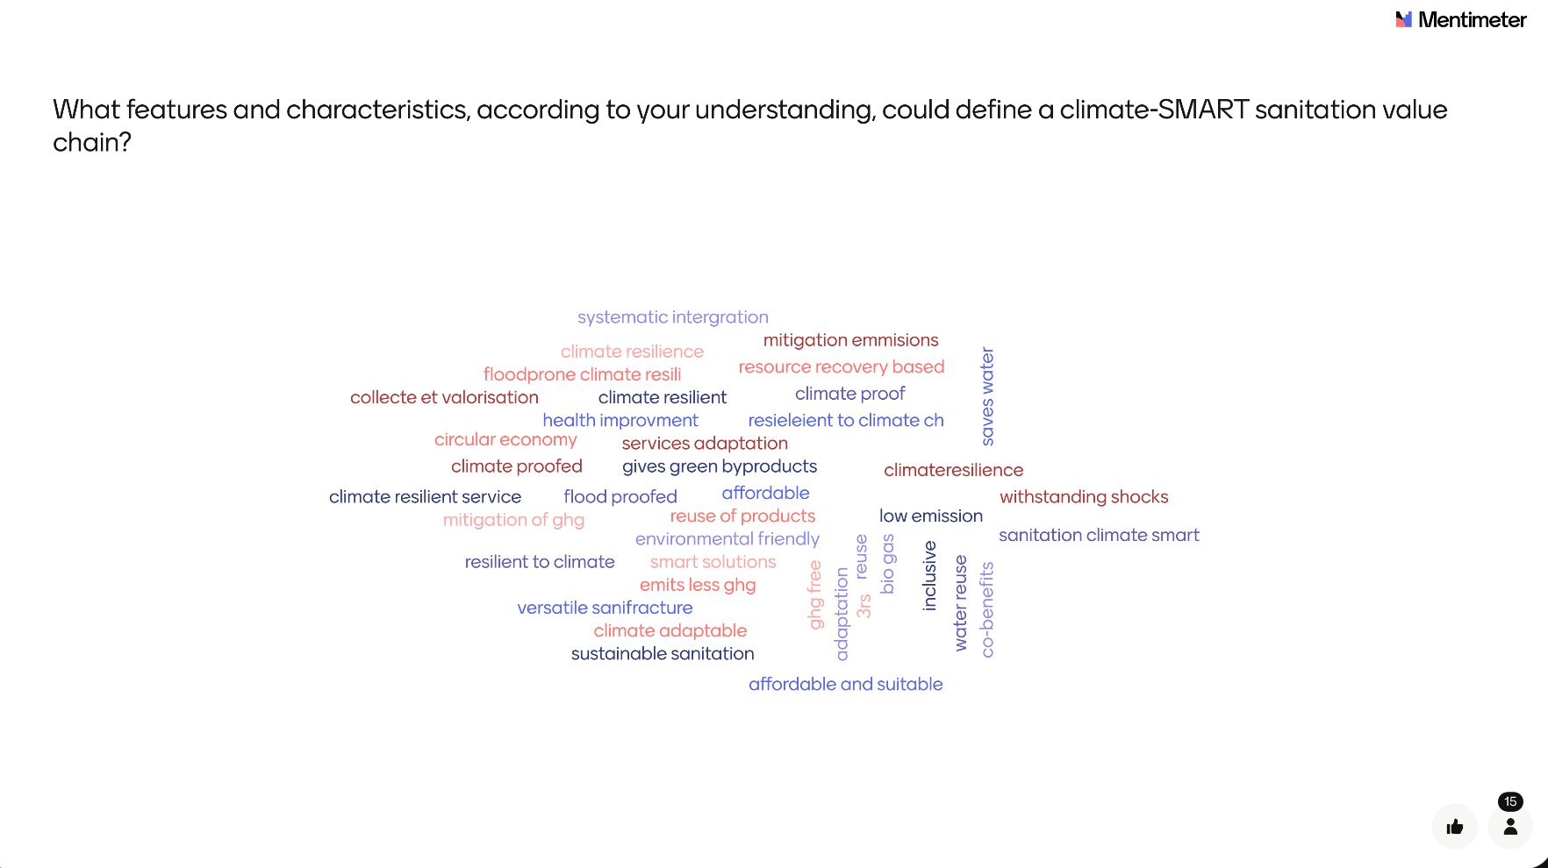
Interactive brainstorming session
Training of Trainers on Climate-Sanitation Nexus – Climate-SMART Sanitation Approach
8

Slide 9
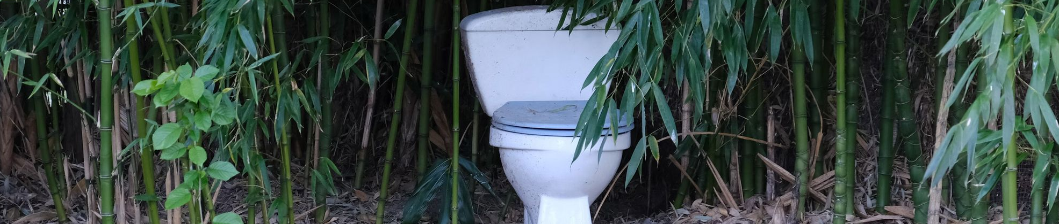
Agenda
Overview of the Climate-SMART sanitation pillars
What is Climate- SMART sanitation ?
Why it is relevant ?
1
2
3
Training of Trainers on Climate-Sanitation Nexus – Climate-SMART Sanitation Approach

Slide 10
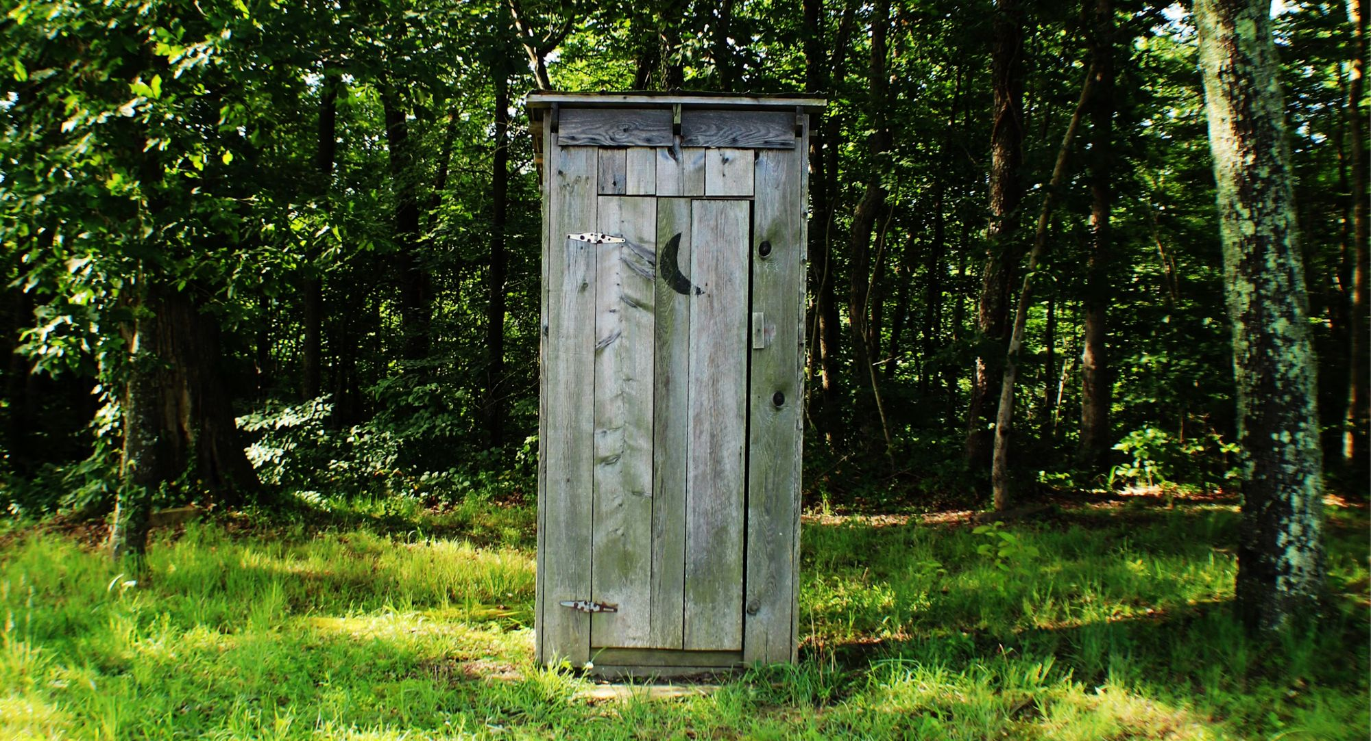
1.
WHAT IS CLIMATE-SMART SANITATION?

Slide 11
Climate-SMART Sanitation is an integrated approach that embeds safety, mitigation, adaptation, resilience, and transformation into sanitation planning and implementation, aiming to reduce greenhouse gas emissions while strengthening systems against current and future climate impacts.
Training of Trainers on Climate-Sanitation Nexus – Climate-SMART Sanitation Approach
11

Slide 12





Climate-SMART Sanitation is:
Training of Trainers on Climate-Sanitation Nexus – Climate-SMART Sanitation Approach
12

Slide 13

2.
WHY IS CLIMATE-SMART SANITATION RELEVANT?

Slide 14
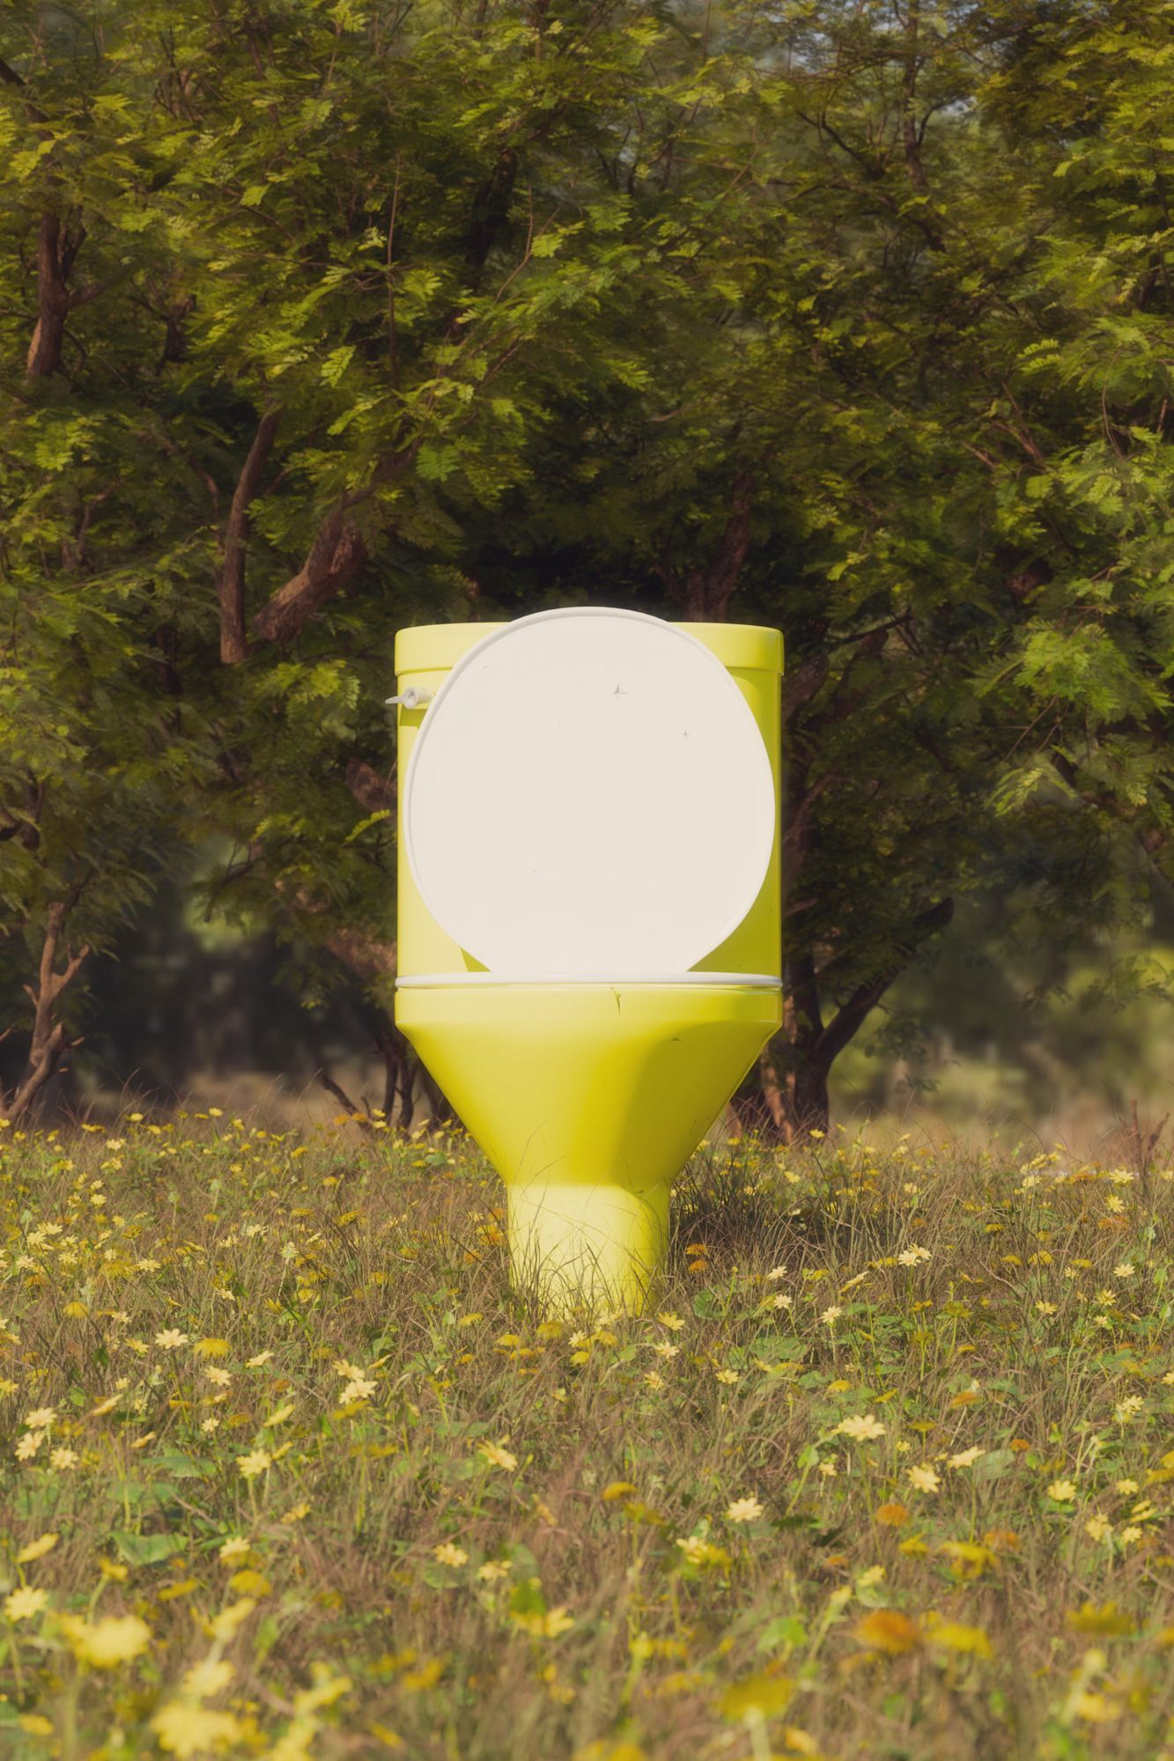

Sanitation and climate are connected
Sanitation systems are highly vulnerable to climate change impacts like:
Floods, droughts, extreme heat, and storms
Physical infrastructure damage
Service delivery disruption
Health and contamination risks
Simultaneously, sanitation contributes to global climate change:
Combined: ~1.3% of total global GHG emissions
            Equivalent to aviation sector
            CO₂ emissions
Methane from non-sewered sanitation: Up to 4.7% of global anthropogenic CH₄ emissions
Training of Trainers on Climate-Sanitation Nexus – Climate-SMART Sanitation Approach
14

Slide 15

Local impacts – case of Kampala
In Kampala, sanitation systems (sewered + non-sewered) account for >50% of citywide GHG emissions ¹
Highlights the urgent need for localized, climate-informed sanitation planning.
¹ Source: https://www.nature.com/articles/s43247-022-00413-w
Training of Trainers on Climate-Sanitation Nexus – Climate-SMART Sanitation Approach
15

Slide 16









Climate hazards impacting sanitation
CHANGING
PRECIPITATION
PATTERN
HIGH SEA
LEVEL
SEVERE
WIND
FLOODS
DROUGHTS
FIRE WEATHER
CHANGING AIR TEMPERATURE
EXTREME HEAT
Training of Trainers on Climate-Sanitation Nexus – Climate-SMART Sanitation Approach
16

Slide 17



Sanitation’s GHG emission sources
METHANE CH₄
NITROUS OXIDE N₂O
CARBON DIOXIDE CO₂
Generated under anaerobic conditions, in the absence of oxygen (e.g., pit latrines or septic tanks, stagnant sewers).
Generated during both aerobic (nitrification) and anoxic (denitrification) microbial processes in sanitation systems.
Generated from fossil energy used in operations (e.g., pumping, transport)
Training of Trainers on Climate-Sanitation Nexus – Climate-SMART Sanitation Approach
17

Slide 18
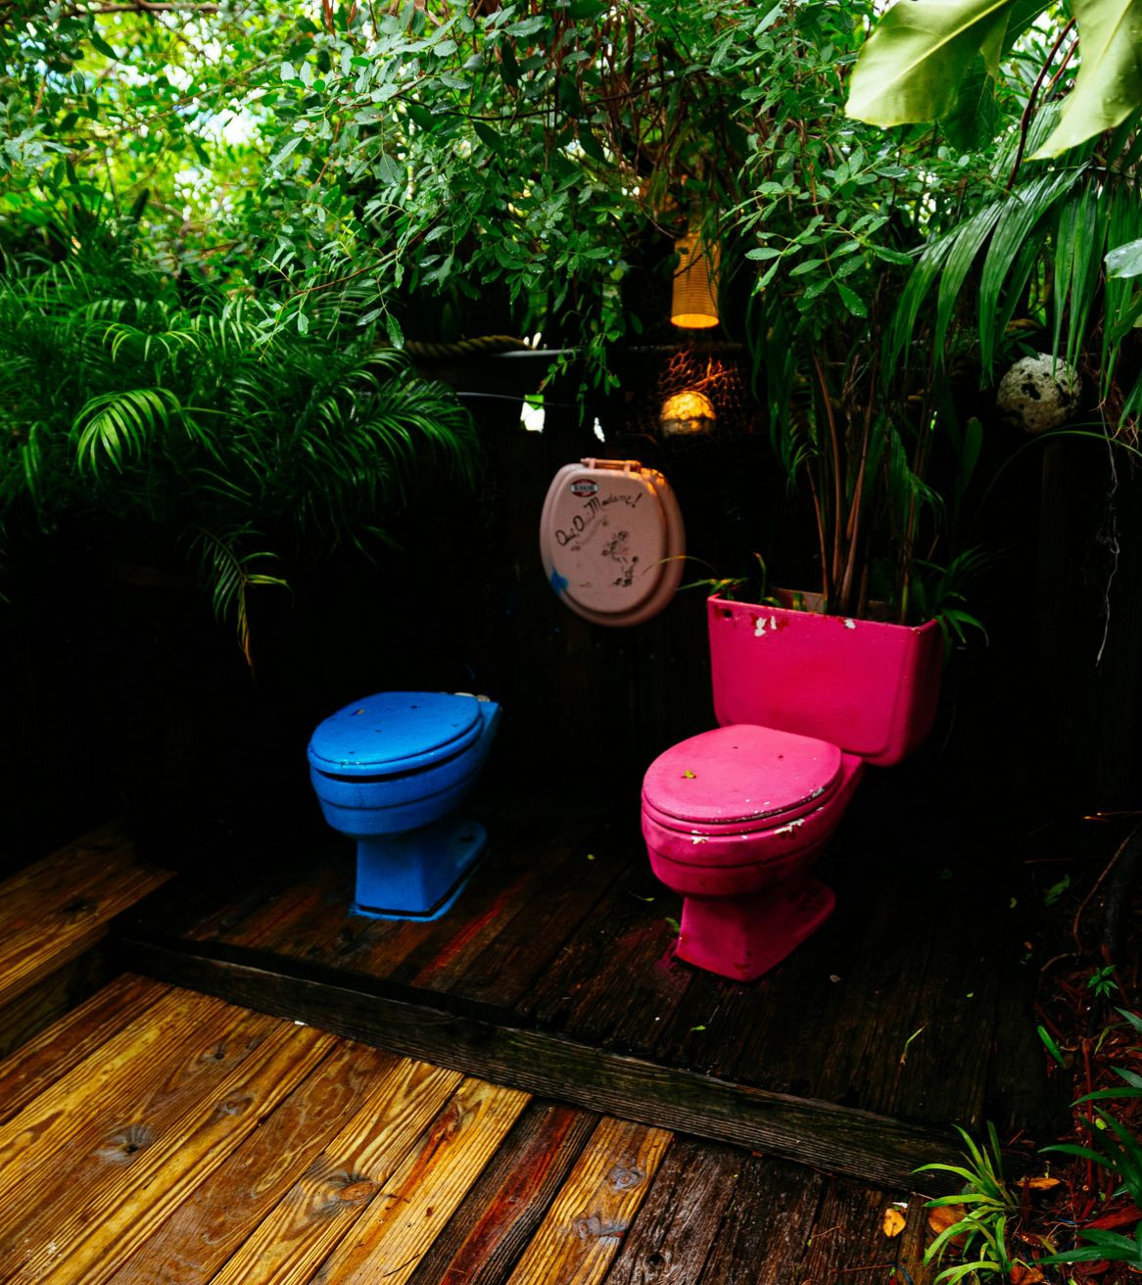
Why this approach matters
Promotes safe sanitation
Focuses on emission reduction at every step of the sanitation chain
Builds systems that can withstand and recover from climate impacts
Promotes paradigm shift
Training of Trainers on Climate-Sanitation Nexus – Climate-SMART Sanitation Approach
18

Slide 19
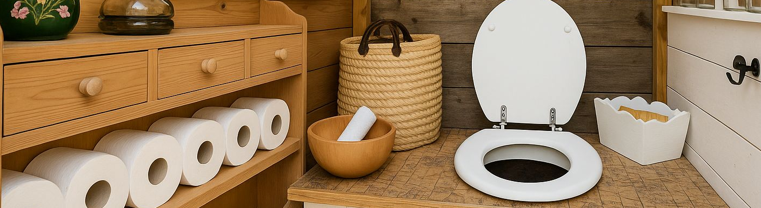
3.
OVERVIEW OF CLIMATE- SMART SANITATION PILLARS

Slide 20
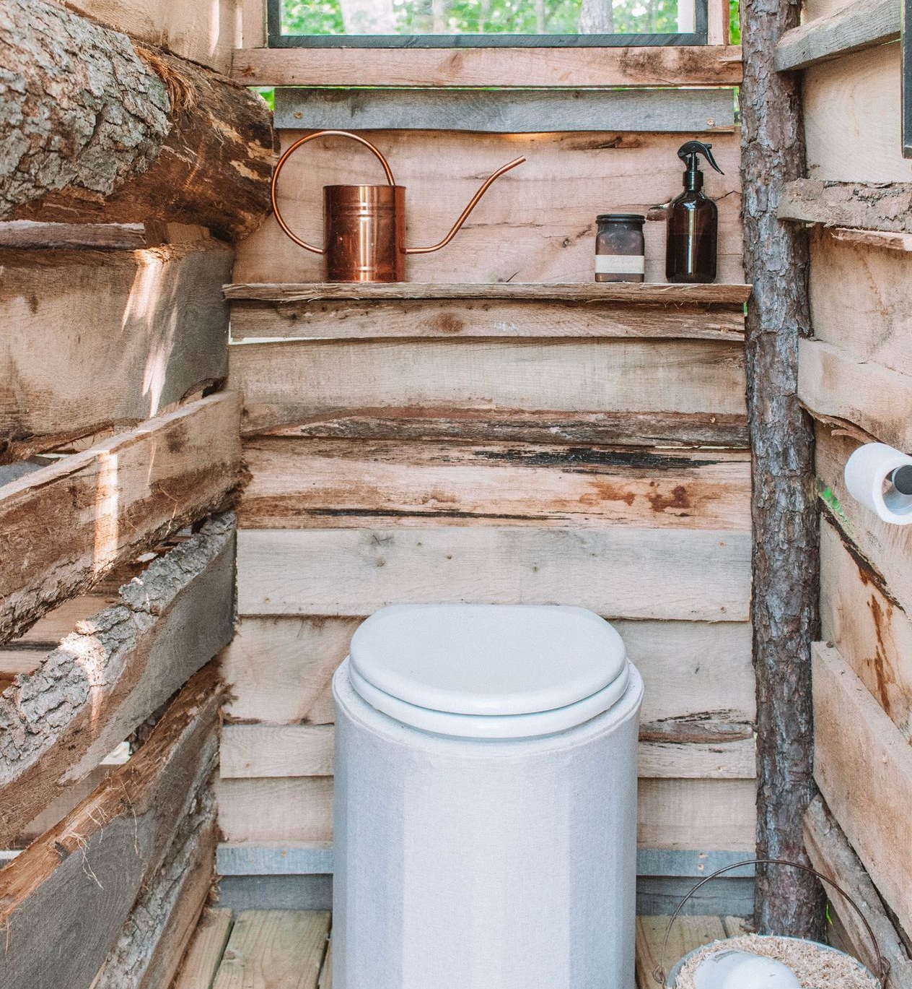
Safe
Ensures the protection of health and dignity by breaking disease transmission pathways and safeguarding public health.
Training of Trainers on Climate-Sanitation Nexus – Climate-SMART Sanitation Approach
20

Slide 21
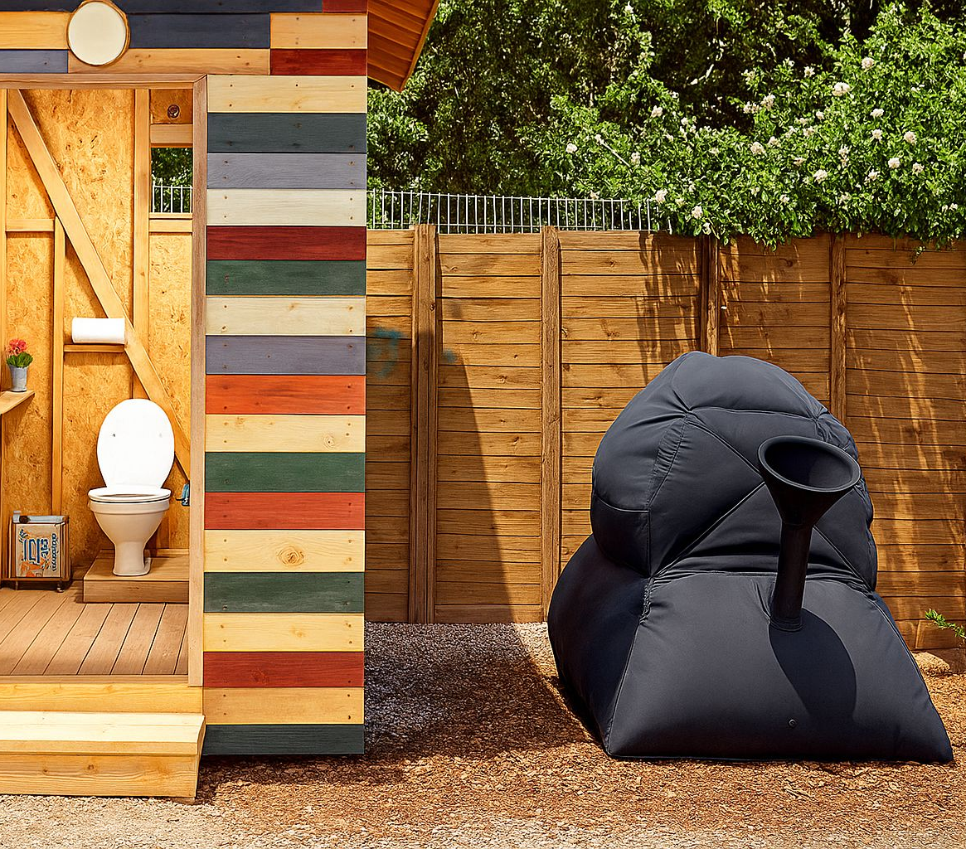
Mitigative
Actively reduces greenhouse gas emissions, through measures such as biogas capture and utilization, composting, and resource recovery.
Training of Trainers on Climate-Sanitation Nexus – Climate-SMART Sanitation Approach
21

Slide 22

Adaptive
Designed to withstand and adjust to climate impacts such as increased rainfall, floods, or droughts, ensuring service continuity during adverse conditions.
Training of Trainers on Climate-Sanitation Nexus – Climate-SMART Sanitation Approach
22

Slide 23
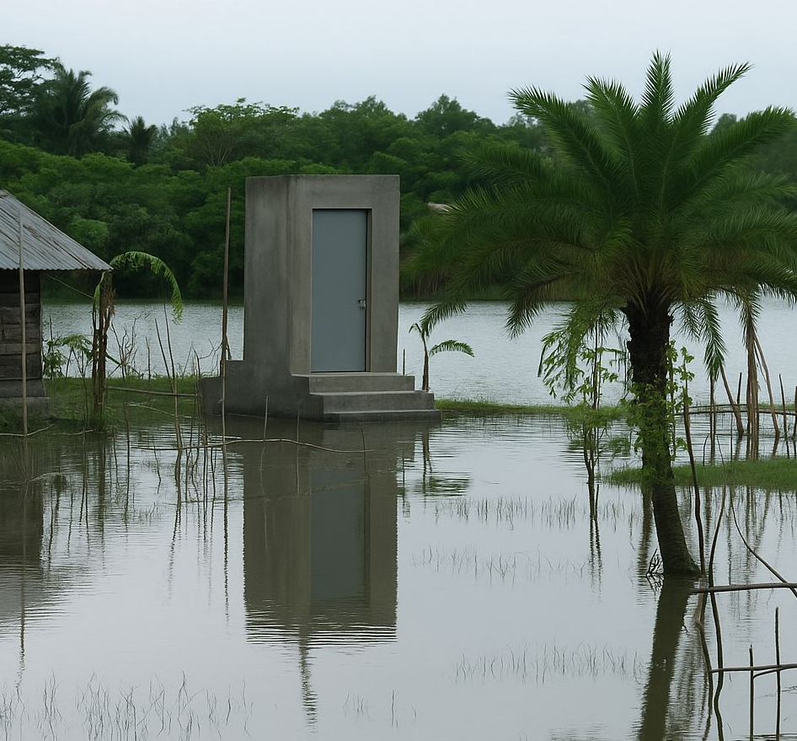
Resilient
Maintains functionality during and after climate shocks, with robust infrastructure, contingency planning, and rapid recovery mechanisms.
Training of Trainers on Climate-Sanitation Nexus – Climate-SMART Sanitation Approach
23

Slide 24
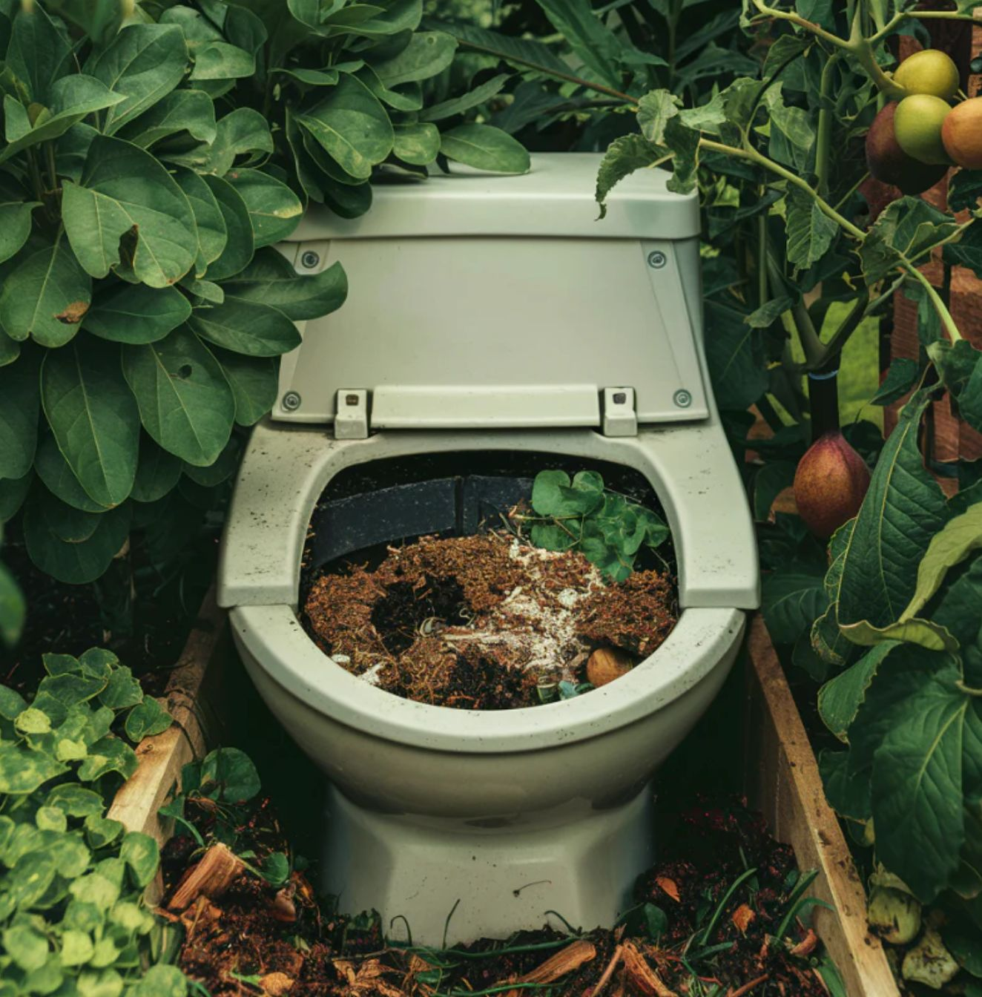
Transformative
Implements circular economy solutions, such as resource recovery and reuse, to drive long-term sustainability, reduce environmental impact or risk for public health.
Training of Trainers on Climate-Sanitation Nexus – Climate-SMART Sanitation Approach
24

Slide 25

Q&A

Slide 26





19th Floor Jeongdong Bldg. 21-15,
Jeongdong-gil, Jung-gu, Seoul,
Republic of Korea 04518
www.gggi.org
@gggi_hq
@GGGIHQ
@GGGIHQ
@gggi_hq
@GGGIMedia

