Slide 1
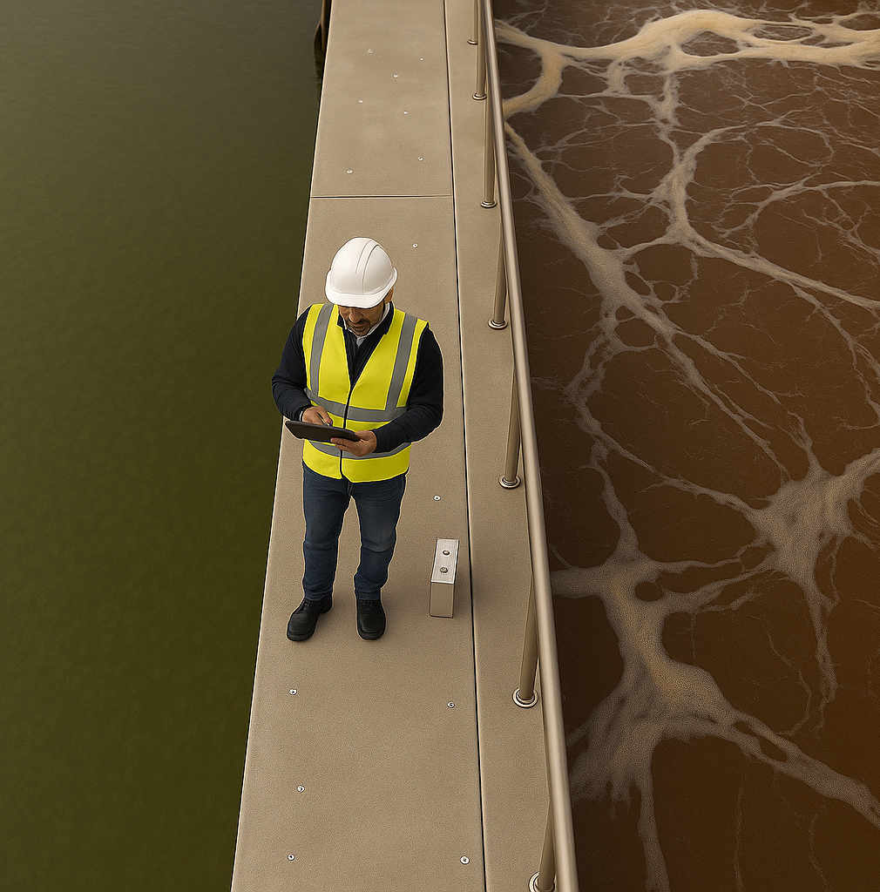

Evaluation Methods for Climate-SMART Sanitation
Assessment Methods
UPM Umwelt-Projekt-Management GmbH
June 2025

Slide 2


Agenda
How to assess the Climate-SMART sanitation component?
How to apply the Climate-SMART Sanitation approach on technology
How to apply the Climate-SMART Sanitation approach on system
1
2
3
Training of Trainers on Climate-Sanitation Nexus – Climate-SMART Sanitation Assessment

Slide 3
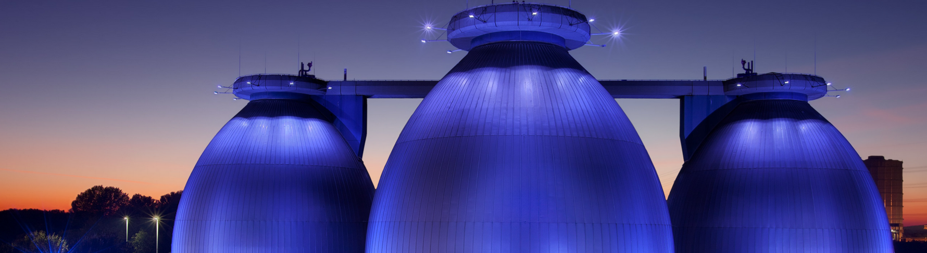
1.
HOW TO ASSESS CLIMATE-SMART SANITATION COMPONENTS

Slide 4





Climate-SMART Sanitation is:
Training of Trainers on Climate-Sanitation Nexus – Climate-SMART Sanitation Assessment
4

Slide 5
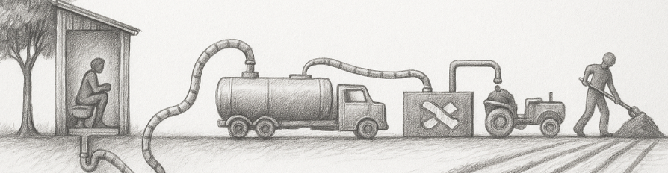
Safe
SHIT FLOW DIAGRAM (SFD)
ACCESS TO SANITATION
“JMP SANITATION LADDER”
MECHANICAL EMPTYING, PPE, SOPs, VACCINES
OUTPUTS (EFFLUENT, SLUDGE, BY-PRODUCTS) MEET NATIONAL / WHO STANDARDS
RISK FOR GROUND WATER POLLUTION
COMPLETE TREATMENT, PPE, SOPs, VACCINES
BUILDING CODE
Training of Trainers on Climate-Sanitation Nexus – Climate-SMART Sanitation Assessment
5

Slide 6
Mitigative
ENERGY PERFORMANCE AND CARBON EMISSIONS AND MONITORING TOOL
IPCC (OR OTHER METHODS IF REQUIRED GOLD STANDARD, …)
IPCC (OR OTHER METHODS IF REQUIRED GOLD STANDARD, …)
IPCC (OR OTHER METHODS IF REQUIRED GOLD STANDARD, …)
IPCC (OR OTHER METHODS IF REQUIRED GOLD STANDARD, …)
Training of Trainers on Climate-Sanitation Nexus – Climate-SMART Sanitation Assessment
6

Slide 7
Adaptative & resilient
UNICEF‑GWP RISK ASSESSMENT
UTS CLIMATE-FIRST
UTS CLIMATE-FIRST
UTS CLIMATE-FIRST
UTS CLIMATE-FIRST
Training of Trainers on Climate-Sanitation Nexus – Climate-SMART Sanitation Assessment
7

Slide 8
Transformative
PERCEPTION & ACCEPTANCE STUDY
MARKET DRIVEN APPROACH FOR SELECTION OF FECAL SLUDGE TREATMENT PRODUCT
Training of Trainers on Climate-Sanitation Nexus – Climate-SMART Sanitation Assessment
8

Slide 9
2.
HOW TO APPLY THE CLIMATE-SMART SANITATION APPROACH ON TECHNOLOGY

Slide 10
Safe
SHIT FLOW DIAGRAM (SFD)
ACCESS TO SANITATION
“JMP SANITATION LADDER”
MECHANICAL EMPTYING, PPE, SOPs, VACCINES
OUTPUTS (EFFLUENT, SLUDGE, BY-PRODUCTS,) MEET NATIONAL / WHO STANDARTS
RISK FOR GROUND WATER POLLUTION
COMPLETE TREATMENT, PPE, SOPs, VACCINES
BUILDING CODE
Training of Trainers on Climate-Sanitation Nexus – Climate-SMART Sanitation Assessment
10

Slide 11
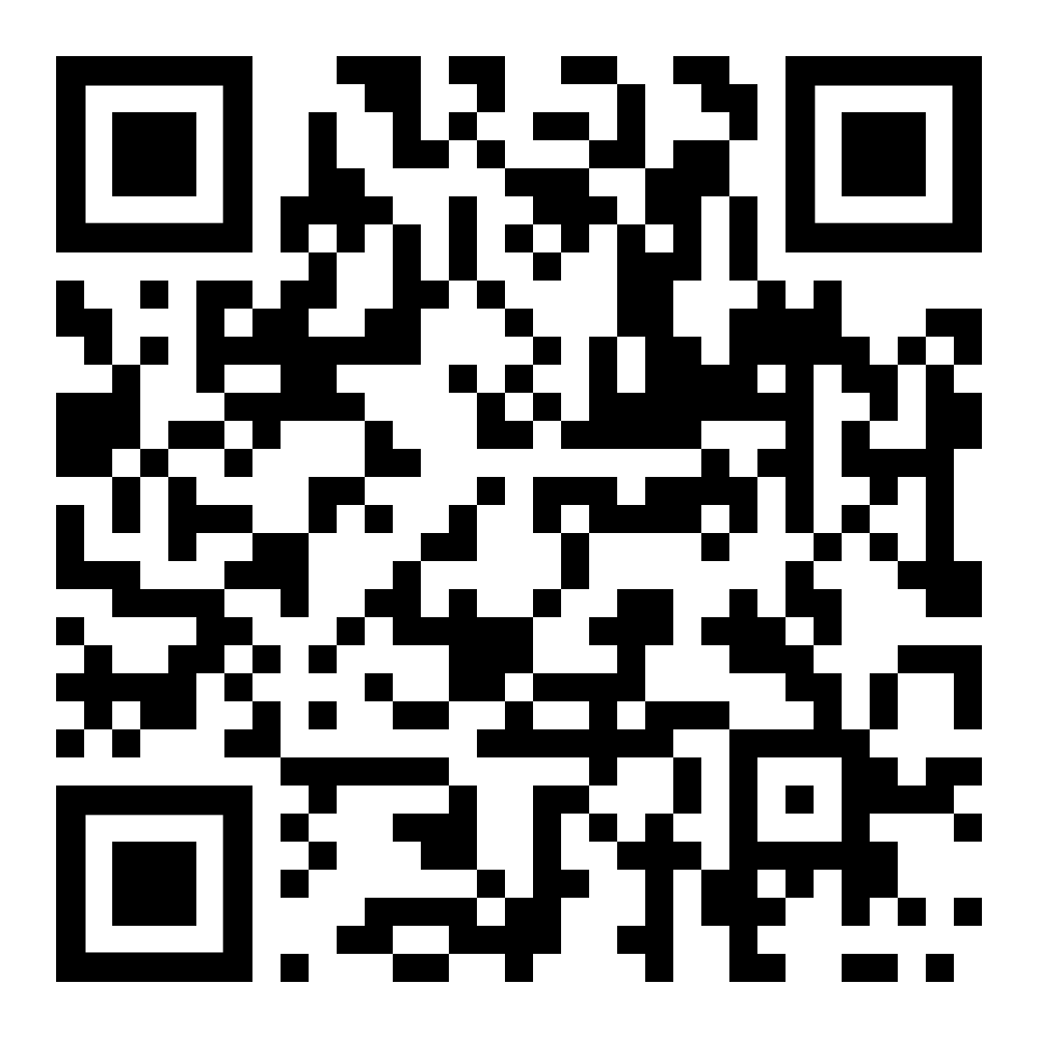
Safe
ACCESS TO SANITATION
“JMP SANITATION LADDER”
SERVICE LEVEL | DEFINITION | SDG | TARGET
SEFELY MANAGED | Use of improved facilities, not shared with other households, with excreta safely disposed of in situ or treated offsite. | 6.2.1a | By 2030, all people should have access to safely managed sanitation services.
BASIC | Use of improved facilities that are not shared with other households | 1.4.1 | By 2030, ensure that all men and women, particularly the poor and the vulnerable, have equal rights to economic resources, as well as access to basic services, …
LIMITED | Use of improved facilities shared between two or more households
UNIPROVED | Use of pit latrines without a slab/platform, hanging latrines, or bucket latrines
OPEN DEFICATION | Disposal of human feces in open spaces (fields, forests, water bodies, etc.) or with solid waste |  | End open defecation
RISK FOR GROUND WATER POLLUTION
BUILDING CODE
MECHANICAL EMPTYING, PPE, SOPs, VACCINES
OUTPUTS (EFFLUENT, SLUDGE, BY-PRODUCTS,) MEET NATIONAL / WHO STANDARTS
Groundwater
pollution
risk
estimation
tool
COMPLETE TREATMENT, PPE, SOPs, VACCINES
Training of Trainers on Climate-Sanitation Nexus – Climate-SMART Sanitation Assessment
11

Slide 12
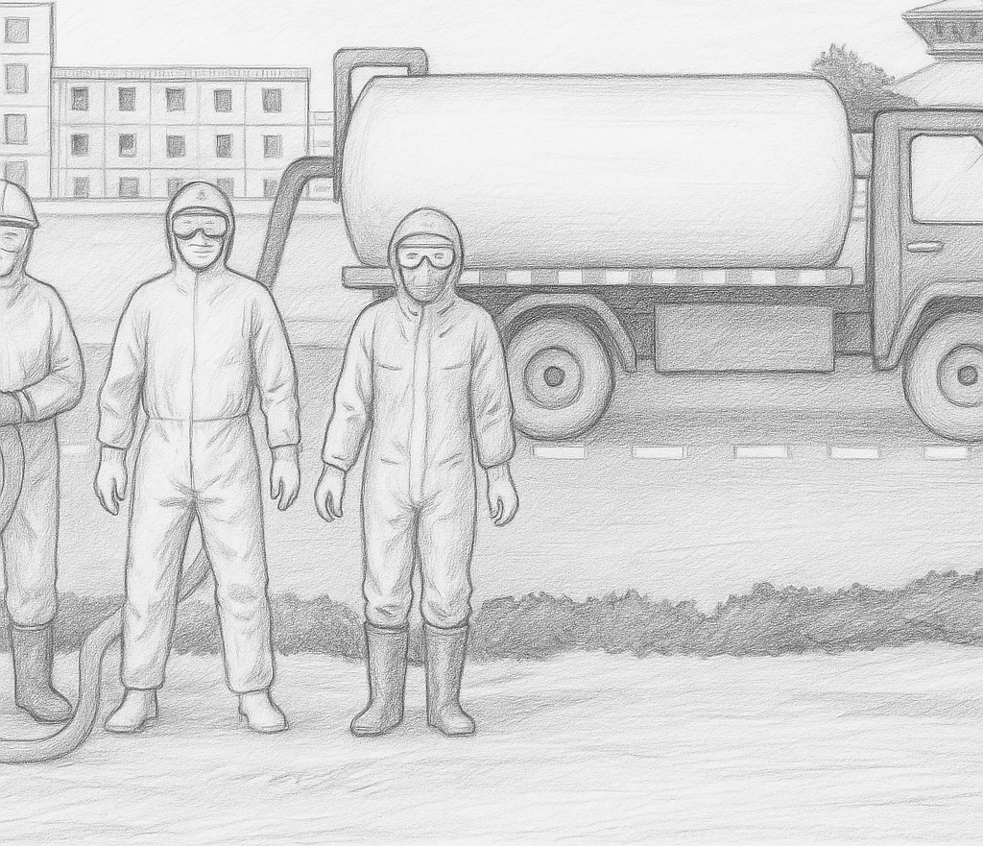
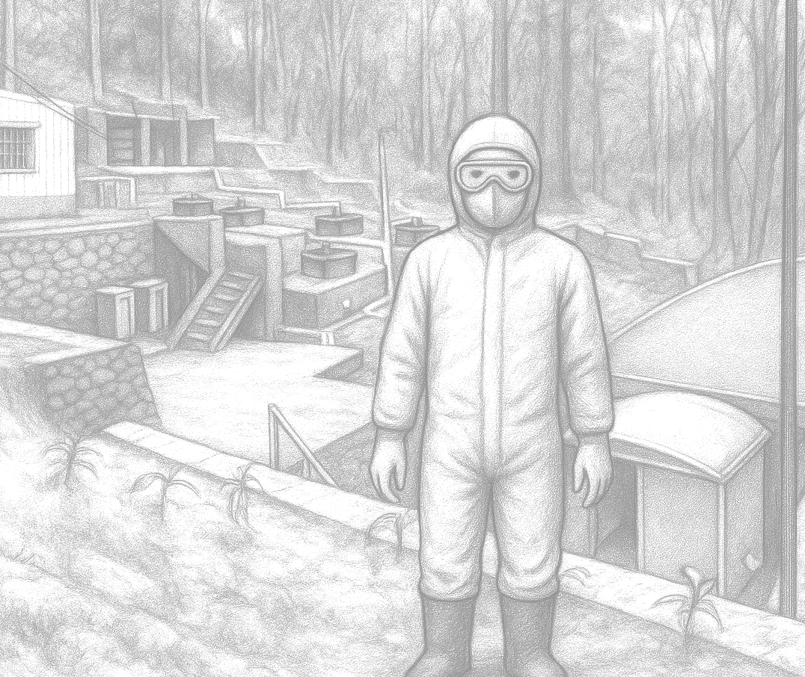

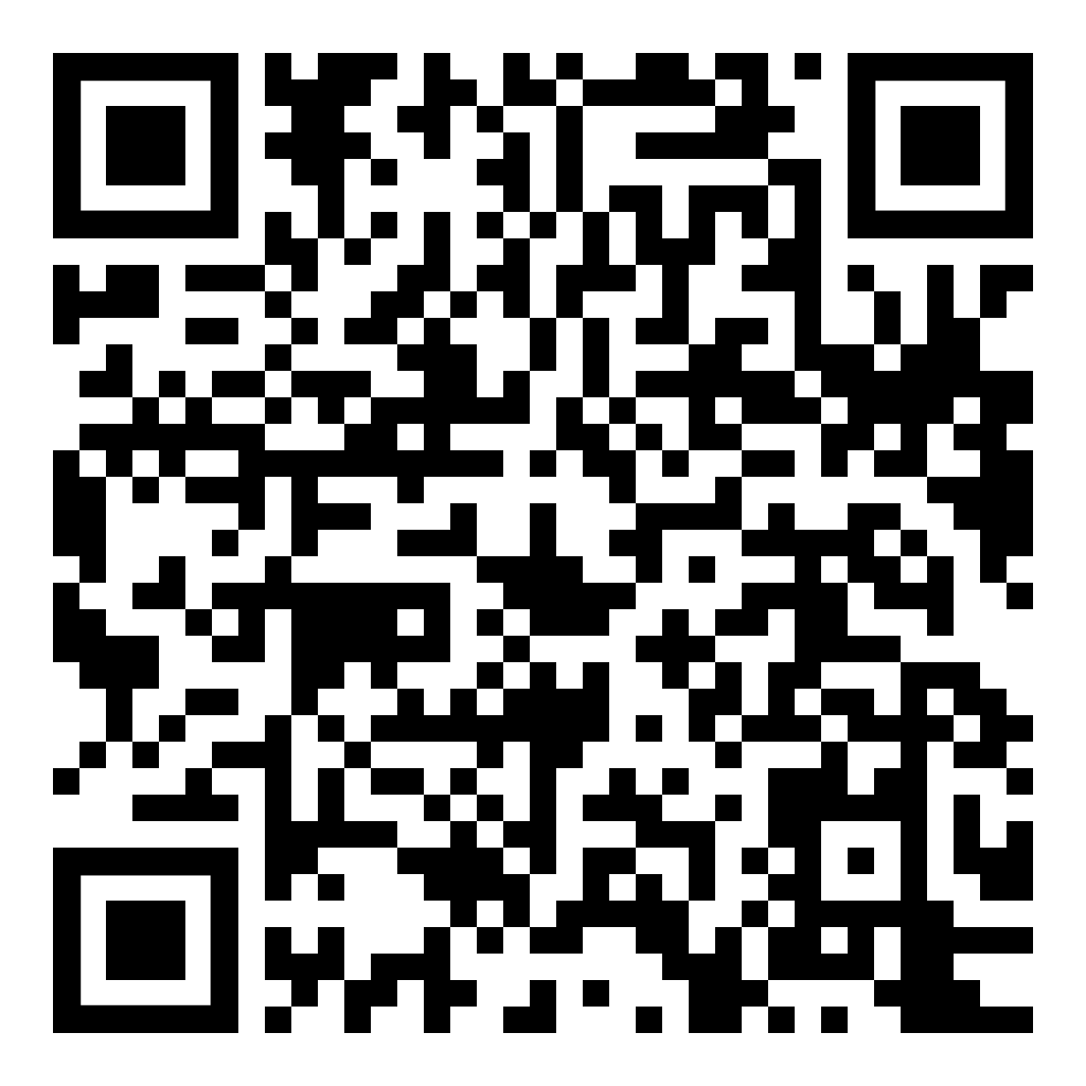
Safe
ACCESS TO SANITATION
“JMP SANITATION LADDER”
VACCINES:
tetanus,
polio,
typhoid fever,
hepatitis A and B
Also, regular health checks &
Treatment (i.e., deworming)
RISK FOR GROUND WATER POLLUTION
MECHANICAL
EMPTYING
BUILDING CODE
PPE
MECHANICAL EMPTYING, PPE, SOPs, VACCINES
OUTPUTS (EFFLUENT, SLUDGE, BY-PRODUCTS,) MEET NATIONAL / WHO STANDARTS
Example Occupational Health & Safety Manual
PPE
COMPLETE TREATMENT, PPE, SOPs, VACCINES
Training of Trainers on Climate-Sanitation Nexus – Climate-SMART Sanitation Assessment
12

Slide 13
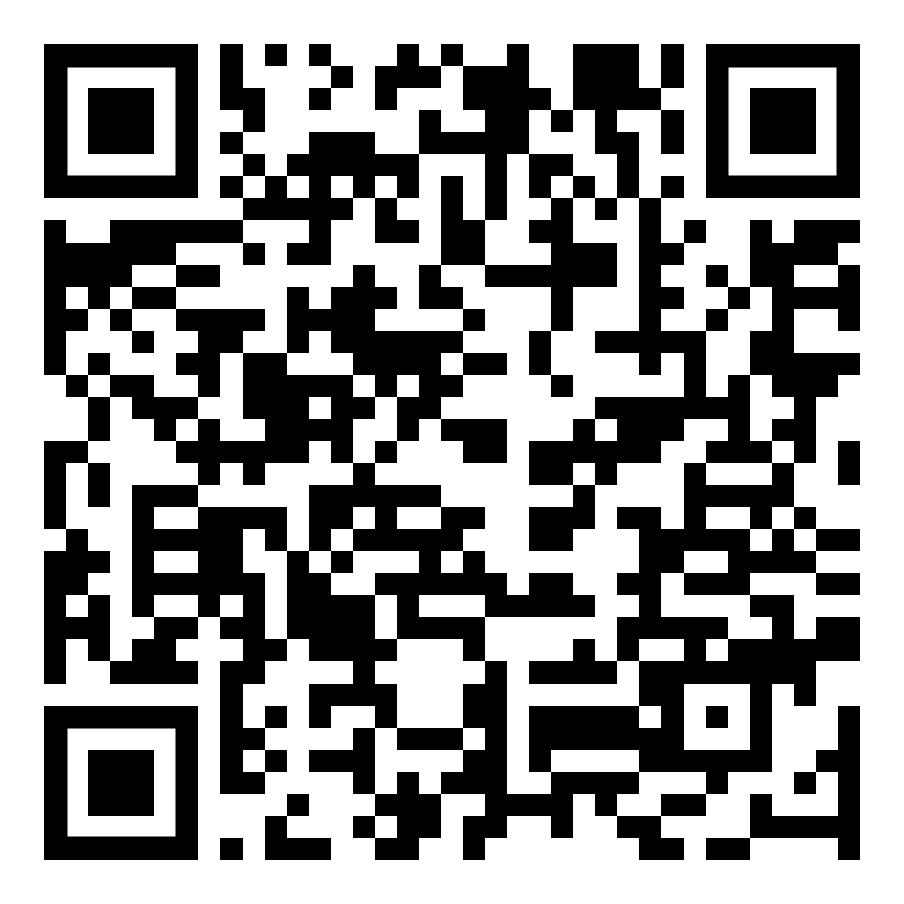
Safe
ACCESS TO SANITATION
“JMP SANITATION LADDER”
VACCINES:
tetanus,
polio,
typhoid fever,
hepatitis A and B
Also, regular health checks &
Treatment (i.e., deworming)
RISK FOR GROUND WATER POLLUTION
BUILDING CODE
PPE
MECHANICAL EMPTYING, PPE, SOPs, VACCINES
PARAMETER | WHO GUIDELINE VALUE FOR IRRIGATION
Helminth eggs | ≤ 1 egg/L
Fecal coliforms | ≤1,000 per 100 mL
OUTPUTS (EFFLUENT, SLUDGE, BY-PRODUCTS) MEET NATIONAL / WHO STANDARDS
Example
Safety
Manual
FSTP
COMPLETE TREATMENT, PPE, SOPs, VACCINES
Training of Trainers on Climate-Sanitation Nexus – Climate-SMART Sanitation Assessment
13

Slide 14
Mitigative
ENERGY PERFORMANCE AND CARBON EMISSIONS AND MONITORING TOOL
IPCC (OR OTHER METHODS IF REQUIRED GOLD STANDARD, …)
IPCC (OR OTHER METHODS IF REQUIRED GOLD STANDARD, …)
IPCC (OR OTHER METHODS IF REQUIRED GOLD STANDARD, …)
IPCC (OR OTHER METHODS IF REQUIRED GOLD STANDARD, …)
Training of Trainers on Climate-Sanitation Nexus – Climate-SMART Sanitation Assessment
14

Slide 15
Mitigative
Community Baseline (1,000 people)
70% unlined pit latrines (no flush)
30% open defecation
Emissions: 24,520 kg CO₂ eq/year or 24.5 kg /person)
Scenario 1: Unmitigated Improvement
100% septic tanks + low-flush toilets, with safe effluent infiltration
Emissions: 137,751 kg CO₂ eq/year or 138 kg /person) 6 x Increase!
Scenario 2: Mitigated Composting Toilets
100% composting toilets (well-managed).
Emissions: 597 kg CO₂ eq/year or 0.6 kg/person
230 times lower than unmitigated!
How to estimate the GHG emissions will be explained and practiced during the exercise after the break.
Training of Trainers on Climate-Sanitation Nexus – Climate-SMART Sanitation Assessment
15

Slide 16
Adaptative & Resilient
UNICEF‑GWP RISK ASSESSMENT
UTS CLIMATE-FIRST
UTS CLIMATE-FIRST
UTS CLIMATE-FIRST
UTS CLIMATE-FIRST
Training of Trainers on Climate-Sanitation Nexus – Climate-SMART Sanitation Assessment
16

Slide 17
Adaptative & Resilient
For planning adaptation measures and designing resilient sanitation technologies UTS ClimateFIRST Framework consisting of 5 steps.
UTS CLIMATE-FIRST
STEP 1: SCOPING THE ASSESSMENT
IN Scope: Pit-lining, slab, super-structure, vent pipe
OUT of Scope: Off-site sludge treatment
STEP 3 RATE IMPACTS OF HAZARDS ON SYSTEM COMPONENTS
HAZARDS | RATING | RATIONALE
Flooding | H | Floodwater can enter via superstructure, filling pit; buoyant force may crack lining.
Short dry spells | L | No functional impact.
Extreme heat | L | Minor odor increase; structure unaffected.
Strong wind | M | Lightweight roofs/doors susceptible.
STEP 2 IDENTIFICATION OF HAZARDOUS EVENTS & TRENDS (HETS)
Flooding: riverbank overtopping & flash floods (≤ 1 m depth)
Short dry spells (≈ 1 week): intermittent low inflow & drying
Extreme heat & high THI: >35 °C, THI > 30
Strong gust winds: embedded convective storm bursts
Color key: H = high-impact, M = moderate, L = low
Training of Trainers on Climate-Sanitation Nexus – Climate-SMART Sanitation Assessment
17

Slide 18
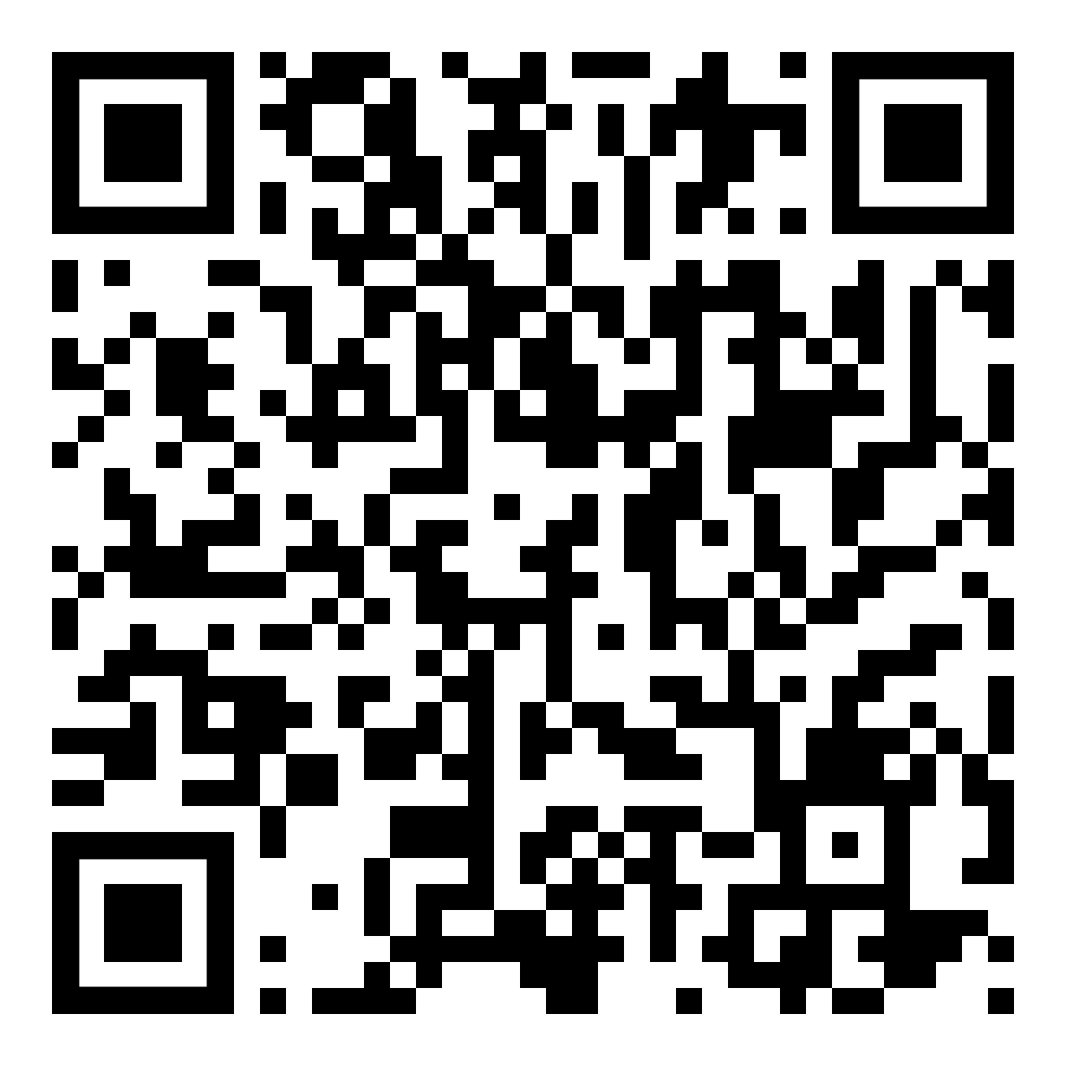
Adaptative & resilient
UTS CLIMATE-FIRST
STEP 4: – ADAPTATION MEASURES
AVOID: Elevate slab 0.5 m; seal drop‑hole with flip‑cap.
WITHSTAND: Reinforced outer supports to prevent pit wall collapse from water pressure in the ground. Anchor the roof panels
FLEXIBILITY / FAST RECOVERY: Detachable prefab superstructure for quick swap after storm damage.
CONTAIN: Gasketed pit cap for emergency closure before flood onset.
LIMITING THE CONSEQUENCES OF COMPLETE FAILURE: Add a small, sealed overflow chamber adjacent to the main pit that captures excess sludge during flooding or overfilling, reducing spill risk.
FAST RECOVERY: Utilize modular superstructure panels that can be easily replaced if damaged and install a visible fill-level indicator for quick detection of overflow risk.
PROVIDING BENEFITS BEYOND RESILIENCE: Integrate a hand‑washing tap on the same plinth and use the greywater for irrigation, add a rainwater collection system.
Note: Step 5 of ClimateFIRST (“Judging Overall Resilience”) uses auto-generated scoring from the tool and is not shown here. A download link is available in the resource section.
Training of Trainers on Climate-Sanitation Nexus – Climate-SMART Sanitation Assessment
18

Slide 19
Transformative
PERCEPTION & ACCEPTANCE STUDY
MARKET DRIVEN APPROACH FOR SELECTION OF FECAL SLUDGE TREATMENT PRODUCT
Training of Trainers on Climate-Sanitation Nexus – Climate-SMART Sanitation Assessment
19

Slide 20
Transformative
Challenging the mindset by embracing circular economy principles—viewing waste as a resource to be recovered, reused, and reintegrated into productive systems.
However, transformation is not solely about resource recovery. A paradigm shift also occurs when a community transitions from no or limited sanitation access to basic and improved services.
PERCEPTION & ACCEPTANCE STUDY
PERCEPTION
 | % WILLING TO USE | KEY CONCERN | WHAT WOULD CHANGE YOUR MIND ? | %
Biogas | 80% | Cookstove to expensive | Free Cookstove | 45 %
Training of Trainers on Climate-Sanitation Nexus – Climate-SMART Sanitation Assessment
20

Slide 21
3.
HOW TO APPLY THE CLIMATE-SMART SANITATION APPROACH ON SYSTEM

Slide 22
Steps to design Climate-SMART Sanitation system
SMART BASELINE
ASSESSMENT
TECHNICAL SOLUTION SCREENING
SMART BASELINE IMPROVEMENT VERIFICATION
SHIT FLOW DIAGRAMM (SFD)
MCDA
SHIT FLOW DIAGRAMM (SFD)
ACCESS TO SANITATION
UTS CLIMATE-FIRST
ACCESS TO SANITATION
ECAM
ECAM
UNICEF‑GWP RISK ASSESSMENT
UNICEF‑GWP RISK ASSESSMENT
MARKET DRIVEN APPROACH
PERCEPTION & ACCEPTANCE
Training of Trainers on Climate-Sanitation Nexus – Climate-SMART Sanitation Assessment
22

Slide 23
Safe
SHIT FLOW DIAGRAM (SFD)
ACCESS TO SANITATION
“JMP SANITATION LADDER”
MECHANICAL EMPTYING, PPE, SOPs, VACCINES
OUTPUTS (EFFLUENT, SLUDGE, BY-PRODUCTS,) MEET NATIONAL / WHO STANDARDS
RISK FOR GROUND WATER POLLUTION
COMPLETE TREATMENT, PPE, SOPs, VACCINES
BUILDING CODE
Training of Trainers on Climate-Sanitation Nexus – Climate-SMART Sanitation Assessment
23

Slide 24
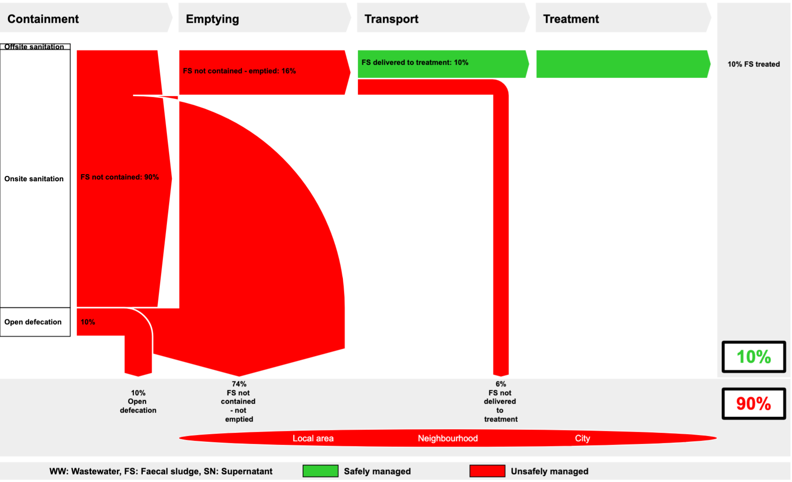
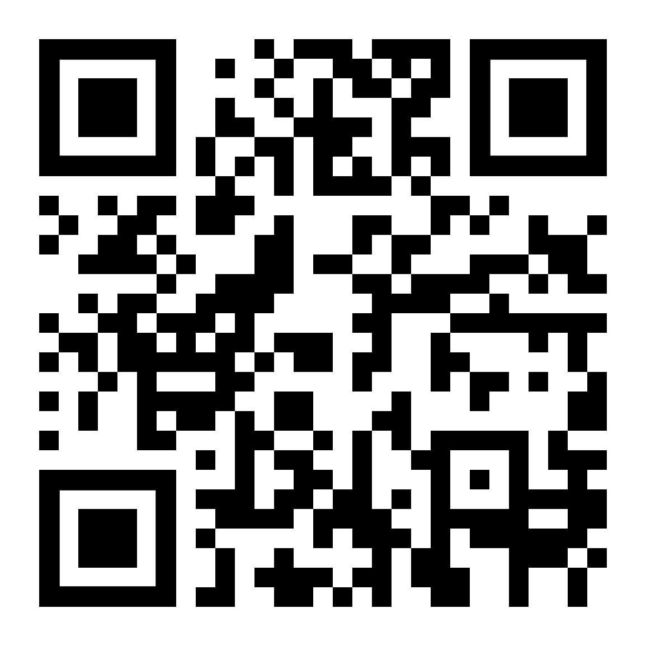
Safe
SHIT FLOW DIAGRAM (SFD)
A Shit Flow Diagram (SFD) is a simple, visual tool that shows how human waste flows through a city or community — from where it's generated (toilets), through collection, treatment, and final disposal or reuse. It highlights what proportion of fecal sludge is safely managed versus unsafely managed. SFDs help identify weak points in sanitation systems, support decision-making, and raise awareness among stakeholders about the need for improved sanitation services.
Training of Trainers on Climate-Sanitation Nexus – Climate-SMART Sanitation Assessment
24

Slide 25
Mitigative
ENERGY PERFORMANCE AND CARBON EMISSIONS AND MONITORING TOOL
IPCC (OR OTHER METHODS IF REQUIRED GOLD STANDARD, …)
IPCC (OR OTHER METHODS IF REQUIRED GOLD STANDARD, …)
IPCC (OR OTHER METHODS IF REQUIRED GOLD STANDARD, …)
IPCC (OR OTHER METHODS IF REQUIRED GOLD STANDARD, …)
Training of Trainers on Climate-Sanitation Nexus – Climate-SMART Sanitation Assessment
25

Slide 26
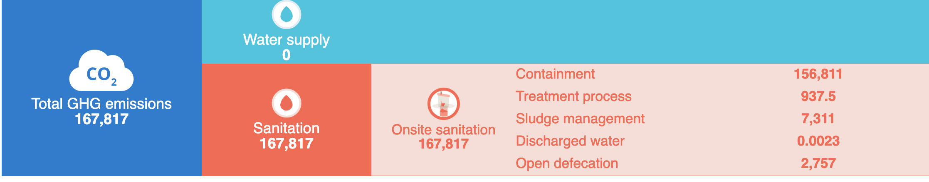
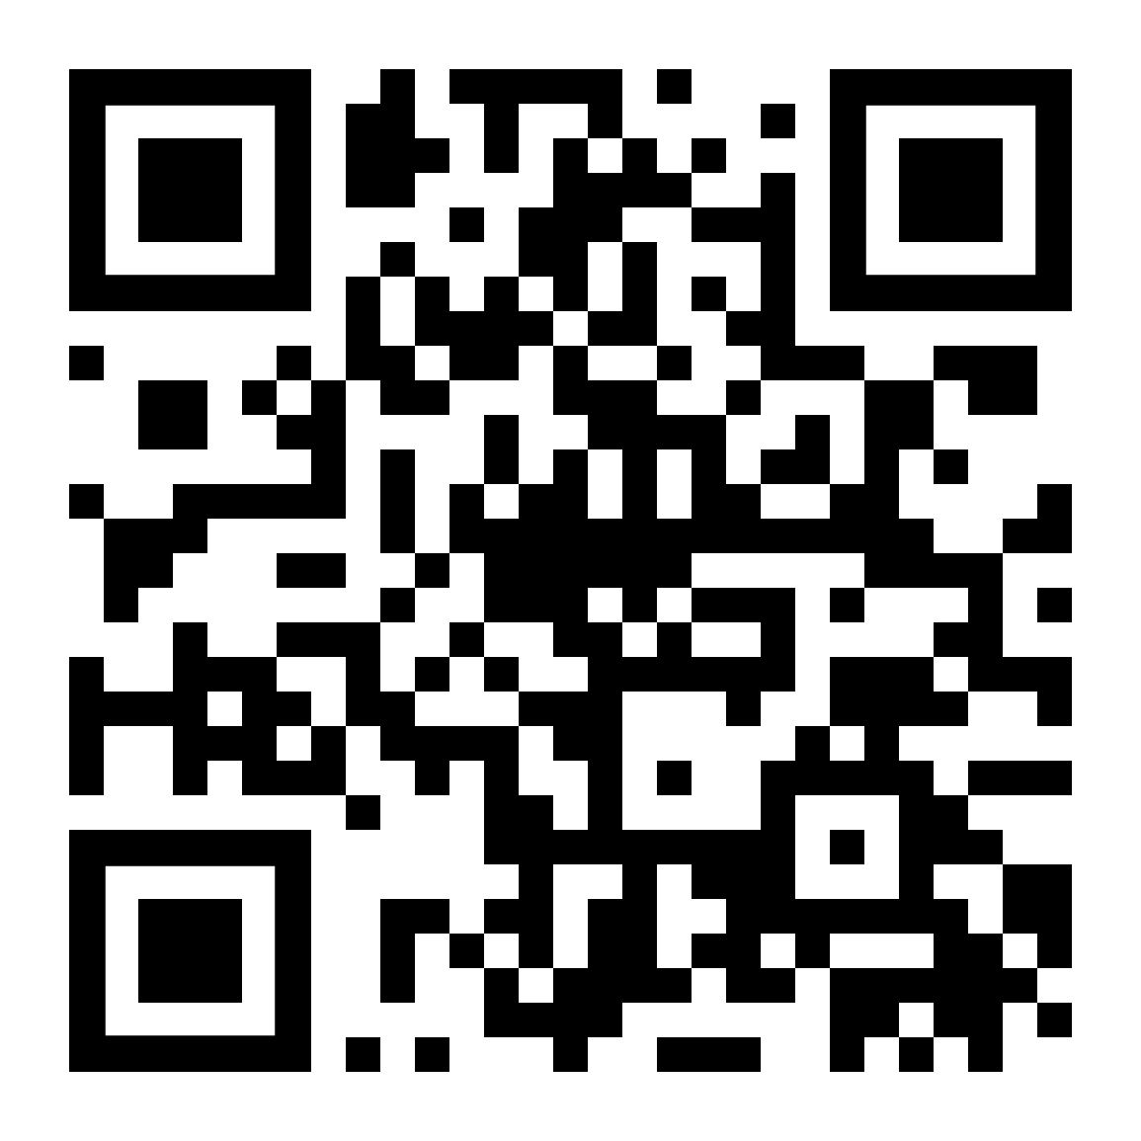
Mitigative
ECAM
ECAM is an open-source software developed to assess greenhouse gas (GHG) emissions from urban water and sanitation systems. It is aligned with IPCC guidelines, using emission factors and methodologies consistent with global standards. The tool covers the entire sanitation service chain
Training of Trainers on Climate-Sanitation Nexus – Climate-SMART Sanitation Assessment
26

Slide 27
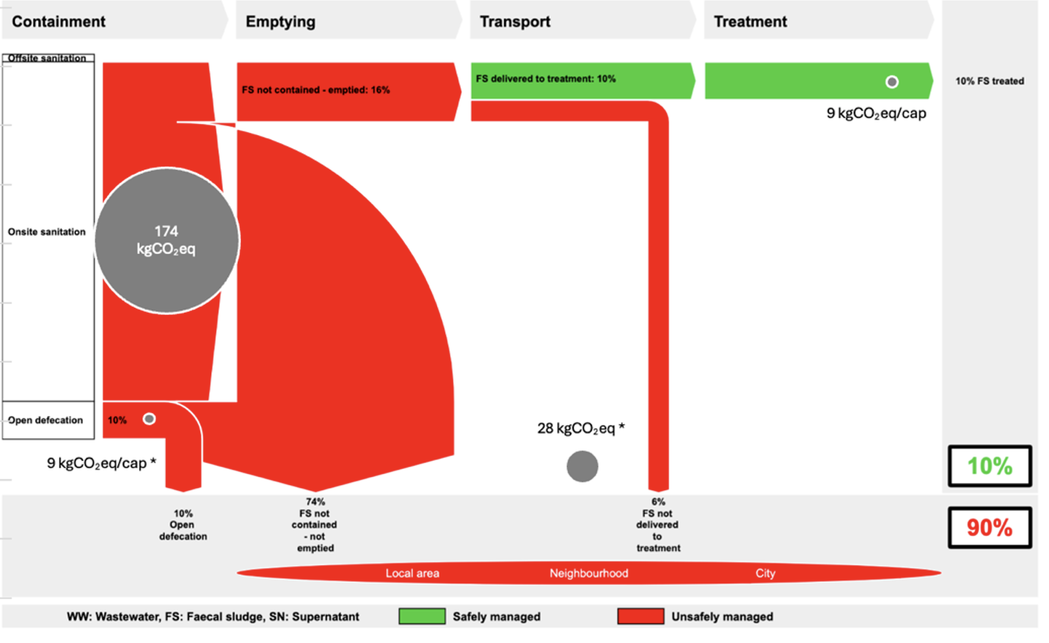
Mitigative
SHIT FLOW DIAGRAM (SFD)
ECAM
It is possible to overlay emissions data onto the SFD, helping visualize both sanitation flows and climate impacts.
Training of Trainers on Climate-Sanitation Nexus – Climate-SMART Sanitation Assessment
27

Slide 28
Adaptative & resilient
UNICEF‑GWP RISK ASSESSMENT
UTS CLIMATE-FIRST
UTS CLIMATE-FIRST
UTS CLIMATE-FIRST
UTS CLIMATE-FIRST
Training of Trainers on Climate-Sanitation Nexus – Climate-SMART Sanitation Assessment
28

Slide 29
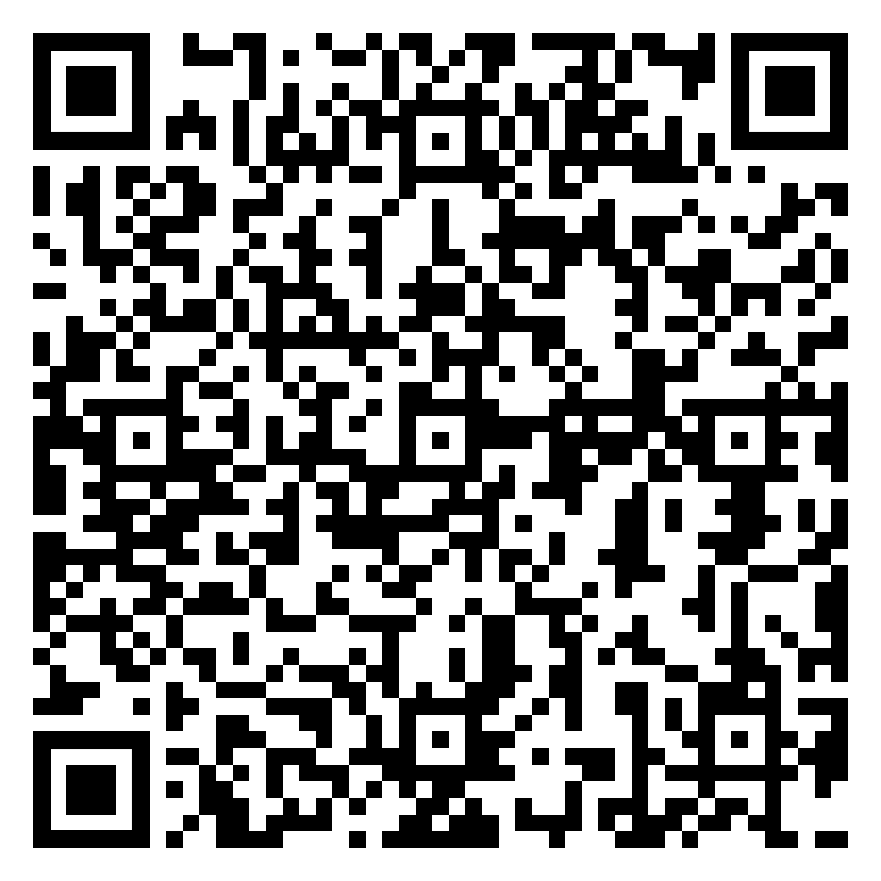
Adaptative & resilient
UNICEF‑GWP RISK ASSESSMENT
STEP 1: HAZARD IDENTIFICATION
ENVIRONMENTAL (flooding)
BIOLOGICAL/CHEMICAL (groundwater contamination)
HUMAN-INDUCED (poor FSM services)
STEP 3: VULNERABILITY ASSESSMENT
PHYSICAL (quality, age infrastructure)
ENVIRONMENTAL (Degradation of water sources, )
SOCIAL (practice, awareness)
FINANCIAL (budget for repairs, insurance)
This Strategic Framework, developed by UNICEF and the Global Water Partnership (GWP), offers a comprehensive approach for integrating climate risks and other stressors (e.g. conflict) into all stages of WASH programming.
STEP 2: EXPOSURE RISK IDENTIFICATION
PHYSICAL (Latrines)
ENVIRONMENTAL (Proximity water source)
SOCIAL (Populations dependent on the system.)
STEP 4: RISK SCORE CALCULATION
Risk = Hazard × Exposure × Vulnerability
Training of Trainers on Climate-Sanitation Nexus – Climate-SMART Sanitation Assessment
29

Slide 30
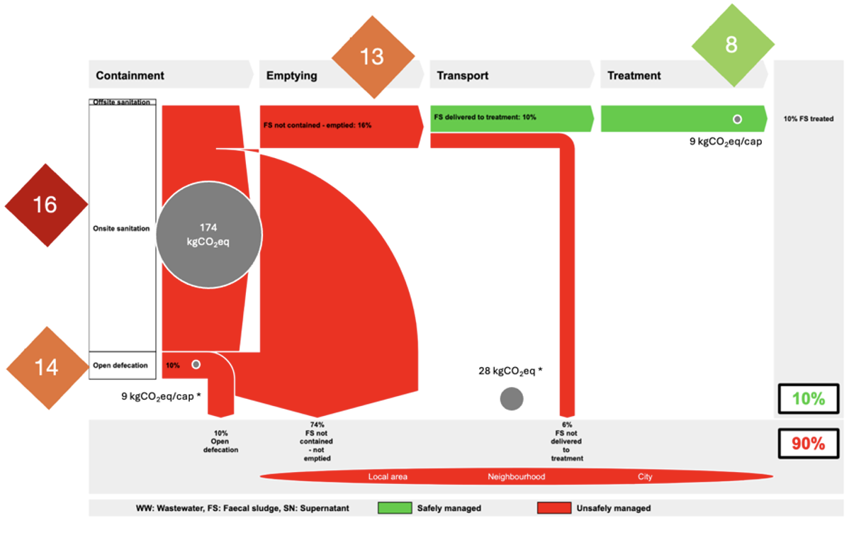
Adaptative & resilient
SHIT FLOW DIAGRAMM (SFD)
ECAM
UNICEF‑GWP RISK ASSESSMENT
The risk score can also be combined with the SFD to identify priority interventions.
Training of Trainers on Climate-Sanitation Nexus – Climate-SMART Sanitation Assessment
30

Slide 31
Transformative
PERCEPTION & ACCEPTANCE STUDY
MARKET DRIVEN APPROACH FOR SELECTION OF FECAL SLUDGE TREATMENT PRODUCT
Training of Trainers on Climate-Sanitation Nexus – Climate-SMART Sanitation Assessment
31

Slide 32
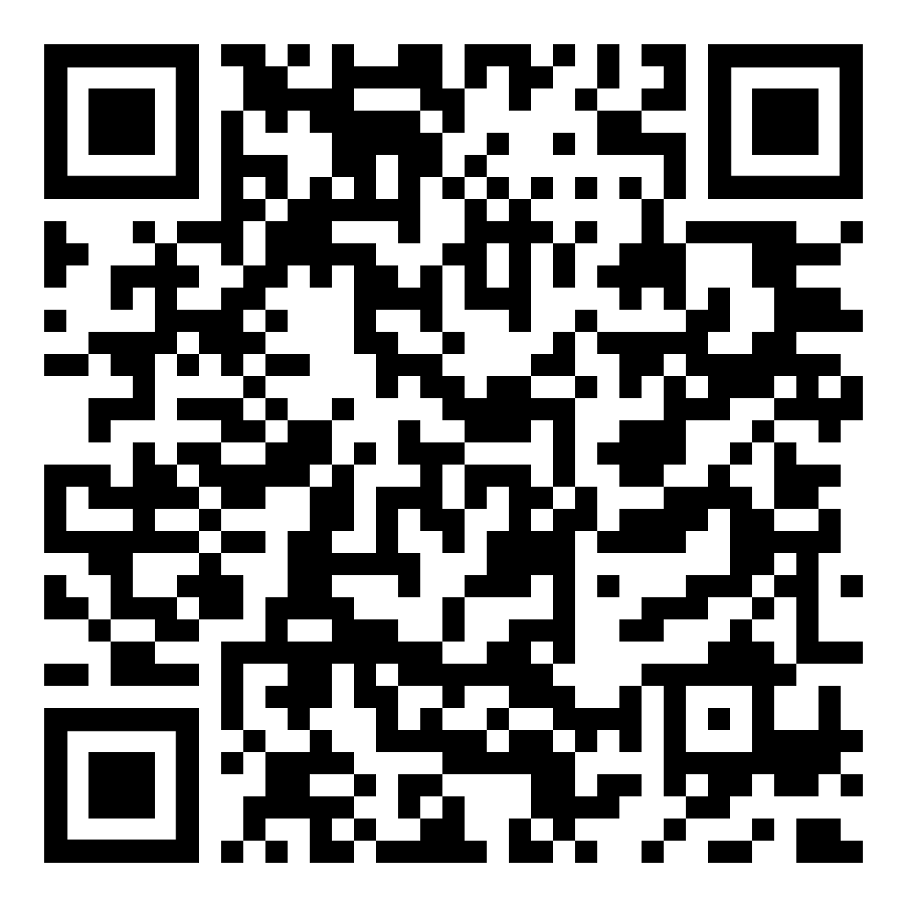
MARKET DRIVEN APPROACH FOR SELECTION OF FECAL SLUDGE TREATMENT PRODUCT
MARKET SIZE ESTIMATION
STEP 1: IDENTIFICATION OF RECOVERY PRODUCTS AND SUBSTITUTES
Each product (e.g. solid fuel, liquid fuel, electricity) is compared with a conventional substitute product already established in the market (e.g. charcoal, LPG, grid electricity).
STEP 3: ADJUSTMENT FOR REALISTIC MARKET CAPTURE
Because reuse products from fecal sludge may differ in quality, availability, or logistics, an adjustment factor is applied (usually <1) in. For biogas the adjustment factor could be purity i.e. 0.7 (because 70% of methane in biogas).
The market-based approach developed by Eawag offers a structured framework for assessing the economic viability and scalability of resource recovery from fecal sludge.
STEP 2: ESTIMATION OF SUBSTITUTE MARKET SIZE
For each substitute, the annual market volume (in tons, kWh, m³, or units) and the market price are specified. This gives the baseline value of the substitute market.
STEP 4 : CALCULATION OF POTENTIAL MARKET SIZE
The adjusted volume is multiplied by the price of the substitute to estimate the realistic market size the reuse product could capture:
Market size = Adjusted volume × Substitute price
Training of Trainers on Climate-Sanitation Nexus – Climate-SMART Sanitation Assessment
32

Slide 33
Technial solution screening
MCDA
STEP 1: DEFINE SCORING (Example Onsite Containment)
SCORE | SAFE | MITIGATIVE | ADAPTIVE & RESILIENT* | TRANSFORMATIVE
5 | Fully watertight/flood-proof | Net-zero or net-negative GHG | Engineered for extreme events | High-value recovered product or energy
4 | Good containment, minor leak risk | Strong CH₄/N₂O avoidance or capture | Flood-protected components | Valuable soil amendment or fuel
3 | Partial lining | Moderate GHG reduction | Some Flood-protected components | Useful but low-value recovery
2 | No lining | Limited GHG reduction | Minimal adaptation | Little to no recovery
1 | No containment | No benefit or high emissions | Vulnerable | Pure disposal
Following the baseline assessment, a comprehensive longlist of potential technical solutions is developed. In this illustrative case, we consider a range of onsite containment options. To systematically evaluate and rank these options, a Multi-Criteria Decision Analysis (MCDA) approach can be applied, using defined scoring criteria and weighted factors, in line with climate SMART approach.
* Note: Adaptive measures can be enhanced over time in alignment with the climateFIRST framework; the current assessment focuses on built-in features.
Training of Trainers on Climate-Sanitation Nexus – Climate-SMART Sanitation Assessment
33

Slide 34
Technial solution screening
MCDA
STEP 2: SCORE DIFFERENT TECHNOLOGIES
TECHNOLOGY | SAFE | MITIGATIVE | ADAPTIVE & RESILIENT* | TRANSFORMATIVE
Composting Toilet | 5 | 5 | 4 | 4
UDDT | 5 | 5 | 4 | 4
Lined Pour-Flush Pit | 4 | 1 | 2 | 1
Prefab Household Biodigester with Constructed Wetlands | 5 | 5 | 4 | 5
Dry Prefab Pit Latrine | 4 | 2 | 4 | 1
Septic Tank with Constructed Wetlands | 5 | 1 | 4 | 2
Following the baseline assessment, a comprehensive longlist of potential technical solutions is developed. In this illustrative case, we consider a range of onsite containment options. To systematically evaluate and rank these options, a Multi-Criteria Decision Analysis (MCDA) approach can be applied, using defined scoring criteria and weighted factors, in line with climate SMART approach.
Training of Trainers on Climate-Sanitation Nexus – Climate-SMART Sanitation Assessment
34

Slide 35
Technial solution screening
MCDA
STEP 3: WEIGHT THE CRITERIA
CRITERIA | WEIGHT %
Safe | 35
Mitigative | 25
Adaptive / Resilient | 25
Transformative | 15
Following the baseline assessment, a comprehensive longlist of potential technical solutions is developed. In this illustrative case, we consider a range of onsite containment options. To systematically evaluate and rank these options, a Multi-Criteria Decision Analysis (MCDA) approach can be applied, using defined scoring criteria and weighted factors, in line with climate SMART approach.
Training of Trainers on Climate-Sanitation Nexus – Climate-SMART Sanitation Assessment
35

Slide 36
Technial solution screening
MCDA
STEP 3: WEIGHT THE CRITERIA
TECHNOLOGY | SAFE | MITIGATIVE | ADAPTIVE & RESILIENT* | TRANSFORMATIVE | SCORE
Composting Toilet | 1.75 | 1.25 | 1 | 0.6 | 4.6
UDDT | 1.75 | 1.25 | 1 | 0.6 | 4.6
Lined Pour-Flush Pit | 1.4 | 0.25 | 0.5 | 0.15 | 2.3
Prefab Household Biodigester with Constructed Wetlands | 1.75 | 1.25 | 1 | 0.75 | 4.8
Dry Prefab Pit Latrine | 1.4 | 0.5 | 1 | 0.15 | 3.1
Septic Tank with Constructed Wetlands | 1.75 | 0.25 | 1 | 0.3 | 3.3
Following the baseline assessment, a comprehensive longlist of potential technical solutions is developed. In this illustrative case, we consider a range of onsite containment options. To systematically evaluate and rank these options, a Multi-Criteria Decision Analysis (MCDA) approach can be applied, using defined scoring criteria and weighted factors, in line with climate SMART approach.
Training of Trainers on Climate-Sanitation Nexus – Climate-SMART Sanitation Assessment
36

Slide 37
Experience sharing
Can you think of any technologies or systems in your country that align with the Climate-SMART Sanitation approach?
Training of Trainers on Climate-Sanitation Nexus – Climate-SMART Sanitation Assessment
37

Slide 38

Q&A

Slide 39





19th Floor Jeongdong Bldg. 21-15,
Jeongdong-gil, Jung-gu, Seoul,
Republic of Korea 04518
www.gggi.org
@gggi_hq
@GGGIHQ
@GGGIHQ
@gggi_hq
@GGGIMedia

