Slide 1


Climate Finance for Sanitation
Climate Financing Tools for Sanitation
UPM Umwelt-Projekt-Management GmbH
June 2025

Slide 2


Agenda
What Climate Financing Options are available for climate-SMART sanitation?
How do Multilateral Climate Funds (MCFs) operate?
The State of Global Climate Financing
01
02
03
Training of Trainers on Climate-Sanitation Nexus – Climate Financing Tools

Slide 3

01
WHAT CLIMATE FINANCING OPTIONS ARE AVAILABLE FOR CLIMATE-SMART SANITATION?

Slide 4
Although only 0.3% of global climate finance is received by the WASH sector, there exist several funding options that aim to support climate adaptation and mitigation through Climate-SMART Sanitation actions.
Training of Trainers on Climate-Sanitation Nexus – Climate Financing Tools
4

Slide 5
Types of Climate Financing for Sanitation Projects
Bilateral Climate Agreements
Direct financial support from one country to another to address climate change challenges involving sanitation, enabling countries to collaborate on implementing climate-SMART sanitation projects globally. Climate finance through bilateral agreements is generally provided in the form of grants and loans.
Multilateral Climate Funds (MCFs)
International financial entities that provide financing, largely in the form of grants, to several developing countries to foster climate mitigation and adaptation. The primary aim of MCFs is to support developing countries in their efforts to mitigate and adapt to climate change, by translating ambitious NDC commitments into tangible climate actions.
Concessional Climate Finance
Often provided through loans with lower interest rates and longer repayment periods than commercial loans. They are most widely used by development banks and are most effective in cases when project solutions require high upfront costs, affordability constraints in vulnerable communities need to be considered, and addressing critical climate-related sanitation challenges may otherwise be unviable without such support.
Blended Climate Finance
Combining public and private capital to fund climate-SMART projects that struggle to attract purely commercial investment. It involves the public sector funds to absorb financial risks, thereby providing a financial environment where the private sector is more willing to participate in.
Community Climate Financing
Mobilization and deployment of community-based financial resources to support climate change mitigation and adaptation projects, particularly at the local level. This method of climate financing ensures local ownership, sustainability, and long-term benefits. Community climate financing can involve direct community fundraising or funding from donors and philanthropic sources
Training of Trainers on Climate-Sanitation Nexus – Climate Financing Tools
5

Slide 6

02
HOW DO MULTILATERAL CLIMATE FUNDS (MCFs) OPERATE?

Slide 7

The Green Climate Fund (GCF)
World’s largest climate fund, mandated to finance climate change mitigation and adaptation activities in developing countries.
Operates on a country-driven approach where developing countries are given the responsibility to lead GCF programming and implementation, allowing developing countries to match their NDC ambitions with climate action effectively.
Over US$20 billion has been pledged to the fund from 2020-2027.
Mandated to invest its resources equally to mitigation and adaptation.
At least half of its adaptation resources are required to be invested in Small Island Developing States (SIDS), Least Developed Countries (LDCs), and African states.
Training of Trainers on Climate-Sanitation Nexus – Climate Financing Tools
7

Slide 8

GCF Resource Mobilization
The GCF accepts contributions from developed countries party to the UN Framework Convention on Climate Change (UNFCCC) as well as public, non-public, and alternative sources including countries not party to the UNFCCC, in the form of grants, capital or loans.
42% of GCF’s climate financing is provided in the form of grants and often focus is placed on community-led projects in underserved countries.
The GCF provides climate finance to developing countries exclusively through its network of Accredited Entities, which consist of public or private, international, national, and regional institutions and NGOs.
Organizations must demonstrate strong financial management and specialized capacities in driving climate action to become an accredited partner of the GCF.
Some examples of accredited entities partner to the GCF include the African Development Bank (AfDB), Development Bank of Southern Africa (DBSA), and Sahara and Sahel Observatory (OSS).
Training of Trainers on Climate-Sanitation Nexus – Climate Financing Tools
8

Slide 9
GCF Readiness Programme
To further assist developing countries in strengthening their institutional capacities, governance mechanisms, and strategic frameworks for climate action, and accessing GCF funding support, the GCF has established its “Readiness Programme” initiative.
Provision of up to US$1 million per country per year on:
Capacity Building: Helping sanitation sector stakeholders assess climate risks, understand adaptation needs and incorporate these considerations into sectoral strategies and policies.
Facilitating Access to Finance: Supporting the accreditation of national or regional entities.
Provision of Technical Assistance and Guidance: Provision of practical guidelines for designing climate-resilient sanitation projects to ensure projects are robust, bankable, and aligned with GCF investment criteria.
Support with the Development of Project Pipelines: Helping to identify, design, and prioritize sanitation projects that address climate vulnerabilities.
Knowledge Sharing and Promotion of Best Practices
Training of Trainers on Climate-Sanitation Nexus – Climate Financing Tools
9

Slide 10

The GCF Strategic Vision for Sanitation
The operation of GCF support for sanitation projects and programs revolves around three key objectives for the sector which are outlined in the GCF Water Security Sectoral Guide:
Encouraging the use of innovative technologies, service models, and community involvement to create adaptive, resilient, and sustainable sanitation systems.
Anticipating and preparing for climate impacts, ensuring systems and services are not just functional but robust against future scenarios.
Integrating sanitation within the wider context of climate goals, promoting sustainable practices, and reducing the carbon footprint.
Training of Trainers on Climate-Sanitation Nexus – Climate Financing Tools
10
Notes:
P87 Manual

Slide 11
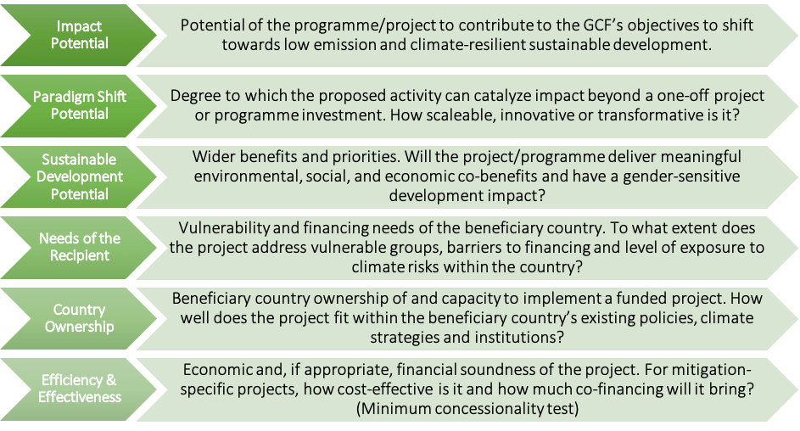
The GCF Investment Criteria for Climate-Resilient Sanitation Projects
The GCF Investment Criteria is defined within the GCF Water Security Sectoral Guide, to guide its funding decisions concerning climate-resilient sanitation projects, and can be summarized by the following figure.
Source: Multilateral Environmental Agreements (MEA) – Republic of Trinidad and Tobago
Training of Trainers on Climate-Sanitation Nexus – Climate Financing Tools
11

Slide 12
The GCF Expected Outcomes for Climate-Resilient Sanitation Projects
Additionally, the GCF has outlined in its Water Security Sectoral Guide, two key outcomes it expects from climate-resilient sanitation activities:
Climate-Resilient Infrastructure and Services: Building new or upgrading existing sanitation infrastructure, to achieve synergies between adaptation and mitigation, and withstand climate-related impacts along the entire sanitation chain.
Examples: Flood-resistant sanitation systems, decentralized climate-resilient sanitation
Circular Economy and Integrated Management: Integrating sanitation with broader health, water, food, and energy security to ensure protection of ecosystems.
Examples: Utilization of treated wastewater for potable, industrial, and agricultural uses in water-scare regions; biogas generation from sanitation systems
Training of Trainers on Climate-Sanitation Nexus – Climate Financing Tools
12

Slide 13
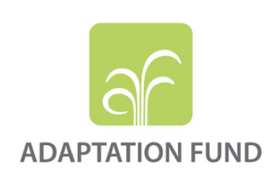
The Adaptation Fund
Originally established in 2001 under the Kyoto Protocol, to finance adaptation projects and programs in developing countries that are vulnerable to the adverse effects of climate change.
Its operation is still active despite the termination of the Kyoto Protocol in 2020, as it now serves the efforts of the Paris Agreement.
Currently, the Adaptation Fund only recognizes and addresses sanitation as a sub-component of broader water, urban, or climate adaptation strategies, and not as a strategic focus on its own.
However, recent developments from COP29 such as the increased global climate finance commitment and emphasis on advancing climate adaptation, means that the Adaptation Fund may be more relevant for the climate-sanitation nexus in upcoming years.
Training of Trainers on Climate-Sanitation Nexus – Climate Financing Tools
13

Slide 14

The African Water Facility (AWF)
Africa’s primary funding entity for water and sanitation projects across Africa
Managed by the African Development Bank (AfDB)
AWF projects often focus on the integration of sanitation improvements in community spaces, highlighting the role of sanitation in broader climate adaptation and resilience strategies.
AWF projects to date have directly impacted 29 million people across Africa with over 148 projects in 52 countries and US$2.2 billion of finance provided, in the form of grants.
Training of Trainers on Climate-Sanitation Nexus – Climate Financing Tools
14

Slide 15

The AWF Strategic Vision for Sanitation
The AWF focuses its activities and operations based on four strategic priorities:
Project Preparation: A focus on financing the preparation of WaSH development projects and securing follow-on investment for implementation through institutional support and capacity building to manage and regulate WaSH resources investments.
Catalytic Investments: Fostering innovation by replicating and piloting innovative sanitation solutions, thereby providing evidence for private stakeholders to invest through deployment of small but catalytic investments.
Investment Promotion: Increasing the number of public and private investment opportunities by establishing a networking platform to market investment project opportunities and connect project sponsors with potential investors.
Water Governance: Establishing guidelines through which decisions for the management of WaSH resources and services are taken and implemented
Training of Trainers on Climate-Sanitation Nexus – Climate Financing Tools
15

Slide 16

AWF Resource Mobilization
AWF’s core funding is grant-based and often directed at public sector entities
Mobilization of resources through partnerships with bilateral and multilateral donors, such as the Danish Government and the Nordic Development Fund.
The investment approach of the AWF aims to secure financing for climate-resilient water and sanitation services in Africa by focusing on three primary themes:
Targeting Investors: Creation of tools to target and foster relationships with suitable investors throughout the project cycle.
Streamlining Processes: Development of tools and processes to enhance the efficiency and quality of project identification, preparation, and implementation.
Aligning with Country Priorities: Selection of projects that specifically align with a country’s set NDC targets and are more resilient to changes in country priorities.
The AWF offers grants of between €50,000 and €5,000,000 to fund both climate change adaptation and mitigation-focused WaSH projects across the African continent.
Training of Trainers on Climate-Sanitation Nexus – Climate Financing Tools
16

Slide 17

03
THE STATE OF GLOBAL CLIMATE FINANCING

Slide 18
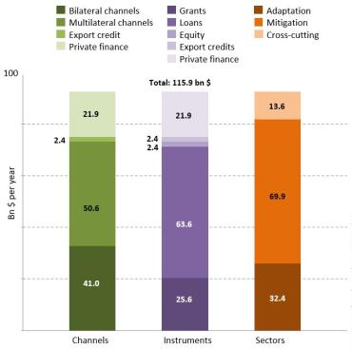
The State of Global Climate Financing
The majority of global climate finance is provided through bilateral and multilateral channels.
The overall funding is provided largely in the form of loans and grants.
Climate mitigation activities receive majority of the funding.
Although global climate finance has significantly increased over the years, most of its growth is due to an increase in mitigation finance, with the largest growth in the renewable energy and transport sectors, leaving the WaSH sector relatively under financed in comparison.
Training of Trainers on Climate-Sanitation Nexus – Climate Financing Tools
18

Slide 19
Climate Financing for Sanitation at a Glance
Financing Type | Entities | Primary Financing Instruments | Climate Action Focus
Bilateral Climate Agreements | National Development Agencies (country-specific) | Grants and loans | Currently slightly favors mitigation projects over adaptation
Multilateral Climate Funding | Green Climate Fund | Grants | Mitigation and Adaptation projects mandated to be equally invested in
 | African Water Facility |  | Applicable for both mitigation and adaptation projects
Concessional Climate Financing | Multilateral development banks such as the AfDB | Concessional loans | Currently slightly favors mitigation projects over adaptation
Blended Climate Financing | Public, private, and NGOs | A mixture of instruments that can include grants, loans, and equity | Applicable for both mitigation and adaptation sanitation projects
Community Climate Financing | Communities, NGOs | Grants, community loan funds | Applicable for both mitigation and adaptation sanitation projects
Green Banks | Green Banks | Mainly Loans but can also include equity investments | Applicable to both mitigation and adaptation sanitation projects
Training of Trainers on Climate-Sanitation Nexus – Climate Financing Tools
19

Slide 20

Module 3: Climate Finance for Sanitation Key Takeaways
Climate finance is an essential component of the Climate-Sanitation Nexus, and is an enabler to deliver context-specific and appropriate sanitation solutions to regions vulnerable to the effects of climate change and also lacking domestic funding to address challenges faced concerning sanitation due to climate change.
Climate finance is continually evolving and is starting to place an emphasis on climate adaptation and recognize the importance of promoting climate-SMART sanitation , to ensure that immediate and future global sanitation needs are met.
Local context is critically important and so, climate financing initiatives require strong local partners who understand the local WaSH and finance contexts and enabling environments,
There is no one-size-fits all approach regarding climate financing methods, however lessons can be learnt from innovatively funded climate-SMART projects that can provide great insights into how they can be effectively implemented and the considerations that have to be made.
Training of Trainers on Climate-Sanitation Nexus – Climate Financing Tools

Slide 21

Q&A

Slide 22




19th Floor Jeongdong Bldg. 21-15,
Jeongdong-gil, Jung-gu, Seoul,
Republic of Korea 04518
www.gggi.org
@gggi_hq
@GGGIHQ
@GGGIHQ
@gggi_hq
@GGGIMedia

