Slide 1
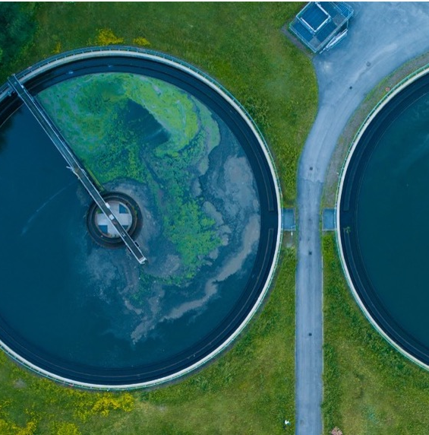

The Climate-Sanitation Nexus
Definition and interconnections between climate and sanitation.
UPM Umwelt-Projekt-Management GmbH
June 2025

Slide 2

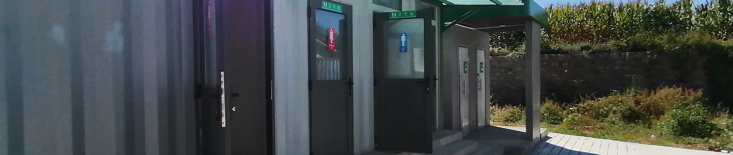
Agenda
What is the Climate-Sanitation Nexus?
How does sanitation impact the climate?
How does the climate impact sanitation?
01
02
03
Training of Trainers on Climate-Sanitation Nexus – The Climate-Sanitation Nexus

Slide 3

01
WHAT IS THE CLIMATE-SANITATION NEXUS?

Slide 4
The Climate-Sanitation Nexus
describes the interconnected relationship
between sanitation systems and climate change.
Training of Trainers on Climate-Sanitation Nexus – The Climate-Sanitation Nexus
4

Slide 5
The understanding of the Nexus is continuously evolving.
The Nexus is an ongoing issue without a definitive endpoint.
There is no right or wrong solution.
Each context presents unique and novel combinations that need to be considered.
Decisions can be "one shot operations" that can have lasting consequences.
The Climate-Sanitation Nexus has a complex nature and can be described as a „wicked problem“!
Training of Trainers on Climate-Sanitation Nexus – The Climate-Sanitation Nexus
5

Slide 6
A concern for all people
Training of Trainers on Climate-Sanitation Nexus – The Climate-Sanitation Nexus
6
Notes:
What implies climate-SMART? It implies sanitation solutions that are safe, mitigative, adaptative, resilient and transformative. We will gain a deeper understanding in Module 2.
What are high-risk climate impacted areas? Locations, where the combination of hazards, exposure and vulnerability can be considered significant resulting in a high likelohood of negative impacts on people, livelihoods, ecosystems and/or infrstructure.
What is improved sanitation? Sanitation facilitires designed to hygienically separate human excreta from human contact.

Slide 7
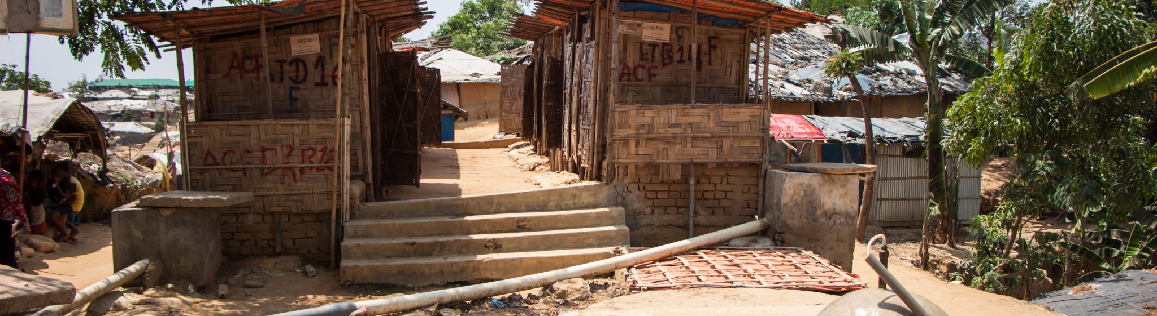
02
HOW DOES SANITATION IMPACT THE CLIMATE?

Slide 8
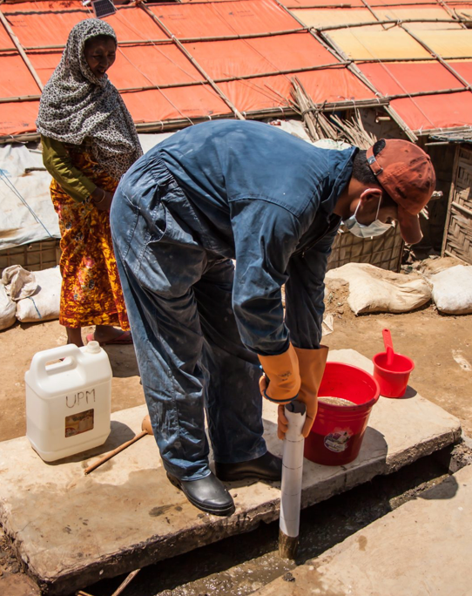
Sanitation's contributions to climate change
Sanitation causes greenhouse gas (GHG) emissions that impact the climate.
These GHG emissions are not possible to be completely avoided based on current technology and biological realities.
With the global goal of “Sanitation for all”, we will cause a rise in GHG emissions.
Training of Trainers on Climate-Sanitation Nexus – The Climate-Sanitation Nexus
8

Slide 9
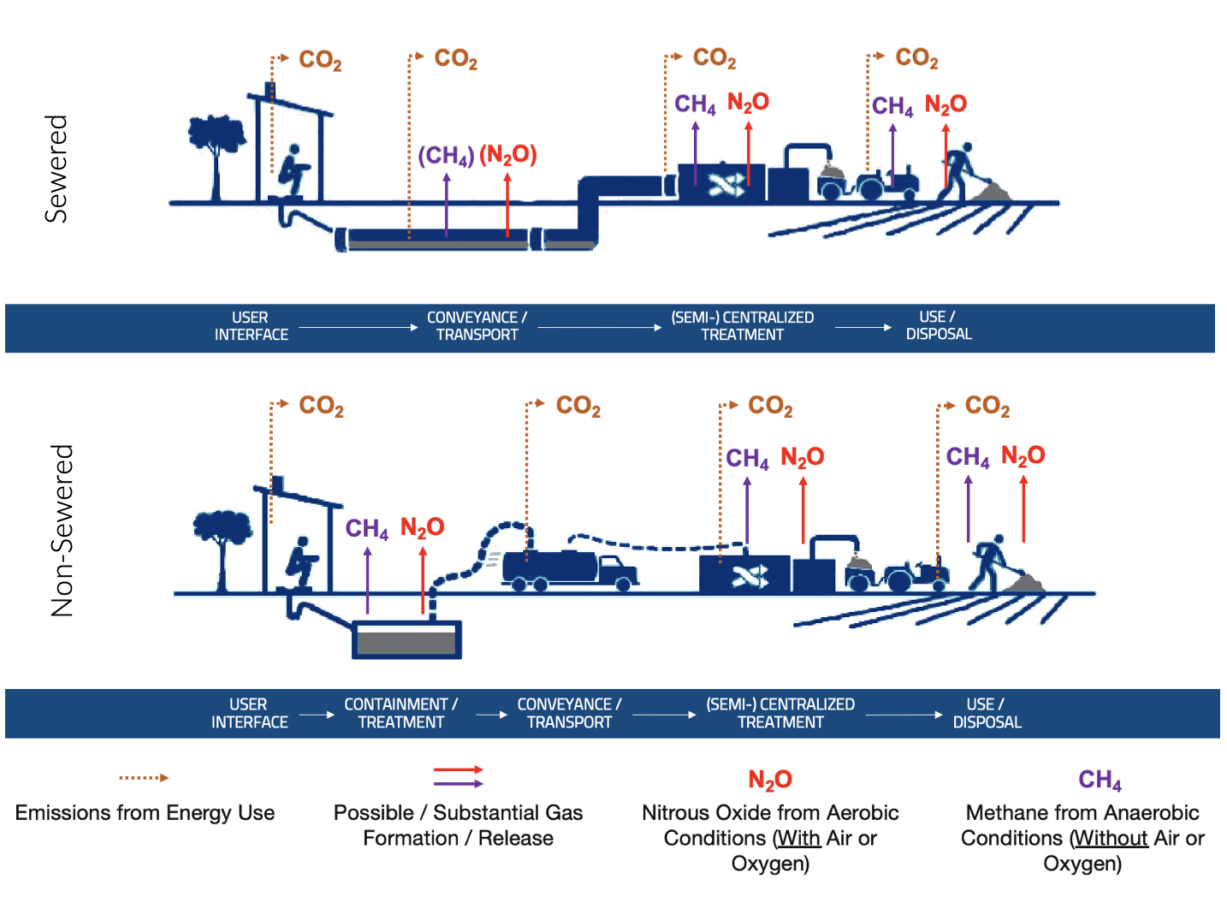
GHG emissions along the sanitation value chain
Training of Trainers on Climate-Sanitation Nexus – The Climate-Sanitation Nexus
9

Slide 10
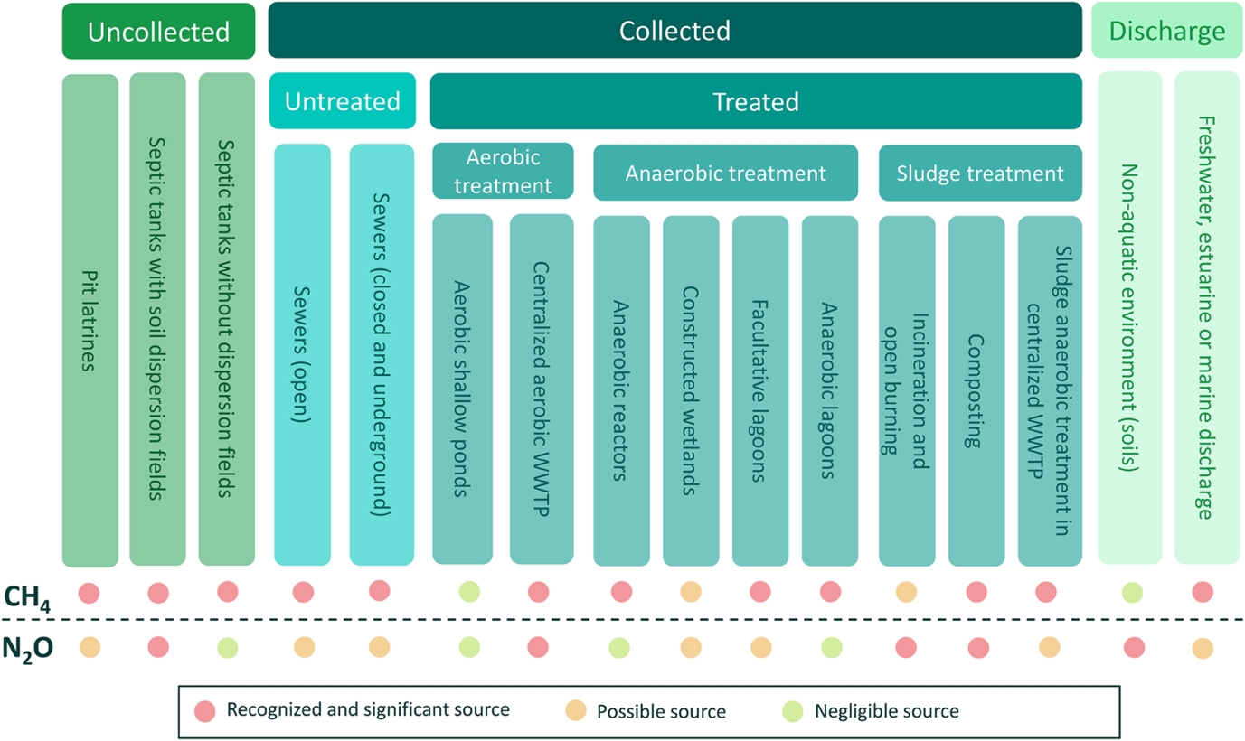
GHG emissions based on selected sanitation solutions
Training of Trainers on Climate-Sanitation Nexus – The Climate-Sanitation Nexus
10

Slide 11
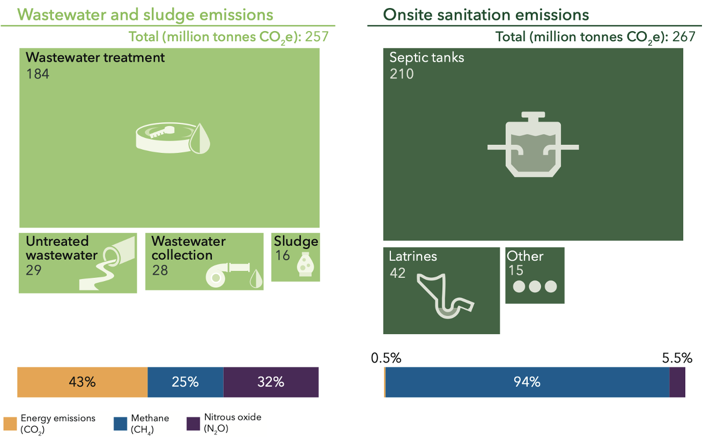
GHG emissions from sanitation in numbers
Training of Trainers on Climate-Sanitation Nexus – The Climate-Sanitation Nexus
11

Slide 12
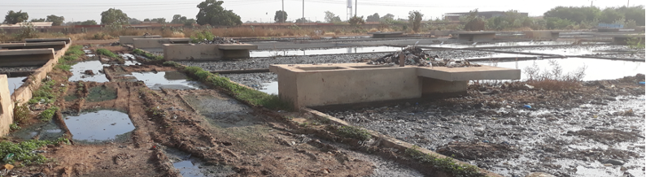
03
HOW DOES THE CLIMATE IMPACT SANITATION?

Slide 13
Climate change's impacts on sanitation
Climate is one of the core stress factors for sanitation.
Climate change and variability creates risks, heightens uncertainties and increases inequality in sanitation access.
The impacts are direct through damage to infrastructure.
The impacts are also indirect by influencing health, migration and resource availability.
Training of Trainers on Climate-Sanitation Nexus – The Climate-Sanitation Nexus
13

Slide 14
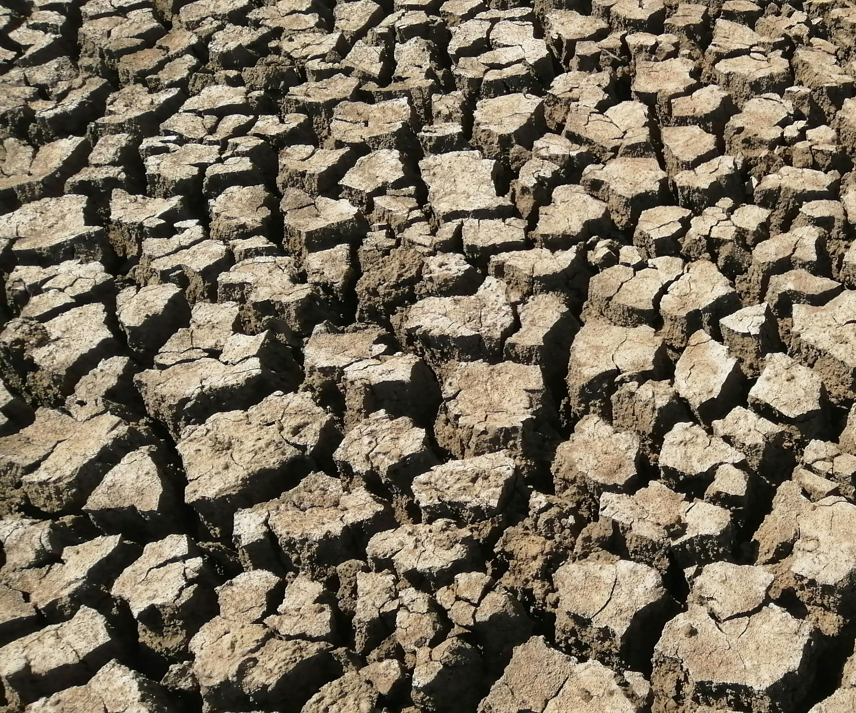
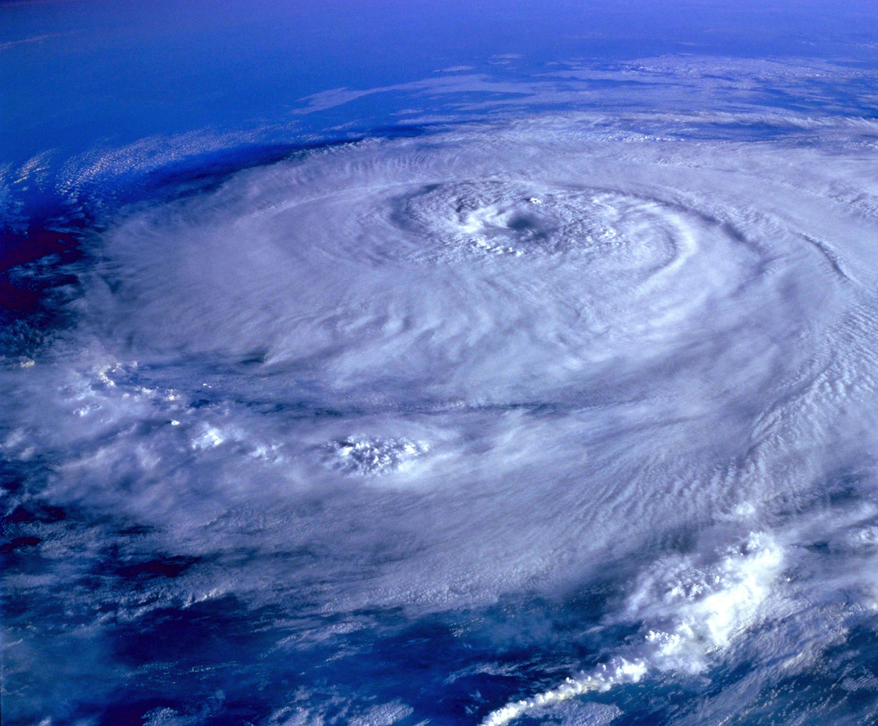
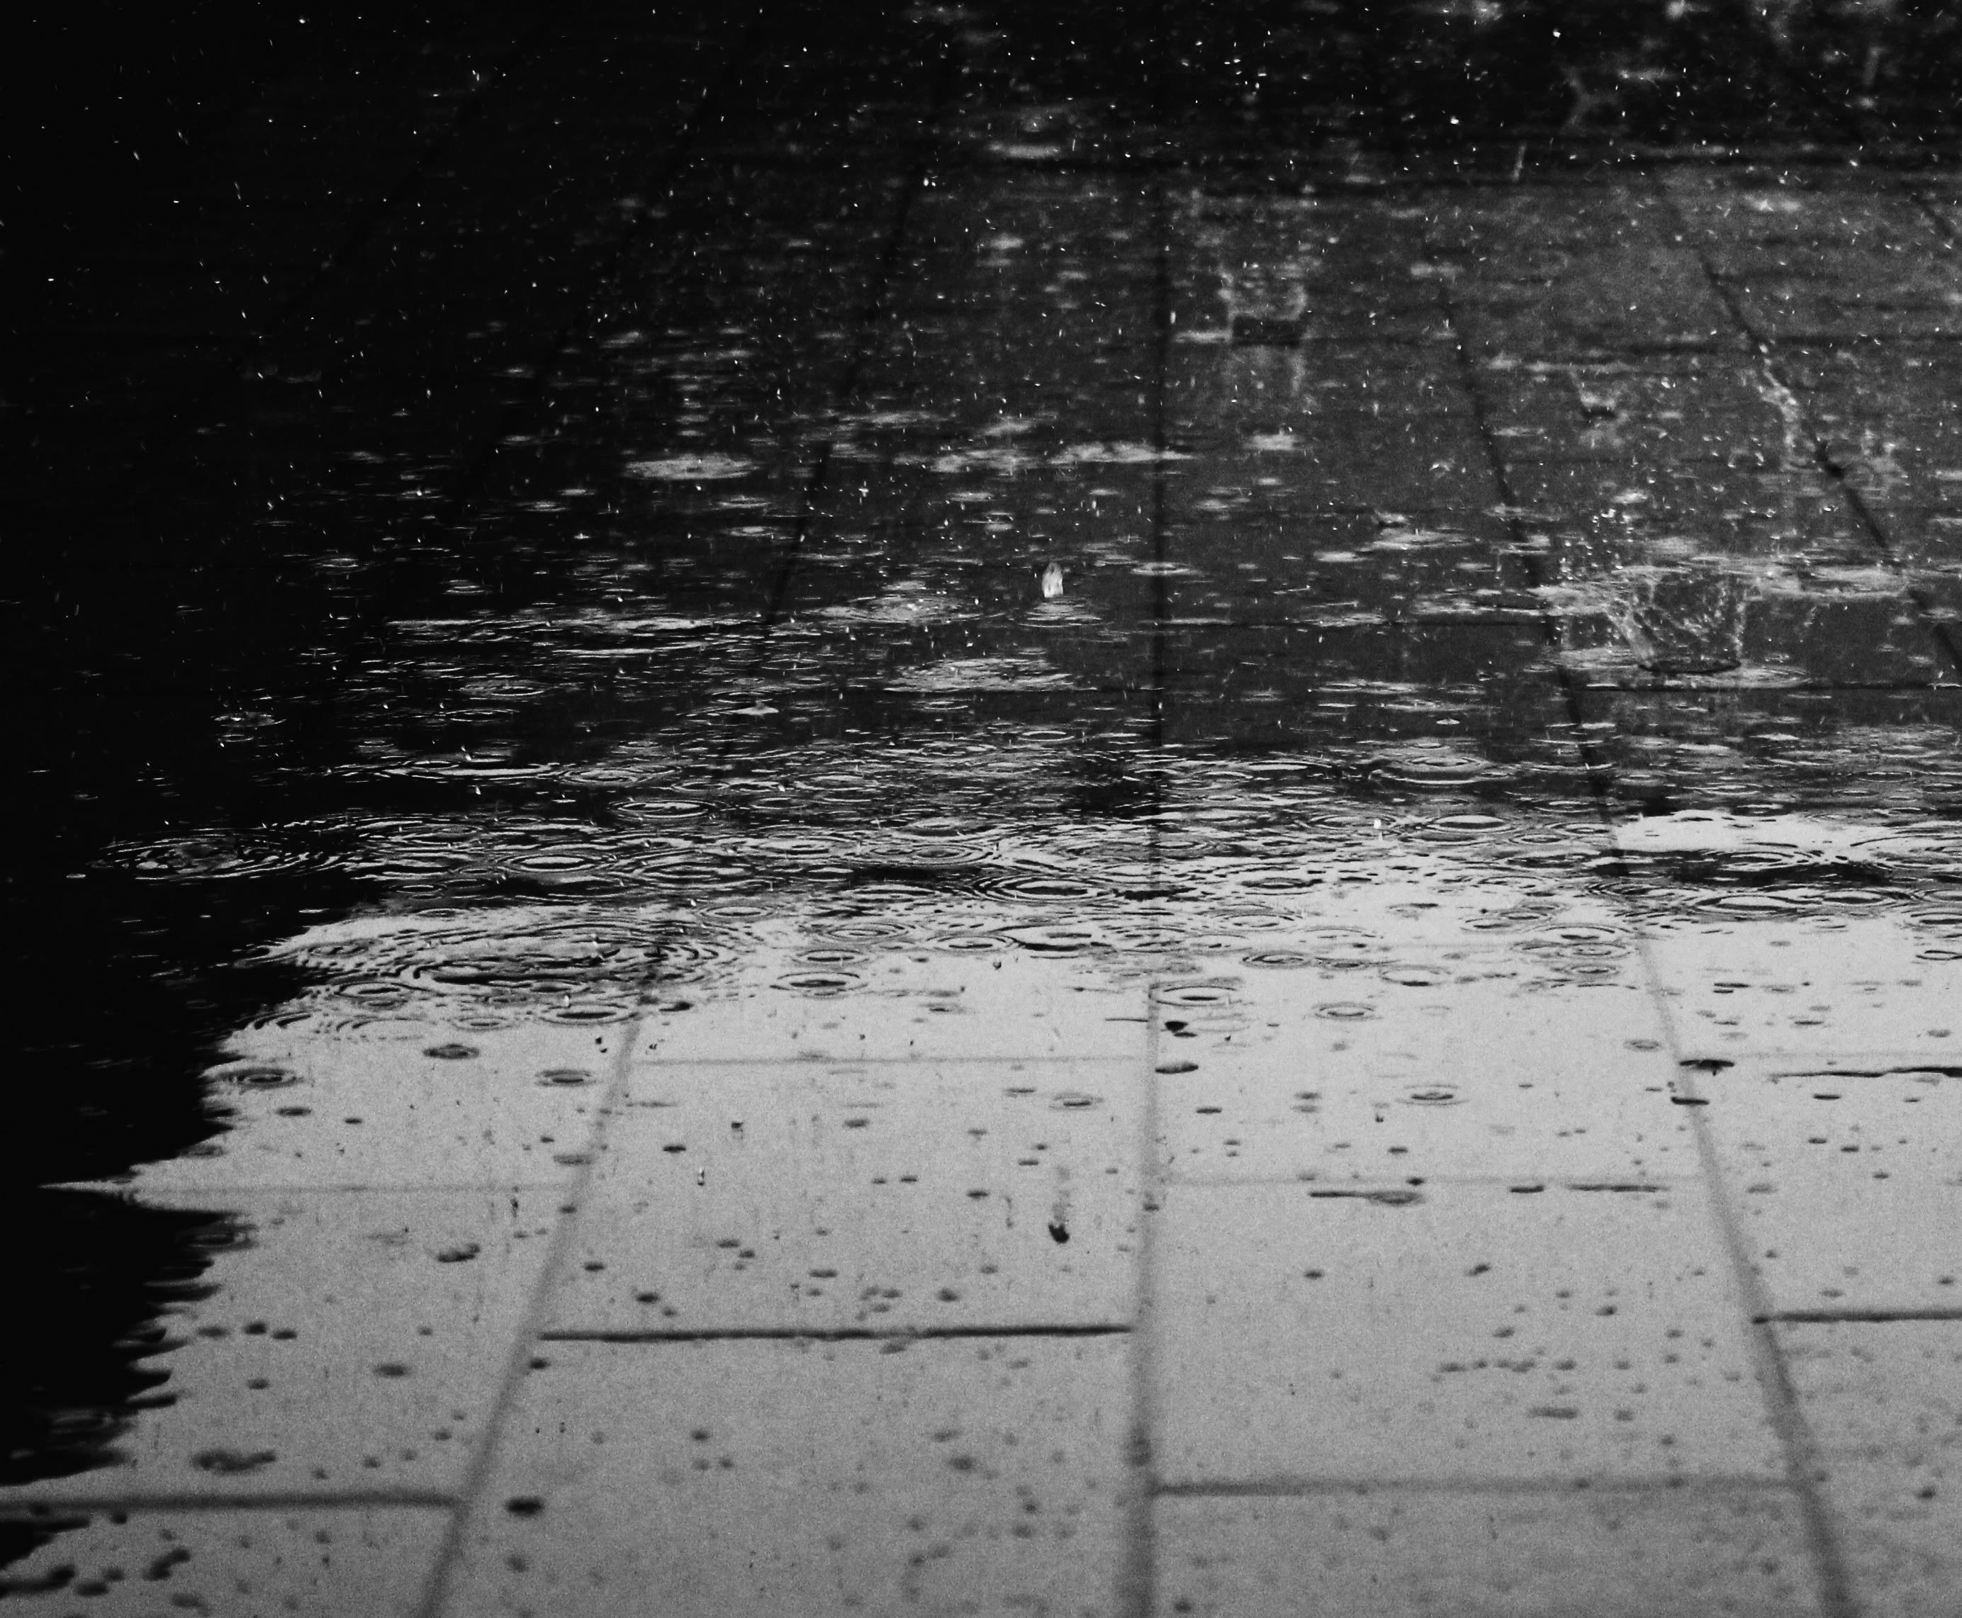

The different types of climate hazards
Slow Onset
Shock Events
Long-term trends
Variability / unpredictability
Events that gradually emerge over extended periods.
E.g., droughts, sea-level rise, salinization.
Events that occur acutely within a short timeframe.
E.g., cyclones, floods, hurricanes, storm surges.
Long-term changes (e.g., decades) in climate variables.
E.g., average temperatures, average annual rainfall.
Increasing contrast between seasons and unpredictability of climate and weather.
E.g., highly variable rainfall, temperature swings, unpredictable seasons.
14
Training of Trainers on Climate-Sanitation Nexus – The Climate-Sanitation Nexus
Notes:
In 2024, 393 natural hazard-related disasters were recorded. This included 75 disasters in Africa that affected 41.2 million people. The number of affected people has risen over the years.
The main hazard for Africa were droughts. In 2024, extreme drought conditions impacted especially Zambia, Zimbabwe and Malawi. This causes food and water shortages and also challenges sanitation systems.

Slide 15
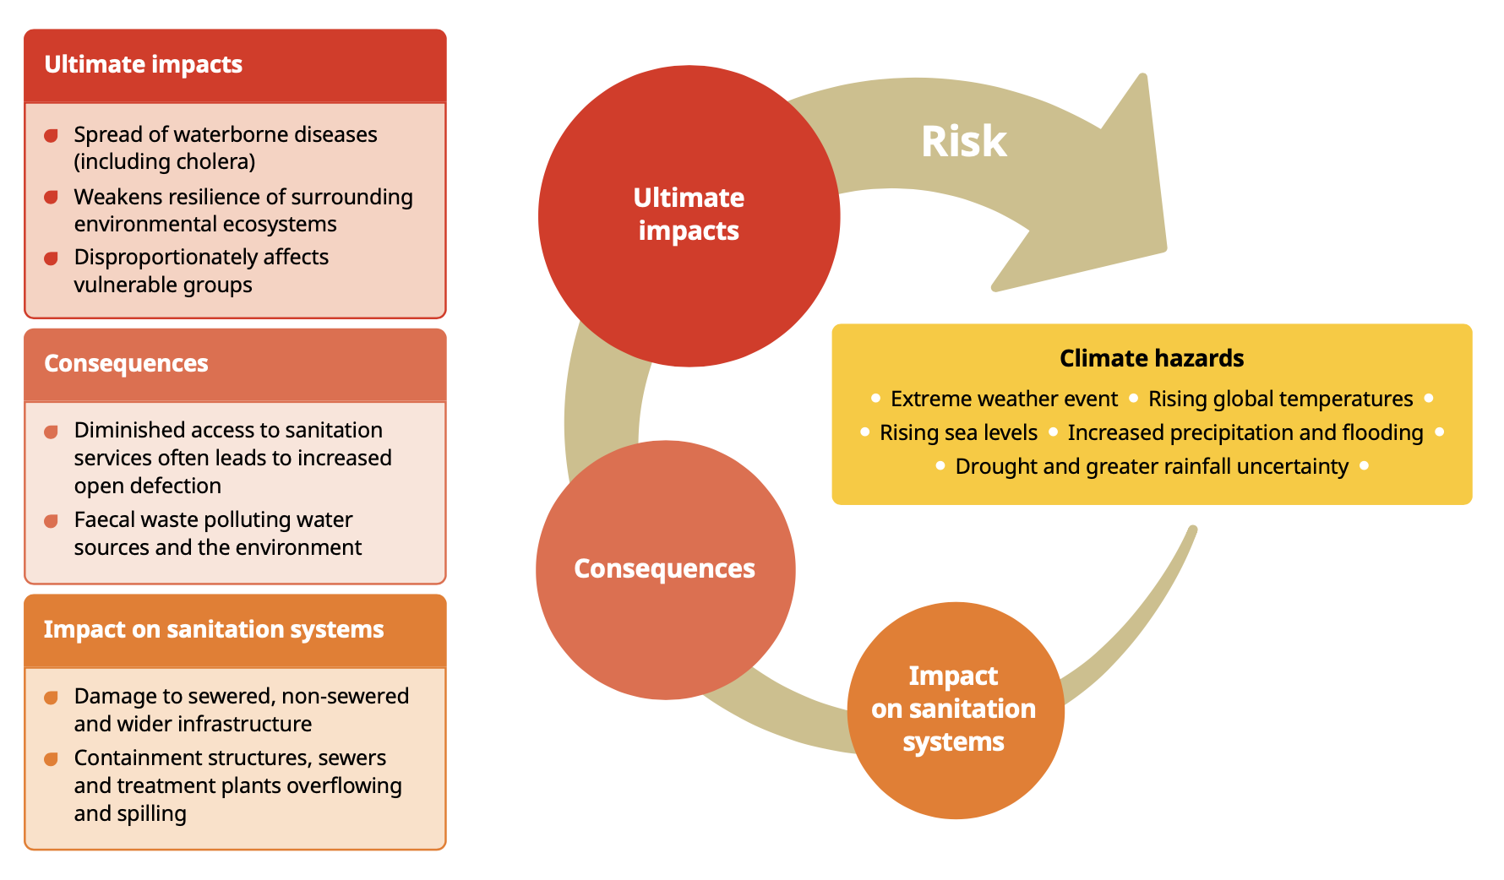
Impacts, consequences and ultimate impacts
Source: WaterAid
15
Training of Trainers on Climate-Sanitation Nexus – The Climate-Sanitation Nexus

Slide 16

Q&A

Slide 17




19th Floor Jeongdong Bldg. 21-15,
Jeongdong-gil, Jung-gu, Seoul,
Republic of Korea 04518
www.gggi.org
@gggi_hq
@GGGIHQ
@GGGIHQ
@gggi_hq
@GGGIMedia

