Slide 1


SITE VISIT
1

Slide 2
Site Visit
See attached presentation
Training of Trainers on Climate-Sanitation Nexus – Climate-SMART Sanitation Assessment
2

Slide 3
Site Visit
Observe, analyze, and gather information based on the climate SMART approach provided in the handout
Try to answer as many questions as you can from each section. Take notes and photos (if permitted) — your findings will support upcoming group work and exercises.
Training of Trainers on Climate-Sanitation Nexus – Climate-SMART Sanitation Assessment
3

Slide 4
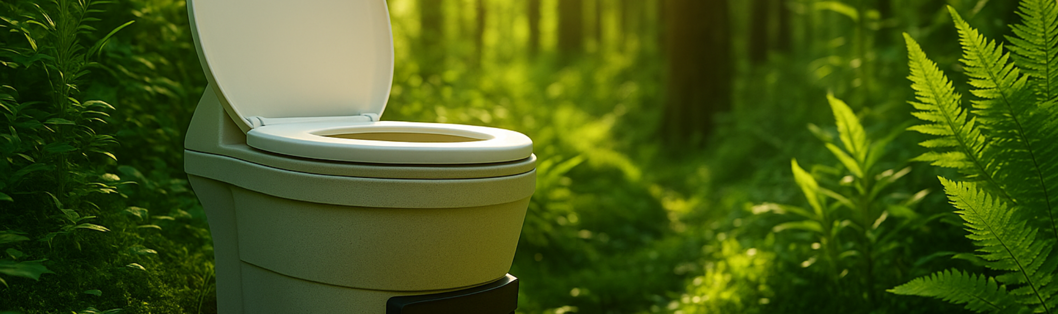




19th Floor Jeongdong Bldg. 21-15,
Jeongdong-gil, Jung-gu, Seoul,
Republic of Korea 04518
www.gggi.org
@gggi_hq
@GGGIHQ
@GGGIHQ
@gggi_hq
@GGGIMedia

