Slide 1


ENERGIZER

Slide 2
Energizer
Climate Finance Acronym Trivia
Instructions:
You’ll be shown an acronym related to climate finance.
Each table will have 30 seconds to discuss and agree on what the acronym stands for.
When time is up, each table will share their answer.
After all tables have shared, we’ll reveal the correct answer and provide a short explanation of its relevance.
Decode the jargon – one acronym at a time!
Training of Trainers on Climate-Sanitation Nexus – Climate Finance for Sanitation
2

Slide 3

Exercise 1: Green Climate Fund Sanitation Project Alignment
Matching Sanitation Project Aspects to GCF Investment Criteria
UPM Umwelt-Projekt-Management GmbH
June 2025

Slide 4

Why this exercise?
Many sanitation projects may not qualify for Green Climate Fund (GCF) support due to differing focuses or misalignment in strategies.
Ensuring project alignment with GCF’s approach and strategy to fund climate-resilient sanitation projects can potentially unlock opportunities for financial support to make much needed impacts in the climate-sanitation nexus.
YOU – as trainers and advocates – can thoroughly assess and develop climate sanitation projects through the lens of the GCF’s investment criteria approach and its expected project outcomes, to ensure projects are in a strong position for GCF approval and receive possible funding support.
Training of Trainers on Climate-Sanitation Nexus – The Climate-Sanitation Nexus
4

Slide 5
Learning objectives
Familiarize with the GCF’s Six Investment Criteria and their application in project evaluation.
Be able to assess the alignment of climate sanitation projects with GCF strategy and requirements.
Highlight best practices and common challenges in developing projects for GCF funding, drawing on real-world case studies and guidelines.
Training of Trainers on Climate-Sanitation Nexus – The Climate-Sanitation Nexus
5

Slide 6
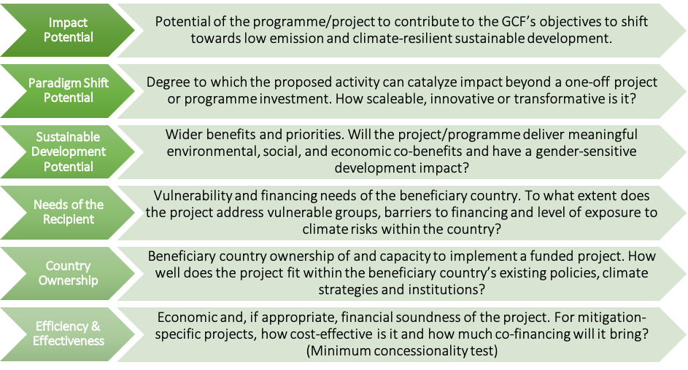
The GCF Investment Criteria for Climate-Resilient Sanitation Projects
Source: Multilateral Environmental Agreements (MEA) – Republic of Trinidad and Tobago
For french: https://www.greenclimate.fund/sites/default/files/document/fr-investment-criteria-indicators.pdf
6

Slide 7

The GCF Expected Outcomes for Climate-Resilient Sanitation Projects
Additionally, the GCF has outlined in the Water Security Sectoral Guide, two key outcomes it expects from climate-resilient sanitation activities:
      Climate-Resilient Infrastructure and Services: Building new or upgrading existing sanitation infrastructure, to achieve synergies between adaptation and mitigation, and withstand climate-related impacts along the entire sanitation chain.
      Examples: Flood-resistant sanitation systems, decentralized climate-resilient sanitation
      Circular Economy and Integrated Management: Integrating sanitation with broader health, water, food, and energy security to ensure protection of ecosystems.
      Examples: Utilization of treated wastewater for potable, industrial, and agricultural uses in water-scare regions; biogas generation from sanitation systems
Training of Trainers on Climate-Sanitation Nexus – Climate Finance for Sanitation
7

Slide 8

THE EXERCISE

Slide 9
Scenario and structure of the exercise
“You are to assess one of three provided real-world sanitation project cases for their alignment with the GCF Investment Criteria and Expected Outcomes."
Form a group.
Read through the sanitation project case provided and identify aspects of the project that align with the GCF Investment Criteria and if the project fulfils aspects of the Expected Outcomes using the checklists provided. You may note the specific aspects of the project for each of the investment criteria and expected outcomes in the empty column of the checklists. (30 minutes)
Share your findings from the assessment discussing how the project fulfils the criteria (20 minutes)
Reflection and feedback. (10 minutes)
Training of Trainers on Climate-Sanitation Nexus – The Climate-Sanitation Nexus
9

Slide 10
The Project Cases
Janicki Omni Processor in Dakar, Senegal
Vacuum Sewer System in Shoshong, Botswana
Sichuan Household Biogas Programme in Sichuan Province, China
10

Slide 11




19th Floor Jeongdong Bldg. 21-15,
Jeongdong-gil, Jung-gu, Seoul,
Republic of Korea 04518
www.gggi.org
@gggi_hq
@GGGIHQ
@GGGIHQ
@gggi_hq
@GGGIMedia

