Slide 1


ENERGIZER

Slide 2

ENERGIZER
The UN SDGs
challenge
One volunteer at a time names the SDGs (in any order).
They keep going until they get one wrong or pause too long.
Then the next person continues from where they left off.
Goal: Together, name all 17 SDGs!
Training of Trainers on Climate-Sanitation Nexus – The Climate-Sanitation Nexus
2

Slide 3
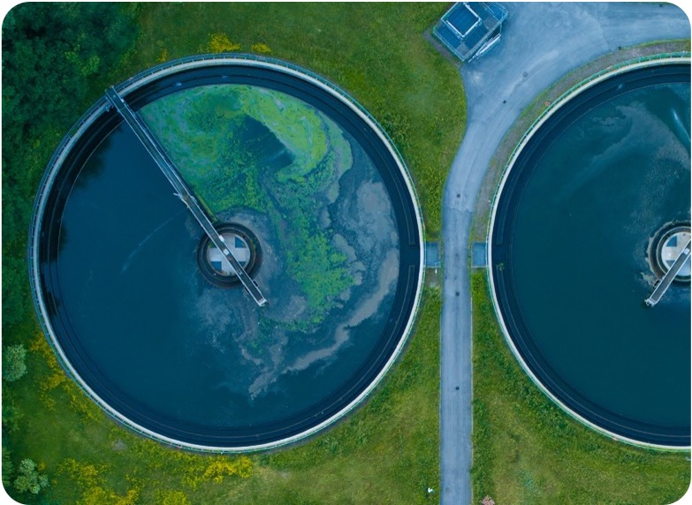
Introduction to SDGs and NDCs
UPM Umwelt-Projekt-Management GmbH
June 2025

Slide 4

Agenda
The relevance of Sustainable Development Goals (SDGs)
Nationally Determined Contributions (NDCs) and National Adaptation Plans (NAPs)
The interlinkage between SDGs and NDCs
Exercise: Mapping Sanitation and Climate
01
02
03
04
Training of Trainers on Climate-Sanitation Nexus – Introduction to NDCs and SDGs

Slide 5

01
THE RELEVANCE OF SUSTAINABLE DEVELOPMENT GOALS

Slide 6

What are the Sustainable Development Goals (SDGs)?
Training of Trainers on Climate-Sanitation Nexus – Introduction to NDCs and SDGs
6
Notes:
The Sustainable Development Goals (SDGs), also known as the Global Goals, were adopted by the United Nations in 2015 as a universal call to action under the resolution “Transforming our world: the 2030 Agenda for Sustainable Development” to end poverty, protect the planet, and ensure that by 2030 all people enjoy peace and prosperity.
With 17 comprehensive and holistic sustainable development objectives and 169 associated targets at its core, the 2030 Agenda builds upon and improves the preceding eight Millennium Development Goals (MDGs) signed in 2000, which primarily focused on social and economic development.

Slide 7


SDGs at the center of the Climate-Sanitation Nexus
Climate-SMART sanitation
SDG 6.2
Access to adequate and equitable sanitation and hygiene for all and end open defecation.
Take urgent action to
combat climate change and its impacts.
Training of Trainers on Climate-Sanitation Nexus – Introduction to NDCs and SDGs
7

Slide 8

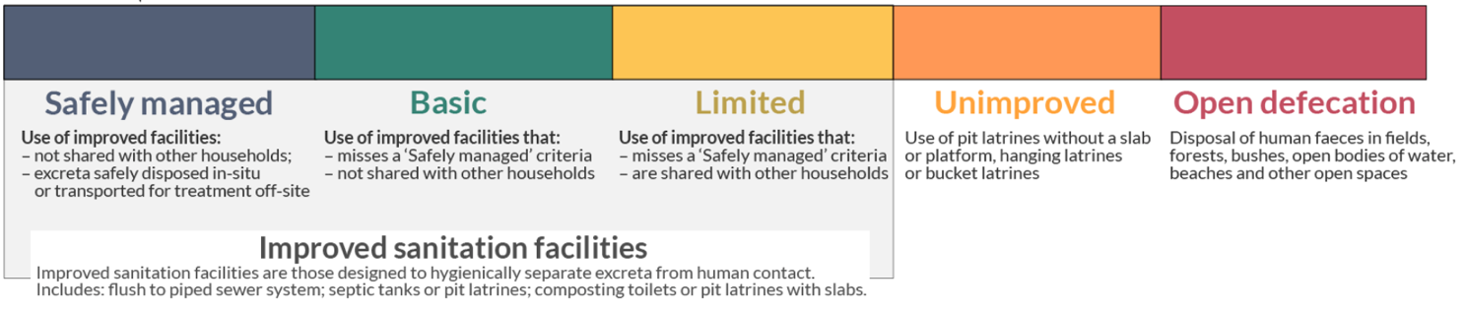
SDG 6: Clean Water and Sanitation
SDG 6 includes targets for water and sanitation.
It is especially targets 6.2 and 6.3 that focus on sanitation.
SDG 6.2 focuses on ending open defecation and aiming for safely managed sanitation.
There is no climate aspect included, but the focus is safety.
If climate was the focus, open defecation could be considered due to its low GHG emissions.
The focus on safety can result in increase of GHG emissions.
Training of Trainers on Climate-Sanitation Nexus – Introduction to NDCs and SDGs
8

Slide 9

SDG 13: Climate Action
SDG 13 calls for urgent action to combat climate change and its impacts across all sectors – including sanitation.
All targets of SDG 13 are equally of interest for the Climate-Sanitation Nexus.
Training of Trainers on Climate-Sanitation Nexus – Introduction to NDCs and SDGs
9

Slide 10
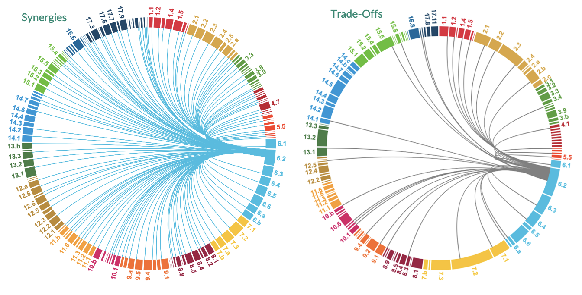
SDG interlinkages: synergies and trade-offs
At the example of SDG 6.2
Training of Trainers on Climate-Sanitation Nexus – Introduction to NDCs and SDGs
10

Slide 11
Climate-SMART sanitation benefits all 17 SDGs
SDG | Clear Direction Impact of Sustainable Sanitation-Related Climate Actions (Selected Goal-Based Impacts)
1 | Improved sanitation and climate-SMART infrastructure reduces poverty by protecting vulnerable communities from health and economic shocks of climate-related disasters.
2 | Climate-SMART sanitation reduces contamination of water sources, ensuring safer irrigation for crops and livestock supporting food production.
3 | Improved sanitation reduces waterborne diseases and health risks, especially as climate change increases the frequency of floods and droughts that can spread contaminants.
4 | Climate-SMART sanitation in schools ensures attendance, particularly for girls, and support a healthy learning environment.
5 | Safe and accessible sanitation facilities empower women and girls, supporting their health, education and participation.
6 | Integrating climate adaptation and mitigation into sanitation systems strengthens the resilience and sustainability of water and sanitation services, while protecting water quality and reducing environmental risks.
7 | Promoting renewable energy use in sanitation reduces emissions, improves energy access and makes sanitation systems more sustainable and particularly valuable in rural or remote regions.
8 | Health, resilient populations and infrastructure support productivity and economic stability.
9 | Implementing climate-SMART sanitation systems and technologies aligns with the sustainable infrastructure, technological advancement and increased resource efficiency.
10 | Prioritizing vulnerable populations in sanitation-related climate strategies helps close gaps in access and outcomes.
11 | Climate-SMART sanitation infrastructure enhances urban resilience and livability, reducing risks from flooding, droughts or other hazards.
12 | Climate-SMART sanitation systems can convert human waste into valuable products promoting circular and sustainable resource management.
13 | Climate-SMART sanitation systems and infrastructure contribute to mitigation, adaptation and resilience to climate change.
14 | Climate-SMART, low-emission sanitation protects ocean health by reducing pollution and safeguarding marine biodiversity, particularly from land-based activities like sanitation.
15 | Climate-SMART sanitation reduces the risk of contamination of soil and terrestrial ecosystems. It protects and restores ecosystems and biodiversity.
16 | Good governance in integrating sanitation-related climate policies fosters transparency, cooperation and effective institutions.
17 | Addressing sanitation and climate together encourages cross-sector and international collaboration.
11

Slide 12
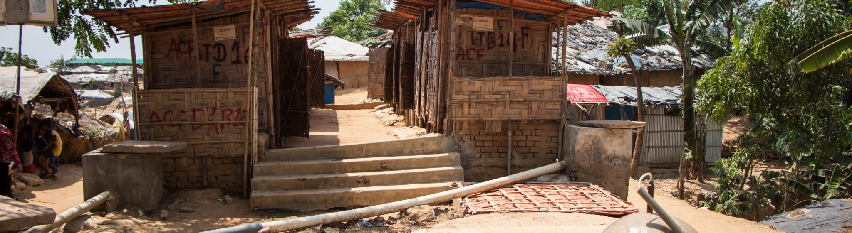
02
Nationally Determined Contributions and National Adaptation Plans

Slide 13
Nationally Determined Contributions (NDCs)
The Paris Agreement, Article 4, paragraph 2 requires each Party to prepare, communicate and maintain successive NDCs that it intends to achieve. These national climate plans can function as climate change mitigation and adaptation plans as well as national investment plans and national development plans.
Unconditional targets: Targets that are implemented using a country’s own resources and typically represent a baseline commitment. Unconditional targets often align with existing national development plans or legislation.
Conditional targets: Targets that require financial aid, technology transfer or capacity-building assistance from other countries or organizations.
NDCs are the heart of the Paris Agreement.
NDCs are submitted every five years to the United Nations Framework Convention on Climate Change (UNFCCC) secretariat.
As of 24 May 2025, 22 countries have submitted their NDC 3.0. In Africa, this includes Zimbabwe, Zambia, and Kenya.
Training of Trainers on Climate-Sanitation Nexus – Introduction to NDCs and SDGs
13

Slide 14
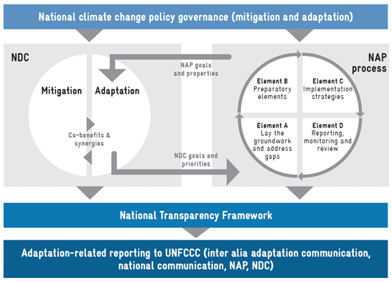
National Adaption Plans (NAP)
The national adaptation plan (NAP) process can help to identify country’s NDC adaptation goals and translate them into action.
Element A – Laying the groundwork and addressing gaps: Initiation of the NAP process by collecting and assessing existing information on climate impacts and vulnerability. Identification of gaps and capacity needs. Evaluation of development priorities and climate risks.
Element B – Preparatory elements: Analysis of current and future climate scenarios. Assessment of vulnerabilities and identification of adaptation options at all relevant levels.
Element C – Implementation strategies:
Element D – Reporting, monitoring and review: Tracking and assessment of progress to update the NAP as needed and incorporate lessons learned to continuously improve adaptation efforts.
In Africa, as of March 2025, 22 out of 54 countries have submitted their NAPs. An additional 25 countries are in the process of formulating their plans, while 3 countries have drafts currently under review. Only Botswana, Angola, Djibouti and Libya have not initiated the implementation yet. (Source: NAP)
Visualization of the Interlinkage between NDCs and NAPs (Source: AC)
Training of Trainers on Climate-Sanitation Nexus – Introduction to NDCs and SDGs
14

Slide 15
Sanitation-Related Climate Action in NDCs and NAPs
WASH measures are often insufficiently integrated.
Common gaps include the absence of clear financing strategies, limited cross-sectoral coordination, and a lack of specific indicators to track progress.
The sanitation sector’s ability to contribute to global emission reduction goals remains overlooked at a policy level.
Training of Trainers on Climate-Sanitation Nexus – Introduction to NDCs and SDGs
15

Slide 16
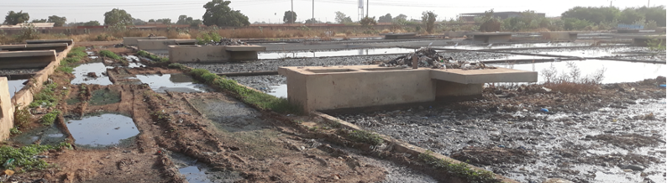
03
The interlinkage between SDGs and NDCs

Slide 17
Case Study: Uganda’s NDC
Uganda submitted its updated NDC in 2022 and adopted its third National Action Plan (NAP) in 2021 for the period 2021-2025.
It sets a positive example for NDCs including action frameworks with indicators, baselines and targets. It further includes sanitation-related climate mitigation as well as adaptation actions for target sectors and locations, as well as the use of specific technologies.
(P29- training manual / P31 manuel de formation)
Training of Trainers on Climate-Sanitation Nexus – Introduction to NDCs and SDGs
17

Slide 18

Q&A

Slide 19
04
EXERCISE: MAPPING SANITATION AND CLIMATE

Slide 20
Mapping Sanitation and Climate: How SDG 6.2 (sanitation) is addressed in your country’s NDC
Pair/Group up and select a country.
Answer the questions on your handout regarding sanitation and NDC in the selected country.
Prepare an overview for the country.
You have 30 minutes to prepare and 1 min to present to the group
Any questions?
Training of Trainers on Climate-Sanitation Nexus – Introduction to NDCs and SDGs
20

Slide 21




19th Floor Jeongdong Bldg. 21-15,
Jeongdong-gil, Jung-gu, Seoul,
Republic of Korea 04518
www.gggi.org
@gggi_hq
@GGGIHQ
@GGGIHQ
@gggi_hq
@GGGIMedia

