Slide 1


Carbon Markets for Sanitation
Introduction of carbon credit projects and carbon markets
UPM Umwelt-Projekt-Management GmbH
June 2025

Slide 2
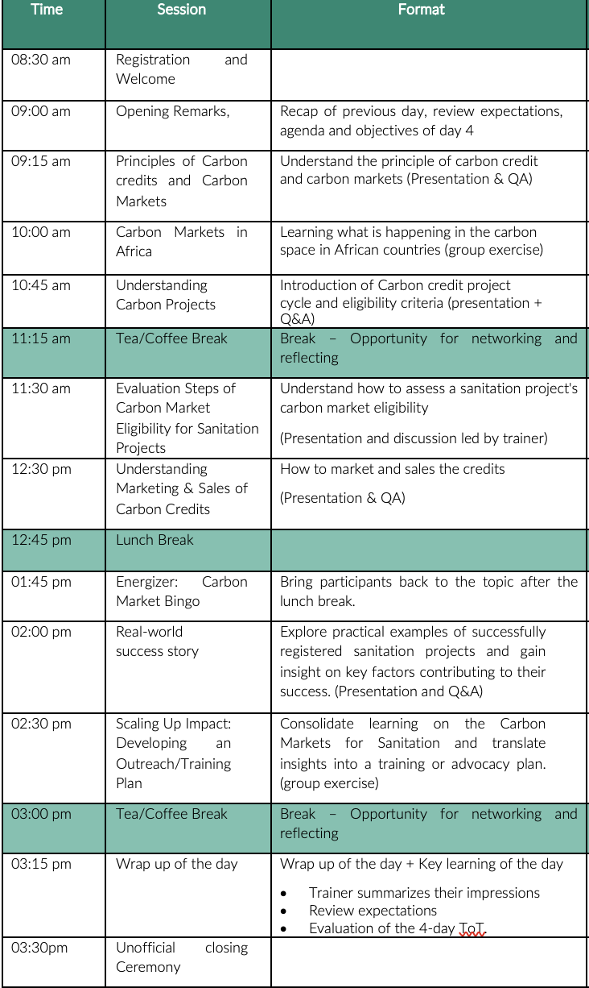
AGENDA
Training of Trainers on Climate-Sanitation Nexus – Climate-Sanitation Nexus
2

Slide 3
RECAP DAY 3
Training of Trainers on Climate-Sanitation Nexus – Climate-Sanitation Nexus
3
Notes:
What were your key insight or takeaway from yesterday?
What did you find most interesting or surprising?
How has your understanding of the topic evolved?
What would you like to explore further?
What part of the session was most valuable or engaging for you?
Is there something you would do differently in your work based on yesterday’s discussion?
What questions do you still have moving forward?

Slide 4


Agenda
What are carbon credit projects and credits?
Basics on Carbon Markets
What is the Carbon Credit Project Cycle?
How to Assess a Sanitation Project’s Carbon Market Eligibility?
Marketing and Credit Sales
01
02
03
04
05
Training of Trainers on Climate-Sanitation Nexus – Carbon Market for Sanitation

Slide 5
A ton is a ton.
What is the intended meaning of this statement?
One ton of CO₂ (or CO₂-equivalent)
reduced, avoided or removed from the atmosphere
anywhere in the world
has the same climate impact,
as long as it’s real, measurable, and verifiable.
5

Slide 6

01
WHAT ARE CARBON CREDIT PROJECTS AND CREDITS?

Slide 7
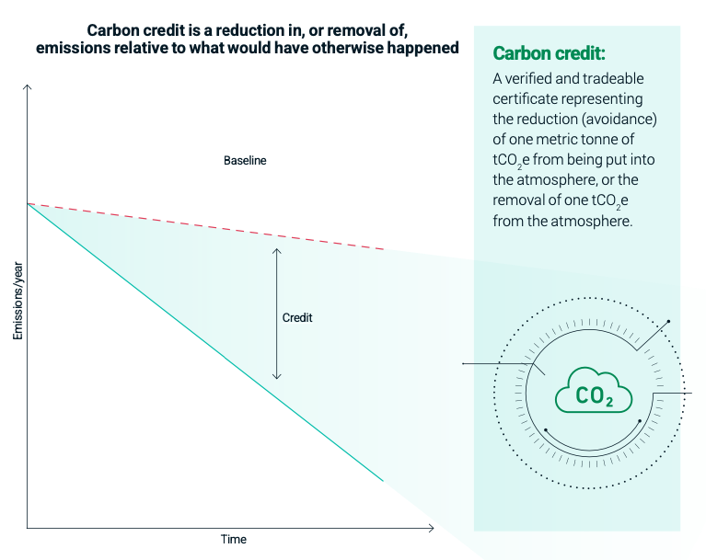
Carbon Credits
Carbon credit is a verified and tradeable certificate representing the reduction, avoidance or removal of one metric ton of CO₂e from being put into atmosphere, respectively the removal of one ton of CO₂e from the atmosphere, while he reductions in emissions would not have occurred without the incentive created by credit revenues.
Additionality: the reductions in emissions would not have occurred without the incentive created by credit revenues.
Quantification: The difference between the reductions in emissions the credit represents, and the baseline needs to be quantified accurately
Permanence: The emissions reduced or removed must not later re-enter the atmosphere
Social and environmental responsibility: The credit project needs to be independently validated
Understand Carbon Markets;_MSCI Guide
Training of Trainers on Climate-Sanitation Nexus – Carbon Market for Sanitation
7

Slide 8
CO₂ Equivalent
CO₂eq is a metric measure used to compare the emissions from various GHG based on their global-warming potential (GWP). By converting amounts of other gases to the equivalent amount of carbon dioxide with the same GWP, evaluation, reporting and offsetting emissions across projects and sectors is made possible:
$$\left(Million Metric Tons of CO_{2}eq \right)=\left(Million Metric Tons of a Gas\right)∗\left(GWP of the Gas\right)$$
Greenhouse Gas | GWP values (IPCC 6th Assessment Report (AR6))
 | 20-year time horizon | 100-year time horizon
Methane (CH₄) | GWP-20: 79.7 ± 25.8 (non-fossil) | GWP-100: 27 ± 11
Nitrous Oxide (N₂O) | GWP-20: 273 ± 118 | GWP-100: 273 ± 130
Carbon Dioxide (CO²) | GWP: 1 | GWP: 1
GWP values of main Greenhouse Gases (IPCC AR6)
Training of Trainers on Climate-Sanitation Nexus – Carbon Market for Sanitation
8

Slide 9
Type of carbon credits
Training of Trainers on Climate-Sanitation Nexus – Carbon Market for Sanitation
9

Slide 10
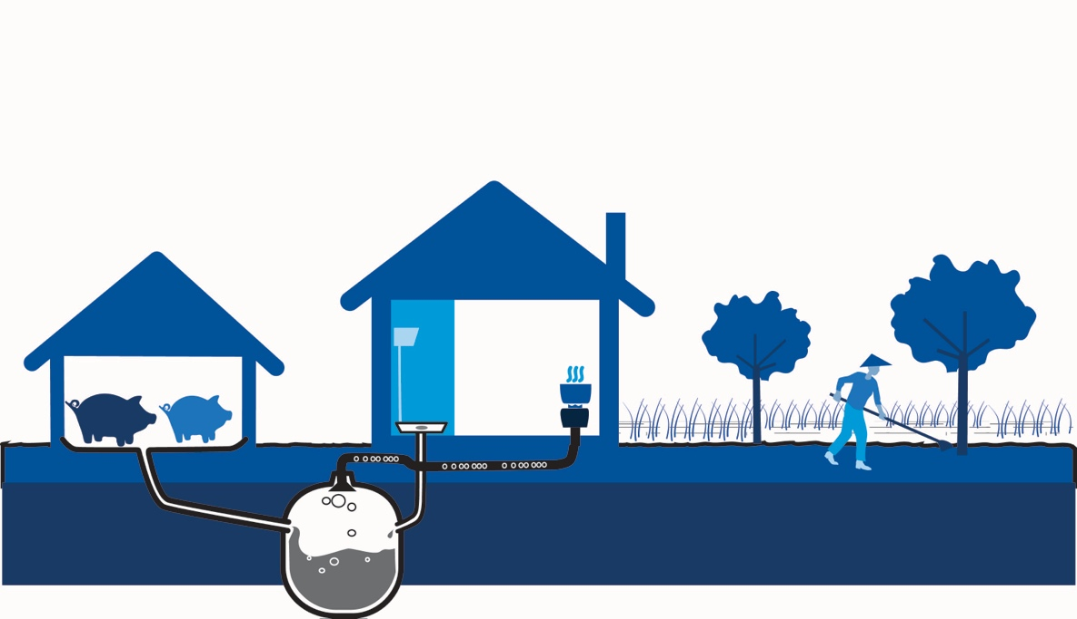
Carbon Credit Projects
X
X
Avergae emission reduction per household and year: ca. 2 tCO₂e
Methan
CH₄
Carbondioxid
CO₂
Carbon credit projects are third party validated and verified activities of environmental conservation, energy efficiency or renewable energy which reduce, avoid, or remove greenhouse gas (GHG) emissions from the atmosphere and contribute to the mitigation of climate change.
Sanitation carbon credit projects focus on emission reduction by actively managing human waste to prevent mainly methane and nitrous oxide emissions that might otherwise result from e.g. unmanaged or outdated anaerobic decomposition in septic tanks or untreated wastewater.
Manure
Biogas
Organic fertilizer
Training of Trainers on Climate-Sanitation Nexus – Carbon Market for Sanitation
10

Slide 11
Benefits of Carbon Credits
Carbon credits enable companies and countries to finance emission reductions where they can be achieved most efficiently and cost-effectively.
For companies, carbon credits provide an opportunity to offset unavoidable emissions and thus achieve ambitious climate targets such as net zero.
Carbon credits contribute to global climate finance by channeling funds to projects in developing countries.
Carbon credits can provide a reliable and performance-based financing mechanism that supports the operational sustainability of climate projects throughout the crediting period.
Training of Trainers on Climate-Sanitation Nexus – Carbon Market for Sanitation
11

Slide 12

02
BASICS ON CARBON MARKETS

Slide 13

Carbon Market Evolution
Overview of the evolution of carbon markets from the Kyoto Protocol to Paris Agreement Article 6
The Kyoto Protocol
The Paris Agreement
Article 6 of the Paris Agreement
Article 6.2 – Basis for country-to-country emissions trading
Article 6.4 – International mechanism for trading of carbon credits by countries or companies
Corresponding Adjustments (CA)
A legally binding international treaty adopted on the 11th of December 1997 during COP3 in Kyoto which entered into force on the 16th of February 2005.
Aimed at tackling climate change through the reduction of 6 greenhouse gas (GHG) emissions.
Reduction obligations only for industrialized countries
Market-based mechanism:
International Emissions Trading
The Clean Development Mechanism (CDM)
Joint Implementation (JI)
A legally binding international treaty on climate change adopted on the 12th of December 2015 by 196 Parties at the UN COP21 in Paris, and entered into force on the 4th of November 2016.
The Paris Agreement works on a five-year cycle of increasingly ambitious climate action with the obligation that committed countries submit their national climate action plans, known as Nationally Determined Contributions (NDCs), with each successive NDC required to be more ambitious than the previous version.
The agreement reaffirms that developed nations should take the lead in providing financial assistance to less endowed and more vulnerable nations, whilst also encouraging voluntary contributions by other committed Parties.
Market-based mechanism: Paris Agreement Article 6
Training of Trainers on Climate-Sanitation Nexus – Carbon Market for Sanitation
13

Slide 14
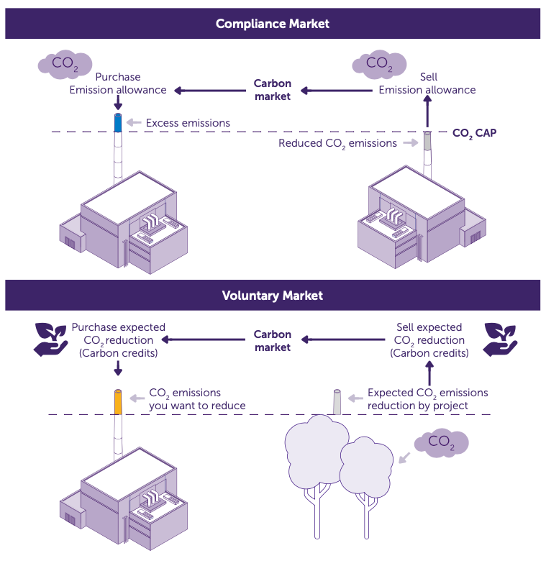
Carbon Markets
Understanding the different carbon markets and their implications
Training of Trainers on Climate-Sanitation Nexus – Carbon Market for Sanitation
14

Slide 15
Carbon Credit Frameworks and Standards
A framework is the overall system or set of rules that defines how a carbon market operates. It establishes the structure, processes and requirements for participation, trading and compliance.
A standard provides the specific set of criteria, methodologies and requirements that projects or credits must meet to be recognized as valid within a given framework.
Clean Development Mechanism (CDM) | Article 6 Mechanism | Gold Standard for Global Goals (GS4GG) | VERRA Verified Carbon Standard (VCS) | Global Carbon Council (GCC) | Puro.earth
Training of Trainers on Climate-Sanitation Nexus – Carbon Market for Sanitation
15

Slide 16
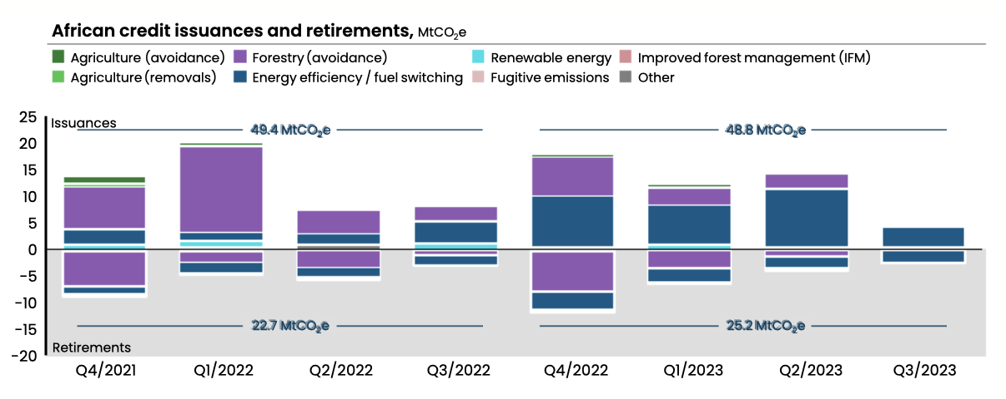
Carbon Markets in Africa
Insights on the current carbon market landscape
African carbon markets currently only compromise 16% of the global market indicating a potential for growth.
Africa’s carbon markets issued approximately 50 MtCO2e of credits and retired an estimated 25 MtCO2e in 2022 and 2023 (see figure beside).
The total technical potential for VCM is estimated to be up to 2400 MtCO2e by 2030.
African Credit Issuances and Retirements
Training of Trainers on Climate-Sanitation Nexus – Carbon Market for Sanitation
16

Slide 17
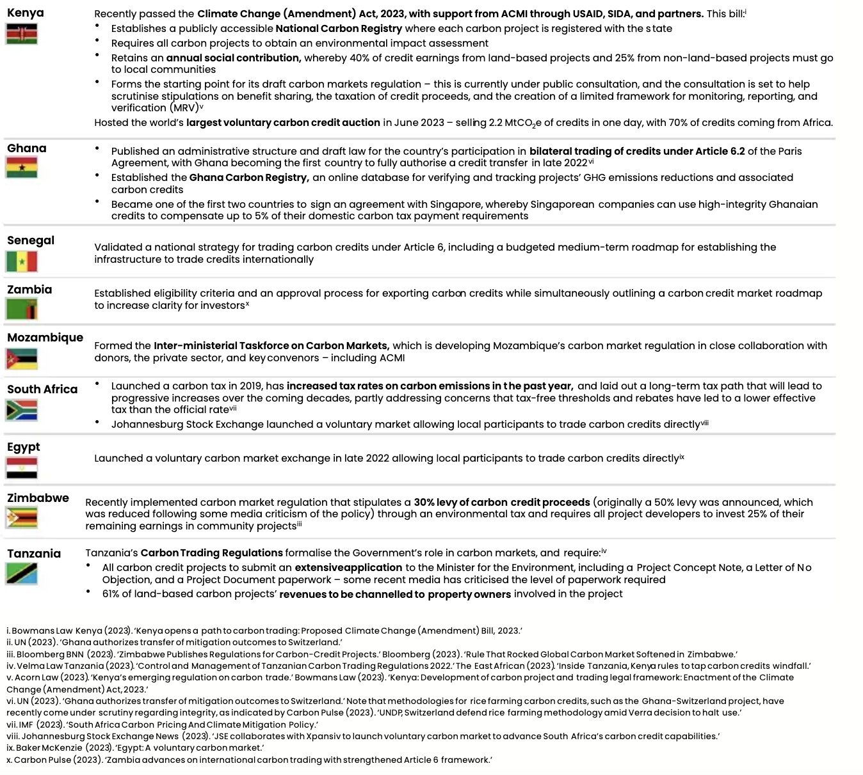
Africa needs to establish favorable government regulation, increase trading under Paris Agreement Article 6 and increase climate action among businesses.
17

Slide 18
Challenges and Trends
Current issues and emerging market dynamics
Global level
Africa
One of the main challenges is the ongoing transition from the Clean Development Mechanism under the Kyoto Protocol to the Article 6.4 mechanism of the Paris Agreement.
Corresponding adjustments (CA) – the process by which countries adjust their emissions inventories to avoid double counting of internationally transferred mitigation outcomes (ITMOs) – are becoming a key requirement for participation in Article 6 markets.
New standards and rating systems are emerging to ensure the environmental integrity and quality of carbon credits.
The growing influence of independent ratings agencies and the adoption of best-practice guidelines. Particularly noteworthy are the Core Carbon Principles (CCPs), which serve as indicators of high-integrity standards and carbon credits.
The development of carbon markets in Africa is hindered by several structural and operational challenges.
Lack of coherent and harmonized regulatory structures across the continent.
The integrity of carbon credit projects.
Financial constraints: e.g. the funding required for the adaptation and mitigation projects included in the NDCs is often lacking.
A growing concern—both in Africa and globally—is the commodification of natural resources through carbon credit schemes.
Training of Trainers on Climate-Sanitation Nexus – Carbon Market for Sanitation
18

Slide 19

Q&A

