Slide 1
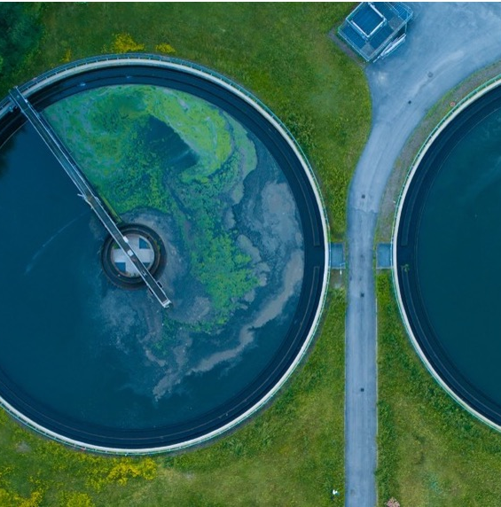

Carbon Markets for Sanitation 2/3
Introduction of carbon credit projects and carbon market, and eligibility of a sanitation project for carbon market
UPM Umwelt-Projekt-Management GmbH
June 2025

Slide 2

Group Exercise:
Country Paris Agreement Carbon Market Readiness

Slide 3

Introduction
Objectives: understand the readiness and possibility to develop a carbon credit project in a specific country
Instructions:
Each table select a country
Prepare an initial country profile based on the lead questions (15 min)
Presentation and discussion (5 min)
By table
Training of Trainers on Climate-Sanitation Nexus – Carbon Market for Sanitation
3

Slide 4
Lead Questions
Has the country ratified the Paris Agreement? If so, when?
Which specific laws or regulations have been enacted to implement carbon credit projects (voluntarily and/or compliance)? Has the country adopted a carbon pricing mechanism (e.g. emissions trading system, carbon tax) linked to its Paris goals?
Looking at past experiences under Kyoto Protocol: Are there any carbon credit projects in the country registered? Under which standard?
Training of Trainers on Climate-Sanitation Nexus – Carbon Market for Sanitation
4

Slide 5




19th Floor Jeongdong Bldg. 21-15,
Jeongdong-gil, Jung-gu, Seoul,
Republic of Korea 04518
www.gggi.org
@gggi_hq
@GGGIHQ
@GGGIHQ
@gggi_hq
@GGGIMedia

