Slide 1
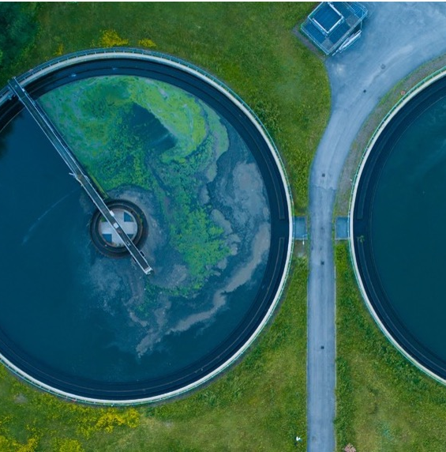

Carbon Markets for Sanitation
Introduction of carbon credit projects and carbon market, and eligibility of a sanitation project for carbon market
UPM Umwelt-Projekt-Management GmbH
June 2025

Slide 2

03
WHAT IS THE CARBON CREDIT PROJECT CYCLE?

Slide 3

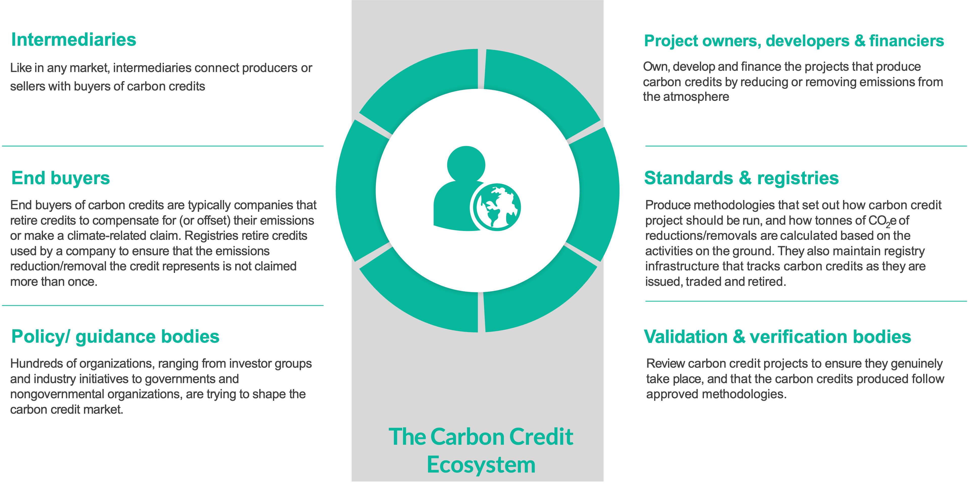
Main stakeholders in the Carbon Market
Training of Trainers on Climate-Sanitation Nexus – Carbon Market for Sanitation
3

Slide 4
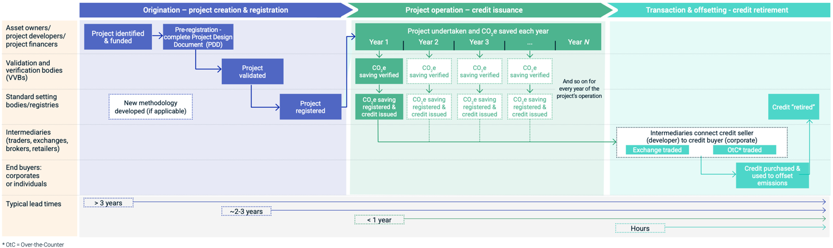
Creating a carbon credit comprises three stages:
Stage 1: The creation and registration of a carbon crediting project;
Stage 2: the operation of that project that leads to the issuance of credits, which can then be sold; and
Stage 3: the retirement of the credit by a buyer who uses the credit to compensate for its emissions or to fulfil legal requirements.
Project Cycle
Visualization of a Typical Carbon Credit Project Cycle (Source: MSCI)
Training of Trainers on Climate-Sanitation Nexus – Carbon Market for Sanitation
4

Slide 5

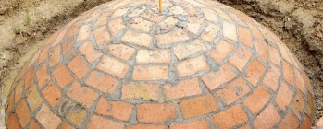
Project Cycle: Origination
From project dentification to project operation:
Possible initial situations:
The long-term financing of a project is uncertain.
Targets in the NDC are already conditionally disclosed.
Experience shows that a project is generally eligible to generate carbon credits.
A climate protection project is being sought specifically for an investor.
Challenges:
Stakeholder identification
Official support
Diverse interests of different stakeholders
First revenue from the project often only after 2 or 3 years, after initial steps
Extensive expertise required up to registration
Extensive standard requirements (eligibility criteria)
Training of Trainers on Climate-Sanitation Nexus – Carbon Market for Sanitation
5

Slide 6
Complexity of project development reduced to 6 key points
Project Description
Description of project location, climate condition, technology applied, emission reduction source, stakeholder structure, etc.
Additionality
The climate project would not occur without carbon credit funding and thus delivers emissions reductions beyond business as usual.
Baseline Scenario
The baseline scenario must clearly describe the emissions that would occur without the project to accurately measure the project's additional emission reductions.
Methodology
Early Consideration
Project Idea Note
The methodology in a carbon project is a technical document that defines the rules and procedures for quantifying greenhouse gas reductions, including setting project boundaries, establishing baselines, assessing additionality, and specifying monitoring and verification requirements.
Early consideration requires that the project developer must demonstrate that the intention to seek carbon credits was taken into account before project implementation began.
A Project Idea Note (PIN) is the initial summary of all steps above and finally brief document outlining the key features, objectives, and expected impacts of a proposed climate project, used for initial stakeholder or investor engagement.
Training of Trainers on Climate-Sanitation Nexus – Carbon Market for Sanitation
6

Slide 7
Methodology selection
Based on the requirements and methodological approach outlined in the Methodology, the core of a carbon credit project is drafted:
Project Design Document (PDD)
The use of an incorrect or unsuitable methodology will sooner or later lead to the failure of the project.
Selection of sanitation-related methodologies:
ACM0014 - Treatment of Wastewater
AMS III.H - Methane recovery in wastewater treatment
AMS I.D - Grid connected renewable electricity (→ Biogas use)
AMS I.C - Thermal energy production with or without electricity (→ Biogas use)
AMS I.F - Renewable electricity generation for captive use and mini-grid (→ Biogas use)
Application of sanitation-related methodologies:
AMS III.H and ACM0014 are accepted under CDM/GS/VCS/GCC.
243 project cases (AMS III.H) are registered under CDM;
27 project cases (ACM0014) are registered under CDM;
All cases are industrial wastewater/sludge treatment in the sectors of alcohol, Palm Oil Mill, Tapioca starch, Sugar, Paper, etc;
No domestic wastewater treatment methodology so far
Under GS more than 50 cases use biogas related methodology
Training of Trainers on Climate-Sanitation Nexus – Carbon Market for Sanitation
7

Slide 8
Project Cycle:
Project Operation – Credit Issuance
From start of operation to credit issuance (verification):
Challenges:
Long waiting period before first monitoring cycle is completed and issuance can occur
Complex monitoring requirements with high data accuracy and consistency needed
High costs and administrative effort for third-party verification (DOE)
Risk of lower-than-expected emission reductions leading to fewer credits
Extensive documentation requirements, including sustainable development reporting
Need to update methodology or monitoring plans if project conditions change
Lack of revenue during pre-issuance phase creates financing pressure
Risk of social or political disruption at the project site
Uncertainty about market access and credit price after issuance
Intensive oversight by standard can lead to delays during review and approval
8

Slide 9
Project Cycle:
Transaction & Offsetting – Credit Retirement
Discussed in the final chapter of Module 4
9

Slide 10

Q&A

Slide 11
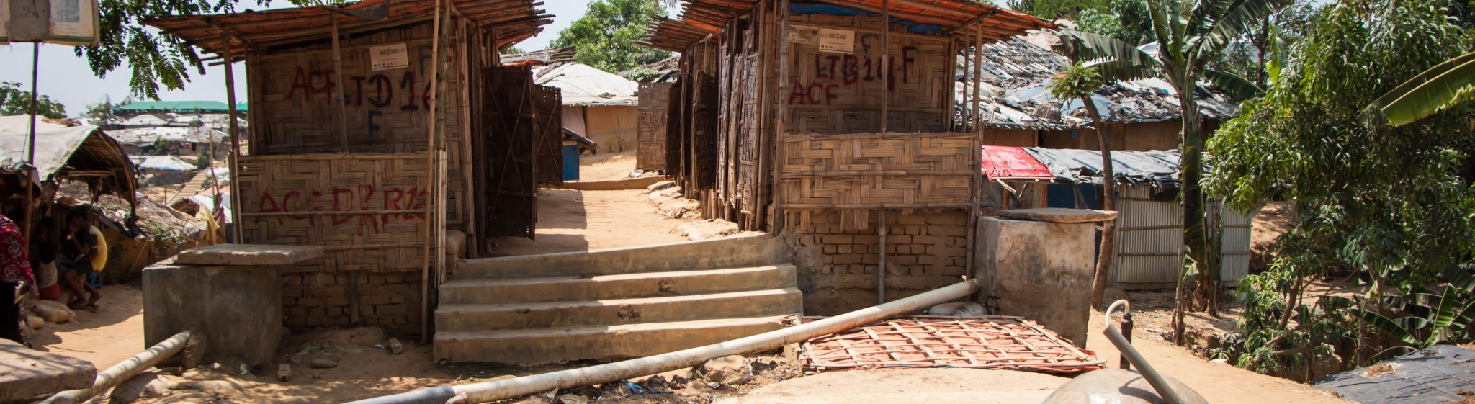
04
HOW TO ASSESS A SANITATION PROJECT'S CARBON MARKET ELIGIBILITY?

Slide 12
Eligibility process
Learning about the detailed steps necessary prior possible project registration.
Project eligibility check
Involvement of national and local authorities
Based on the project description, the additionality justification, the baseline description, a credible early consideration statement, and the methodology selection, an initial projection of the potential emission reductions can be made.
Involving official authorities early in the development of a climate protection project under certification standards such as Gold Standard or Verra is crucial for ensuring regulatory alignment, securing political acceptance, and facilitating long-term project sustainability. National governments, particularly through their Designated National Authorities (DNAs), play a central role in approving and overseeing climate mitigation activities within their jurisdiction.
Project idea note (PIN)
A PIN is a concise, early-stage document that outlines the basic concept of a climate protection project. It is used to determine whether a proposed project has the potential to qualify for carbon crediting and climate finance.
Risk assessment
Feasibility Study
Climate protection projects are exposed to a variety of risks that can affect their environmental integrity, financial viability, and long-term sustainability. Identifying and addressing these risks early in the project cycle is essential to ensure successful implementation and eligibility for carbon crediting.
A feasibility study for a climate mitigation project is a critical step in assessing whether a project idea is technically, economically, environmentally, and socially viable, particularly in the context of carbon market participation.
Training of Trainers on Climate-Sanitation Nexus – Carbon Market for Sanitation
12

Slide 13
Quick assessment, for a wastewater treatment plant (including methane recovery) project - I
Understanding how to work with methodologies (see handout “quick AMS III.H meth. assessment”)
Methodology preselection
Government Approval
Categorize by mitigation activity type
Categorize by applied technology type/measure
Do you fulfil all legal requirements to implement such project in the host Country?
Methodology applicability
Double counting
Does your project meet the methodology category?
- Recovery of biogas resulting from anaerobic decay of organic matter in wastewaters through introduction of an anaerobic treatment system for wastewater and/or sludge treatment with biogas recovery?
Is your project registered under any GHG program (e.g. Gold Standard for Global Goals, Clean Development Mechanism, Verified Carbon Standard, Global Carbon Council, etc)?
Wastewater management baseline
Project start date determination
In the absence of the project activity, does the waste/wastewater management generate methane emissions without recovery and utilization?
Has any construction contract or equipment purchase agreement signed within the last 12 months?
Did the commercial operation start within the last 12 months?
Project location
Is your project located in LDC or non-LDC?
Training of Trainers on Climate-Sanitation Nexus – Carbon Market for Sanitation
13

Slide 14
Quick assessment, for a wastewater treatment plant (including methane recovery) project - II
Understanding how to work with methodologies (see handout “quick AMS III.H meth. assessment”)
Technology employed
Common practice
Does your project adopt domestic or international technology (proof of concept)?
Is the project technology application already widely implemented in the region without carbon finance? Is there any similar projects with the technology operational without carbon support?
Financial viability
Is your project financially attractive without the carbon support, e.g., whether the IRR of the project reaches the benchmark?
ODA funding (Official Development Assistance)
Is there any ODA (Official Development Assistance) funding involved in the project? Please describe.
SDGs contributions
Eligibility evaluation
Does your project create any co-benefits? Could you please list them (rough estimation is enough for now)
The result of the quick check should be an essential part of the PIN.
Training of Trainers on Climate-Sanitation Nexus – Carbon Market for Sanitation
14

Slide 15
Follow-up on quick assessment
The quick assessment should help to
justify the financing of a feasibility study,
reconsider the project setup, or
if necessary, stop the project at this point.
If the result is of the quick assessment is promising
it is recommended to commission a professional feasibility study,
to deal intensively with the project risks, and
to initiate initial discussions with the relevant authorities.
Training of Trainers on Climate-Sanitation Nexus – Carbon Market for Sanitation
15

Slide 16
Q&A

Slide 17




19th Floor Jeongdong Bldg. 21-15,
Jeongdong-gil, Jung-gu, Seoul,
Republic of Korea 04518
www.gggi.org
@gggi_hq
@GGGIHQ
@GGGIHQ
@gggi_hq
@GGGIMedia

