Slide 1
Applicability cases AMS III.H

Slide 2
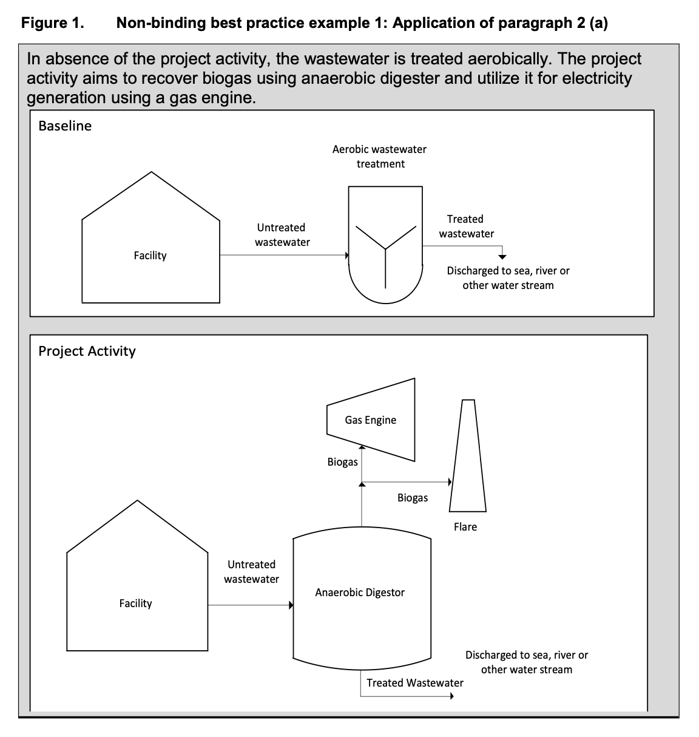
Applicable Case a)
Substitution of aerobic wastewater or sludge treatment systems with anaerobic systems with biogas recovery and combustion;

Slide 3
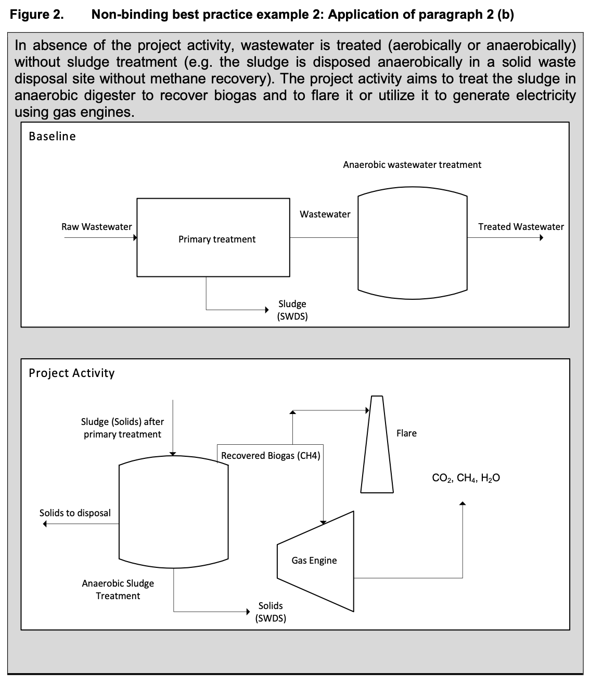
Applicable Case b)
Introduction of anaerobic sludge treatment system with biogas recovery and combustion to a wastewater treatment plant without sludge treatment;

Slide 4
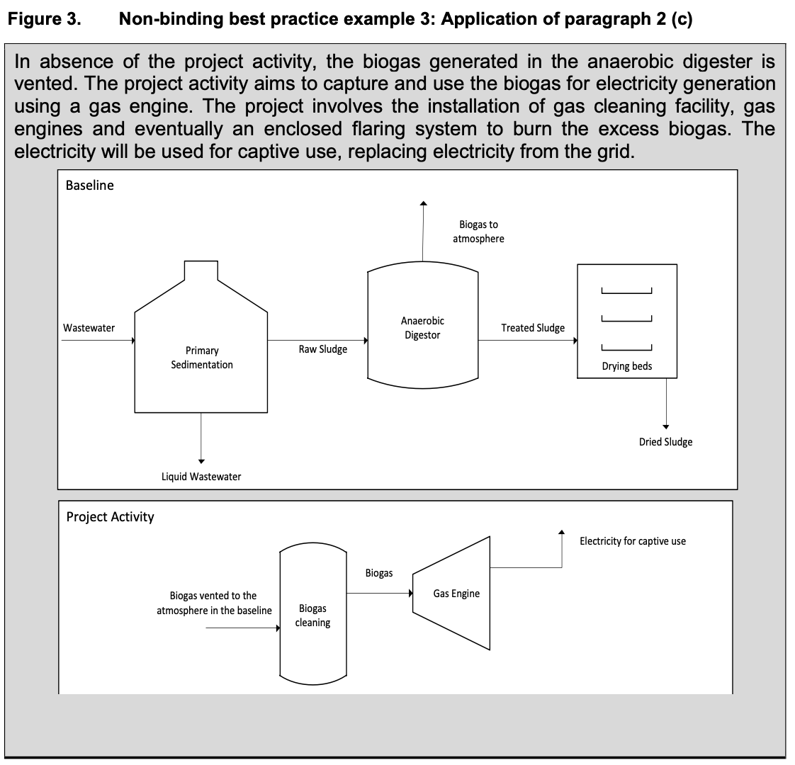
Applicable Case c)
Introduction of biogas recovery and combustion to a sludge treatment system;

Slide 5
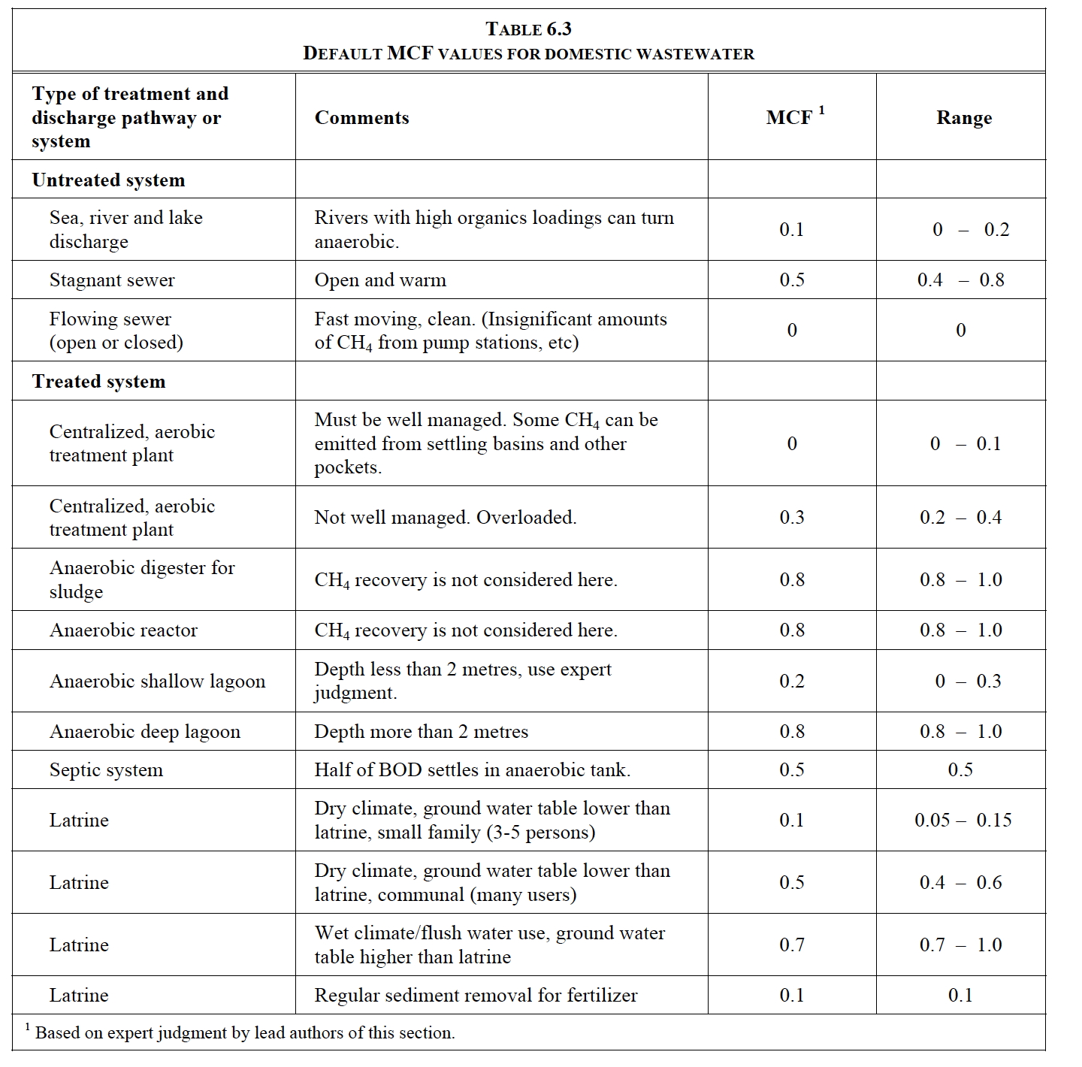
Applicable Case d)
Introduction of biogas recovery and combustion to an anaerobic wastewater treatment system such as anaerobic reactor, lagoon, septic tank or an on-site industrial plant;
other technologies in table 6.3, chapter 6, IPCC2006 are included.

Slide 6
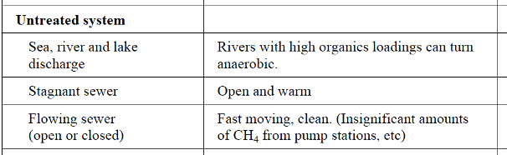
Applicable Case e)
Introduction of anaerobic wastewater treatment with biogas recovery and combustion, with or without anaerobic sludge treatment, to an untreated wastewater stream;
Source: table 6.3, chapter 6, IPCC2006

Slide 7
Applicable Case f)
Introduction of a sequential stage of wastewater treatment with biogas recovery and combustion, with or without sludge treatment, to an anaerobic wastewater treatment system without biogas recovery (e.g. introduction of treatment in an anaerobic reactor with biogas recovery as a sequential treatment step for the wastewater that is presently being treated in an anaerobic lagoon without methane recovery).
Example chart (next slide)

Slide 8
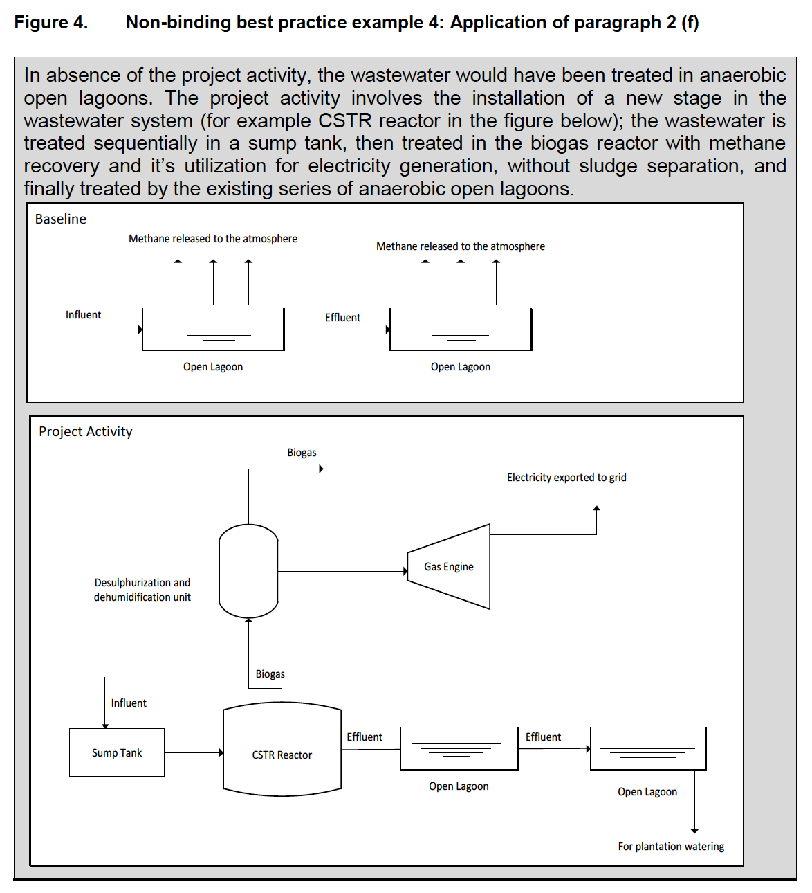
Applicable Case f)

