Slide 1


Carbon Markets for Sanitation
Introduction of carbon credit projects and carbon market, and eligibility of a sanitation project for carbon market
UPM Umwelt-Projekt-Management GmbH
June 2025

Slide 2

ENERGIZER

Slide 3
Energizer
Carbon Market Bingo!
Instructions:
Each group receives a Bingo card filled with basic terms related to the carbon market.
The trainer will read out simple definitions, one at a time.
If you have the term that matches the definition, mark it off on your card.
The first person to complete a full line (horizontal, vertical, or diagonal) shouts “Bingo!”!
Please prepare your cards, our next activity will help consolidate your understanding of carbon market terms
Training of Trainers on Climate-Sanitation Nexus – Climate-SMART Sanitation Assessment
3

Slide 4

05
MARKETING AND CREDITS SALES

Slide 5

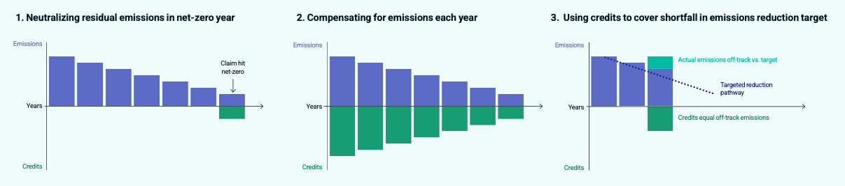
When and how credits are used
Compliance Market: Qualified credits are needed to meet regulatory obligations in case own emission reduction activities are failing the target.
Voluntary Market: The credits are required so that self-imposed targets can be met, with companies usually pursuing one of the following strategies:
Overview of Different voluntary approaches in buying carbon credits
Training of Trainers on Climate-Sanitation Nexus – Carbon Market for Sanitation
5

Slide 6

Role of Marketing
Compliance Market:
Once a company is obliged to offset unmet reduction targets with carbon credits, the only thing that matters in terms of marketing is the visibility of the project on the relevant trading platforms.
Co-benefits play a subordinate role, market forces come into play, and the price is primarily determined by supply and demand.
Under Article 2 PA (bilaterally developed and financed projects), co-benefits play a slightly greater role than for companies.
Voluntary Market:
In the voluntary market, the influence of an extensive marketing campaign on achievable prices is often underestimated.
It is important that the socio-economic and environmental effects of a project are emphasized.
Regular and publicly accessible updates on the project are important.
Social Media are also playing an increasingly important role in this regard.
Training of Trainers on Climate-Sanitation Nexus – Carbon Market for Sanitation
6

Slide 7
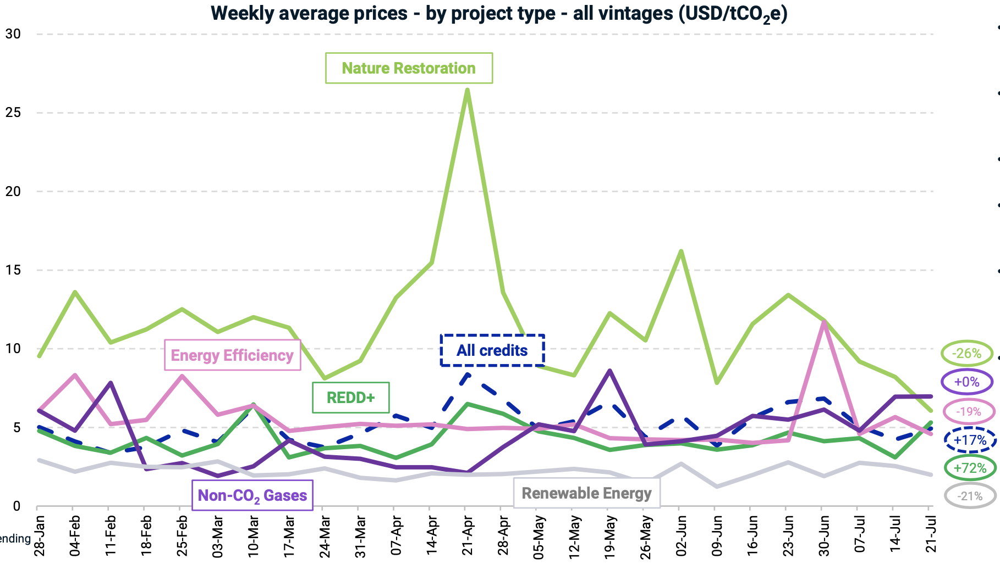
Price of Carbon Credits
Carbon credit prices are dynamic, fluctuating based on a range of variables, from project-specific attributes to broader market dynamics.
In the voluntary carbon market, price transparency is limited, with transaction details often kept private, abstract and anonymous.
Weekly Average Carbon Credit Prices by Project Type at the Voluntary Carbon Market from January to July 2024 (Source: MSCI)
Training of Trainers on Climate-Sanitation Nexus – Carbon Market for Sanitation
7

Slide 8
Price determination 1/2
Compliance Market:
Qualified credits are needed to meet regulatory obligations in case own emission reduction activities are failing the target.
Public trading platforms, exchanges, or the price level of the ETS to be served usually enable transparent pricing.
Voluntary Market:
The credits are required so that self-imposed targets can be met.
Usually significantly higher quality standards for the project required, so that, among other things, reputational risks can be controlled, or the voluntary commitment can be used appropriately for own marketing purposes.
The pricing is generally very non-transparent.
Even though the credits are offered on public platforms, the deals are usually concluded Over The Counter (OTC) and deal agreements are confidential.
Training of Trainers on Climate-Sanitation Nexus – Carbon Market for Sanitation
8

Slide 9
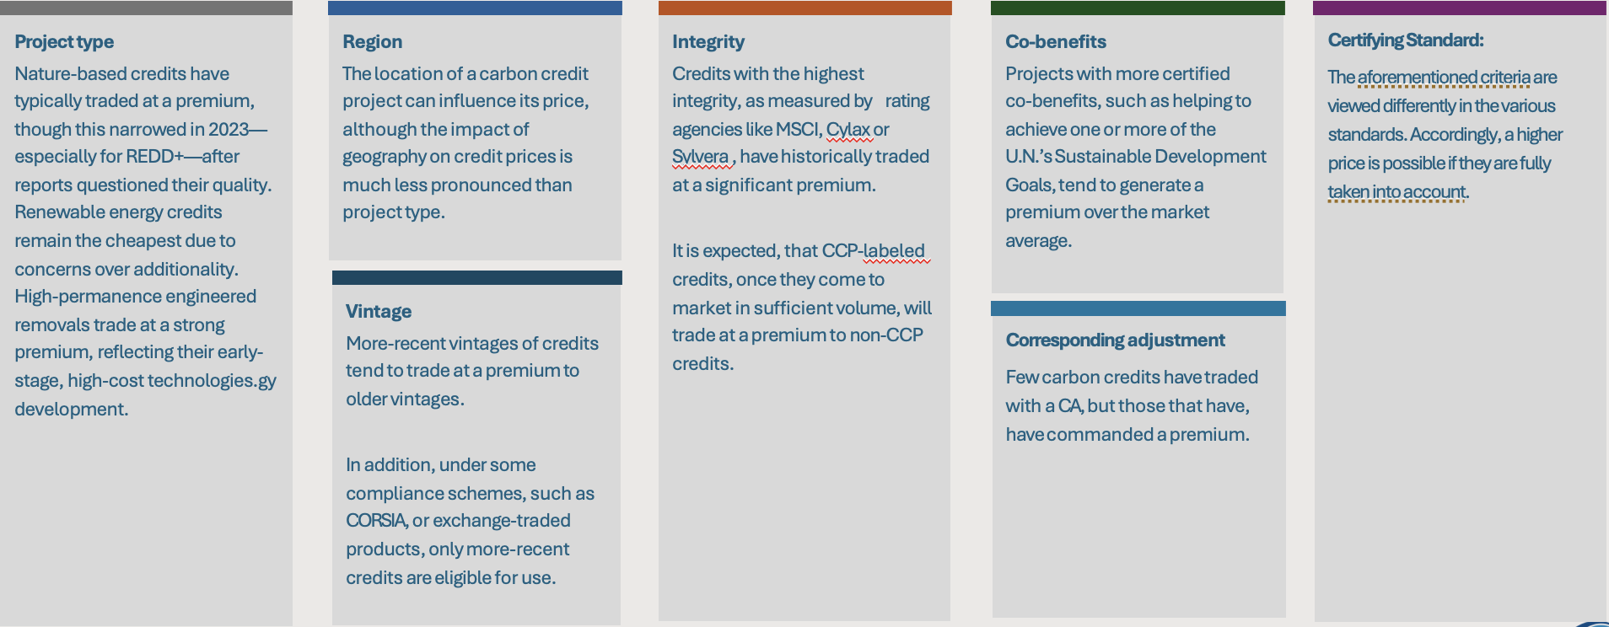
Price determination 2/2
Training of Trainers on Climate-Sanitation Nexus – Carbon Market for Sanitation
9

Slide 10
Sales channels for carbon credits
Sales Channel | Description | Typical Buyer
Bilateral directly between project owner and investors | Buyer contracts directly with project owner. Provides greater transparency and ensures more funds go directly to the project. Wholesale price, generally cheaper than secondary market. | Usually large corporates. Governments.
Commodity Brokers / Traders | Brokers act as intermediaries, sourcing carbon credits and negotiating deals on behalf clients. Personalized service and access to exclusive projects. Wholesale price plus intermediary margin (broker commissions or fees) | All types (corporates, governments, individuals, NGOs, …).
Carbon Market Exchanges | Formal trading platforms such as Xpansiv CBL or AirCarbon Exchange (ACX). Wholesale price plus exchange transaction fee. Suitable for large, standardized transactions and financial players. | Traders, financial institutions, corporates seeking standardized or large-volume credits.
Marketplaces | Wholesale price plus marketplace fees and transaction costs. Online platforms that connect buyers and sellers. Offer a wide range of project types and vintages. Allow for smaller transactions and more project-specific selection. | Small and medium sized enterprises, NGOs, individuals, corporates seeking specific project characteristics or smaller volumes.
Overview of Different Sales Channels for Carbon Credits (Source: Based on Abatable)
Training of Trainers on Climate-Sanitation Nexus – Carbon Market for Sanitation
10

Slide 11

Q&A

Slide 12




19th Floor Jeongdong Bldg. 21-15,
Jeongdong-gil, Jung-gu, Seoul,
Republic of Korea 04518
www.gggi.org
@gggi_hq
@GGGIHQ
@GGGIHQ
@gggi_hq
@GGGIMedia

