Slide 1


Real-world success story
Explore practical examples of successfully registered sanitation projects and gain insight on key factors contributing to their success.
UPM Umwelt-Projekt-Management GmbH
June 2025

Slide 2
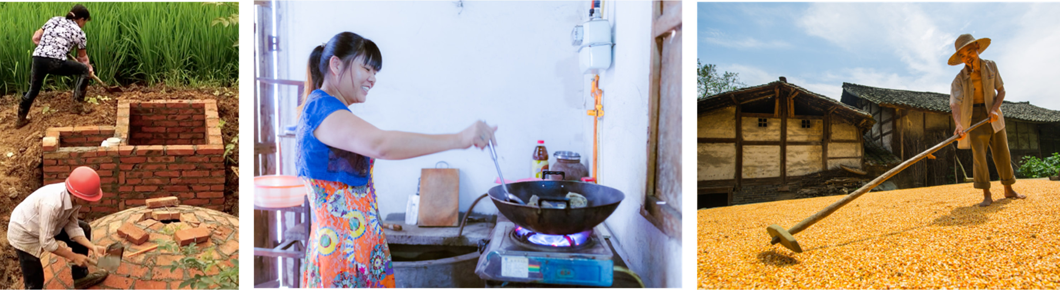
Sichuan Rural Poor-Household Biogas Development Programme

Slide 3

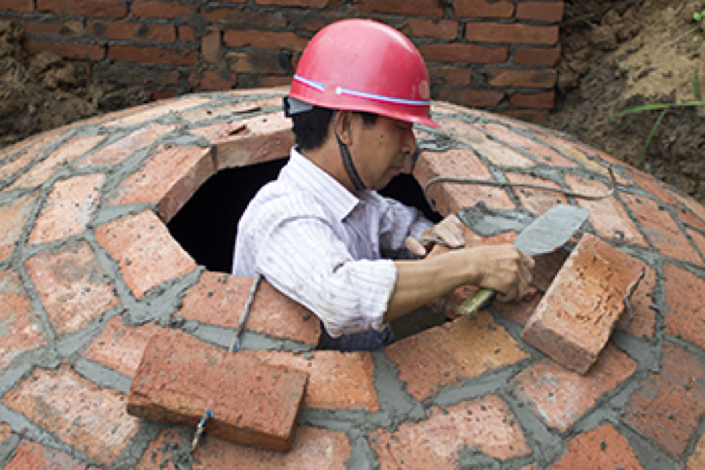
At-a-glance
Sichuan Household Biogas PoA is one of the world‘s most ambitious Gold Standard and CDM climate protection programs
The PoA shall save approx. 20 million tCO2e by providing up to
1 million poor farmer house-holds in Sichuan with climate-friendly biogas digesters and efficient, smoke-free cook stoves.
Key Facts Sichuan Household Biogas PoA
Project ID: CDM PoA 2898, GS 1239
Project type: Household Biogas Programme of Activities
Target number of households: up to 1 million
Target group: only rural households with an annual per capita income prior to inclusion of below EUR 500
Currently included households: nearly 400,000
Location: China, remote areas of Sichuan Province
Local Partners: Chengdu Oasis Science & Technology, Sichuan Rural Energy Office (SREO)
Carbon Standards: CDM and Gold Standard (GS4GG)
Project status: registered and with issuance of GS CERs (up to incl. vintage 2019) and GS VERs (vintage 2020+)
Past issuances: 11, with an aggregated issuance volume of nearly 7.2 million GS CERs and GS VERs
Current annual GHG savings: approx. 725,000 tCO₂e
Training of Trainers on Climate-Sanitation Nexus – Carbon Market for Sanitation
3

Slide 4


Rationale
Why has the household biogas PoA in rural China been developed?
1.
China has become the biggest GHG emitter in the world but will also be one of the worst affected countries by global warming.
4.
Millions of rural households in China, especially those with a below average income, still do neither dispose of modern energy supply nor of functioning waste management systems.
2.
China‘s non-sustainable economic growth is causing extreme environmental damage which endangers health and life of China‘s population.
5.
With its Programmes of Activities (PoAs), the UN Clean Development Mechanism (CDM) has the ideal instrument for large-scale climate action with massive SDG impact and multiple co-benefits for many thousands of most needy and vulnerable households.
3.
There are large disparities between cities and rural areas in China with booming mega cities but also with widespread poverty in remote regions, such as the mountains of Sichuan province.
Training of Trainers on Climate-Sanitation Nexus – Carbon Market for Sanitation
4

Slide 5

How does it work?
Avoids GHG emissions from untreated animal manure, organic waste and from burned coal, and generates climate-friendly, convenient and inexpensive biogas for cooking, lighting or heating.
Complements and improves an existing rural biogas promotion scheme run by the Chinese government and implemented by the Sichuan Rural Energy Office (SREO).
Uses the dense network and qualified experts of the SREO, to distribute, maintain and monitor biogas devices all over Sichuan.
Disposes of a top-tier IT system for PoA management and monitoring.
aims at reimbursing up to 40% of its GS CER sales revenue to participating low-income households and the SREO to help them afford the biogas digesters and cover the costs of the maintenance.
Training of Trainers on Climate-Sanitation Nexus – Carbon Market for Sanitation
5

Slide 6
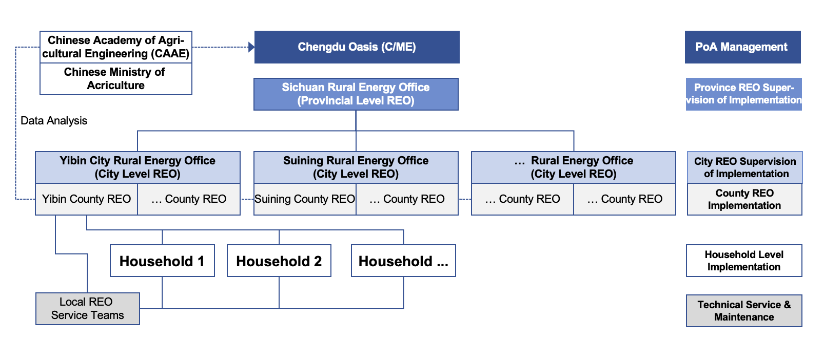
Approach
The PoA‘s unique approach aims at improving an existing national government promotion scheme for household biogas in rural China
Via the established SREO network, the PoA exclusively targets low-income rural house-holds that have not been able to participate in the national scheme due to financial constraints
Training of Trainers on Climate-Sanitation Nexus – Carbon Market for Sanitation
6

Slide 7


Setting up the benchmark
It successfully demonstrates how large amounts of GHG emissions can be avoided in a most effective and cost-efficient way while simultaneously supporting sustainable development.
The first PoA of its kind to apply a new combination of CDM methodologies that are ideally suited for large-scale biogas development programs at household level
One of the first PoAs worldwide to be registered with both the CDM and the Gold Standard, and having issued GS CERs; as per today, the PoA still has the largest aggregated GS CER issuance volume
One of the first participants in the Global Alliance for Clean Cook Stoves and the UNFCCC CDM Sustainable Development Co-Benefits Reporting Initiative
Winner of the 2014 Energy Globe Awards for the best national climate protection project in China
The first Gold Standard PoA ever to have successfully migrated to the new Gold Standard for the Global Goals (GS4GG)
Training of Trainers on Climate-Sanitation Nexus – Carbon Market for Sanitation
7

Slide 8
Co-Benefits
According to scientific CSES research, the project contributes notably to achieving at least 14 out of 17 UN Sustainable Development Goals (UN SDGs) in its Chinese target areas
Training of Trainers on Climate-Sanitation Nexus – Carbon Market for Sanitation
8

Slide 9
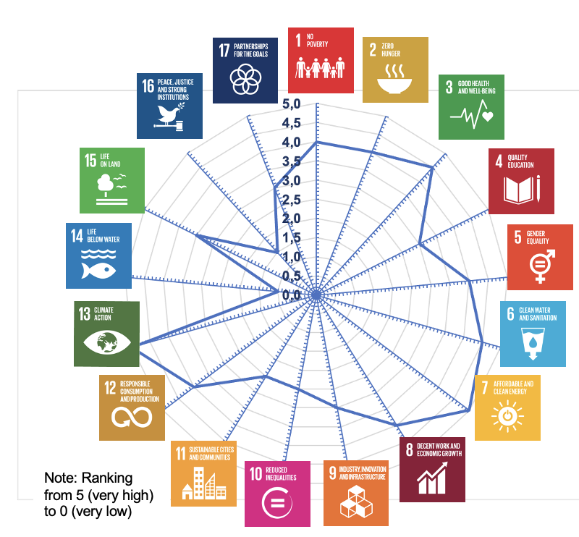
Impacts to UN SDGs
The Sichuan household biogas PoA substantially improves the lives of nearly 1.2 million needy people and helps achieving many UN SDGs
According to the CSES study, the PoA scores particularly high for the following nine UN SDGs:
UN SDG 01 - No Poverty
UN SDG 02 - Zero Hunger
UN SDG 03 - Good Health & Well-Being
UN SDG 05 - Gender Equality
UN SDG 06 - Clean Water & Sanitation
UN SDG 07 - Affordable & Clean Energy
UN SDG 08 - Decent Work & Economic Growth
UN SDG 12 - Responsible Consumption & Production
UN SDG 13 - Climate Action
In bold, UN SDG’s impacts verified by the Gold Standard for the Global Goals (GS4GG)
Training of Trainers on Climate-Sanitation Nexus – Carbon Market for Sanitation
9

Slide 10
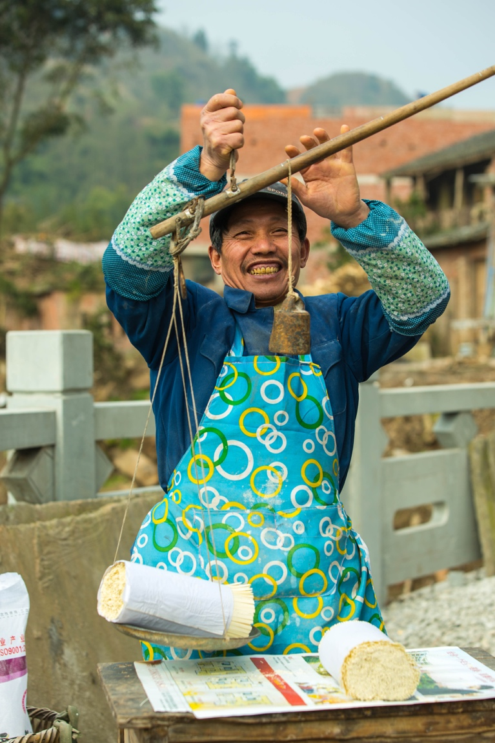









Nearly 400,000 households or 1.2 million people ...
Benefiting financially from the PoA with 40% increase of disposable household income
with improved food security and nutrition with 182,000 ha under sustainable agricultural practices
benefitting from improved health, mostly women and children
better qualified in renewable energy with 2,000 additional people qualified as biogas experts
slightly more than 1,000 jobs created by the PoA for women
1.5 hours per day less cooking time for women and now available for other purposes
benefitting from improved waste management, less fertilizer & pesticide use and better sanitation systems
with access to clean, reliable, convenient and affordable biogas
10,000 total jobs created by the project, thereof 2,000 permanent jobs and 8,000 temporary jobs
around CNY 2.4 billion of total expenditure in local material, services and infrastructure induced
Training of Trainers on Climate-Sanitation Nexus – Carbon Market for Sanitation
10

Slide 11
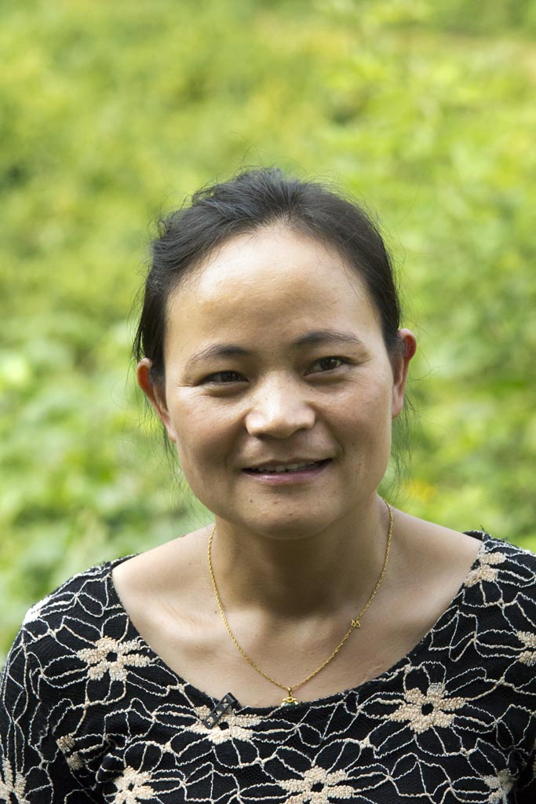





Nearly 400,000 households or 1.2 million people ...
in the periphery of the Sichuan province benefitting from sustained income growth
total annual avoidance of untreated manure of approximately 220,000 tons of dry matter (for all 400,000 PoA households)
approx. 700,000 tCO2e reduced by the PoA year by year (for all 400,000 PoA households)
nearly 340,000 tons of coal reduced annually
total annual decrease of firewood approx. 690,000 tons (for all 400,000 PoA households)
nearly 100,000 tons of chemical fertilizer reduced p.a.
around CNY 2.4 billion in domestic financial resources mobilized
solid and long-term multi-stakeholder partnership between German and Chinese key project participants
Training of Trainers on Climate-Sanitation Nexus – Carbon Market for Sanitation
11

Slide 12

Q&A

Slide 13

TRAINING/ADVOCACY PLAN

Slide 14
Scenario and structure of the exercise
“You are a trainer/advocate for carbon finance for sanitation. You want to convince a decision-maker to consider carbon finance for their sanitation project ."
Form a group.
Agree on who is your target audience. Fill the training plan template accordingly. (15 minutes)
Presentation: Present your training plan and arguments to convince/train your target audience of the opportunities of the Carbon Finance for Sanitation. (5 minutes)
Reflection and feedback. (10 minutes)
Training of Trainers on Climate-Sanitation Nexus – Climate-SMART Sanitation Approach
14

Slide 15
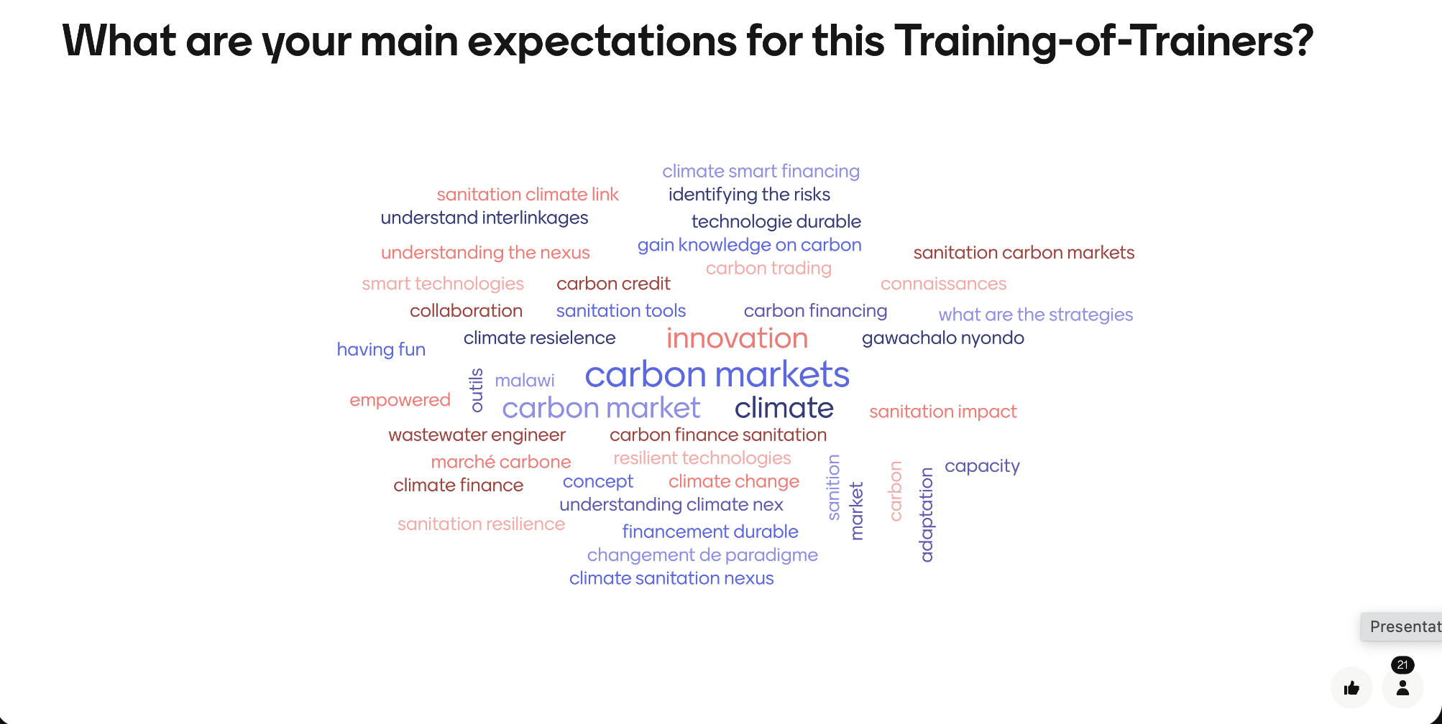
EXPECTATIONS
Training of Trainers on Climate-Sanitation Nexus – Climate-Sanitation Nexus
15
Notes:
What were your key insight or takeaway from yesterday?
What did you find most interesting or surprising?
How has your understanding of the topic evolved?
What would you like to explore further?
What part of the session was most valuable or engaging for you?
Is there something you would do differently in your work based on yesterday’s discussion?
What questions do you still have moving forward?

Slide 16
SUMMARY & FINAL EVALUATION
Menti.com
Code: XXXXX
Training of Trainers on Climate-Sanitation Nexus – Climate-Sanitation Nexus
16
Notes:
What were your key insight or takeaway from yesterday?
What did you find most interesting or surprising?
How has your understanding of the topic evolved?
What would you like to explore further?
What part of the session was most valuable or engaging for you?
Is there something you would do differently in your work based on yesterday’s discussion?
What questions do you still have moving forward?

Slide 17
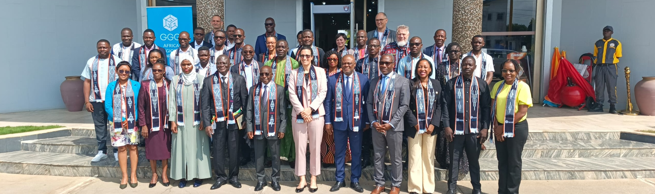
For your insights and very active participation! See you all soon!
Heinz-Peter (hpmang@upm-cdm.eu),
Marie (mreysset@upm-cdm.eu, Martin (mdilger@upm-cdm.eu)

