Slide 1
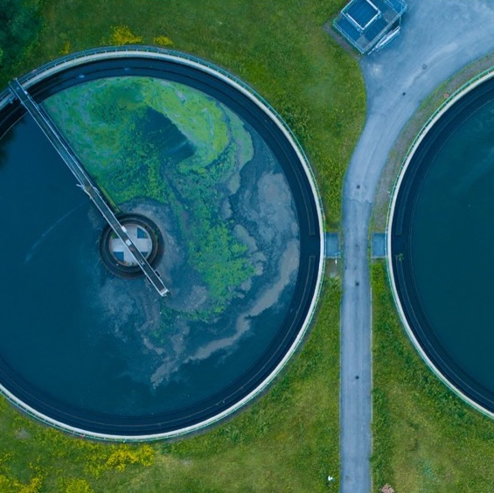

Exercise: Scaling Up Impact
Developing an outreach / training plan
UPM Umwelt-Projekt-Management GmbH
June 2025

Slide 2

Why this exercise?
Many stakeholders are still unaware of how climate and sanitation are interconnected.
Sanitation is often overlooked in climate policies like Nationally Determined Contributions (NDCs) and National Adaptation Plans (NDPs).
YOU – as trainers and advocates – can change this by influencing local and national decision makers.
Training of Trainers on Climate-Sanitation Nexus – Scaling-up impact / Training Plan
2

Slide 3
Learning objectives
Apply training plan to prepare approach, key messages, etc. tailored to a specific stakeholder.
Communicate the Climate-Sanitation Nexus clearly and persuasively.
Handle objections and questions effectively.
Reflect on strategies to improve real-life outreach.
Training of Trainers on Climate-Sanitation Nexus – Scaling-up impact / Training Plan
3

Slide 4
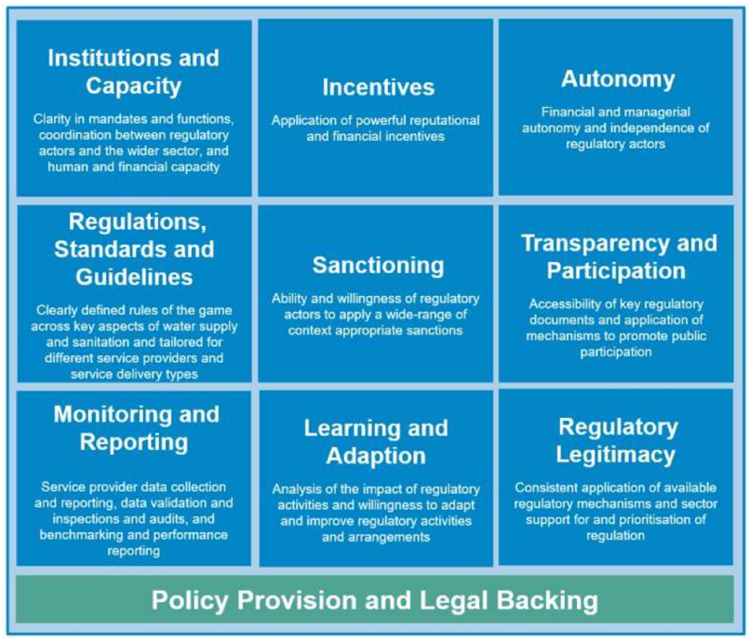
How to advocate for
sanitation-related climate actions
Developing Effective Advocacy for Sanitation-Related Climate Actions
Practical strategies for promoting inclusion of sanitation in climate policies and for engaging diverse stakeholders in advocacy processes
ESAWAS Building Blocks
Training of Trainers on Climate-Sanitation Nexus – Scaling-up impact / Training Plan
4

Slide 5
How to advocate for
sanitation-related climate actions
Category | Guiding Questions
Assessment of climate risks | What climate risks (e.g. floods, droughts, temperature changes) are expected to impact sanitation systems?
Vulnerability and needs | Which communities or regions are most vulnerable to climate-related sanitation issues (e.g. infrastructure failure, challenges to service providers)?
Adaptation measures | What sanitation-specific adaptation measures can be implemented to strength resilience to climate impacts?
Co-benefits | How can sanitation interventions also contribute to other adaptation goals (e.g. health, biodiversity, ecosystem health, livelihoods, food security)?
Mitigation potential | What are the opportunities for reducing GHG emissions within the sanitation sector (e.g. through resource recovery, the use of aerobic treatment technologies, more frequent de-sludging of containments facilities, etc.)?
Institutional capacity | Are there gaps in institutional capacity or governance structures that hinder climate-resilient and low-emission sanitation implementation?
Monitoring and evaluation | How will progress on sanitation-related climate adaptation and mitigation measures be monitored and evaluated?
Financing | What financial resources are available or needed to scale up sanitation-related climate adaptation and mitigation measures?
International cooperation | How can international collaboration support the integration of sanitation into national adaptation and mitigation strategies, as well as the integration of climate action into sanitation strategies?
Designing Actionable Sanitation-Climate Initiatives
To effectively address sanitation’s contributions to climate action, it is essential for activities to be specific and to include baseline data and relevant indicators where appropriate. This will allow the progress to be tracked.
SEI's Guiding Questions to prompt thinking on integrating climate action into sanitation systems and vice versa
Training of Trainers on Climate-Sanitation Nexus – Scaling-up impact / Training Plan
5

Slide 6
Examples of a Training Plan
Element | Example
Target audience | Mayor of a small town that is affected by seasonal flooding
Objective of the approach | Raise awareness how climate-SMART sanitation can mitigate local climate impacts and should be included in the local climate adaptation strategy
Format | One-on-one dialogue during a municipal planning meeting
Key messages | Sanitation upgrades reduce environmental damage during climate shocks. Access to climate finance may be possible if sanitation is included in climate adaptation strategy
Arguments & content | Evidence: Past flooding events caused latrine overflows, contaminating water sources. Climate-SMART sanitation solutions can be affordable and scalable.
Methods / support | Visuals: local flood maps, impact diagram Success stories from similar towns
Objections & reactions | “This is a health issue, not my responsibility.” “The community has other priorities.”
Follow-up | Offer short technical consultation to show sanitation-climate links. Follow-up briefing notes and potential funding information
Training of Trainers on Climate-Sanitation Nexus – Scaling-up impact / Training Plan
6

Slide 7
Élément | Exemple
Public cible | Maire d'une petite ville touchée par des inondations saisonnières
Objectif de la démarche | Sensibiliser sur la manière dont un assainissement climato-intelligent peut atténuer les impacts climatiques locaux et devrait être intégré dans la stratégie locale d’adaptation au climat
Format | Entretien individuel lors d’une réunion de planification municipale
Messages clés | Les améliorations de l’assainissement réduisent les dommages environnementaux lors des chocs climatiques. Un accès à des financements climat pourrait être possible si l’assainissement est inclus dans la stratégie d’adaptation au climat.
Arguments et contenu | Preuve : des inondations passées ont provoqué des débordements de latrines, contaminant les sources d’eau. Les solutions d’assainissement climato-intelligent peuvent être abordables et évolutives.
Méthodes / supports | Supports visuels : cartes locales des inondations, diagramme d’impact Exemples de réussite dans des villes similaires
Objections et réactions | « C’est un problème de santé, ce n’est pas de ma responsabilité. » « La communauté a d’autres priorités. »
Suivi | Proposer une courte consultation technique pour montrer les liens entre assainissement et climat. Notes de synthèse en suivi et informations sur les financements possibles
Training of Trainers on Climate-Sanitation Nexus – Scaling-up impact / Training Plan

Slide 8

01
TRAINING PLAN DEVELOPMENT

Slide 9
1. Define your target audience
Ask yourself
Who are you trying to influence?
What role do they plan in sanitation or climate policy?
What decision or actions can they take?
Training of Trainers on Climate-Sanitation Nexus – Scaling-up impact / Training Plan
9

Slide 10
2. Define the objective of your approach
Clarify
What exactly do you want your target audience to do or understand?
How will this contribute to integrating sanitation in climate policies or actions?
Training of Trainers on Climate-Sanitation Nexus – Scaling-up impact / Training Plan
10

Slide 11
3. Select an appropriate format
Chose a format that matches the target audience, their time, interest and level of engagement
Target audience | Primary interests | Communication style | Recommended format
Decision makers | Policy relevance, public visibility, political risks/opportunties | High level, concise, action-oriented, value-driven | Short briefings, high-level roundtables, field visits with media potential
Technical staff | Technical feasibility, scientific and operational accuracy | Detailed and evidence-based, solution-oriented, analytical and practical | Workshops, technical presentations, planning sesssions
Project managers | Delivery times, resource allocation, managing partnerships | Pragmatic and goal-focused, structured | Working meetings, reporting frameworks, action plans
Business people | Return on investment, market opportunities, risk management | Data-driven, results- and partnership-oriented | Roundtables, pitch
Training of Trainers on Climate-Sanitation Nexus – Scaling-up impact / Training Plan
11

Slide 12
Public cible | Centres d’intérêt principaux | Style de communication | Format recommandé
Décisionnaires | Pertinence politique, visibilité publique, risques/opportunités politiques | Stratégique, concis, axé sur l’action, orienté vers la valeur | Notes de synthèse courtes, tables rondes de haut niveau, visites de terrain avec potentiel médiatique
Personnel technique | Faisabilité technique, exactitude scientifique et opérationnelle | Détaillé et fondé sur des données probantes, orienté vers les solutions, analytique et pratique | Ateliers, présentations techniques, séances de planification
Chefs de projet | Délais de mise en œuvre, allocation des ressources, gestion des partenariats | Pragmatique et centré sur les objectifs, structuré | Réunions de travail, cadres de suivi et de reporting, plans d’action
Acteurs du secteur privé / Entrepreneurs | Retour sur investissement, opportunités de marché, gestion des risques | Axé sur les données, orienté vers les résultats et les partenariats | Tables rondes, présentations de type pitch
Training of Trainers on Climate-Sanitation Nexus – Scaling-up impact / Training Plan

Slide 13
4. Develop key messages
Develop key messages that are clear, relevant and backed by evidence. Use language in relation to your target audience.
5. Build arguments and content
Support your key messages with local data or examples, case studies from similar contexts, maps, infographics, etc. These contents should reflect the primary interests of your target audience.
Training of Trainers on Climate-Sanitation Nexus – Scaling-up impact / Training Plan
13

Slide 14
6. Choose engagement methods and support tools
Decide how to deliver your key messages and content:
Interactive: discussion, Q&A, poll, …
Visual: flipchart, power point, video, maps, …
Collaborative: group work, planning exercise
Supporting tools could be
One-page briefs
Handouts
Templates
Training of Trainers on Climate-Sanitation Nexus – Scaling-up impact / Training Plan
14

Slide 15
7. Anticipate objections and reactions
List likely doubts or resistance points.
8. Define the follow-up
Plan how you will sustain interest and remain in contact with your target audience.
Training of Trainers on Climate-Sanitation Nexus – Scaling-up impact / Training Plan
15

Slide 16
02
THE EXERCISE

Slide 17
Scenario and structure of the exercise
“You are a trainer/advocate for climate-SMART sanitation. You want to convince a decision-maker to consider sanitation in climate planning."
Form a group.
Agree on who is your target audience. Fill the training plan template accordingly. (25 minutes)
Presentation: Present your training plan and arguments to convince/train your target audience of the importance of sanitation-related climate action. (10 minutes)
Reflection and feedback. (10 minutes)
Training of Trainers on Climate-Sanitation Nexus – Scaling-up impact / Training Plan
17

Slide 18
Examples of Target Audience
Examples for Target Person | Perspective
NDC coordinator | „ We are revising our NDCs. But sanitation hasn‘t come up yet.“
Head of sanitation authority | „Our infrastructure is outdated. Climate is just another burden.“
Climate change officer | „Sanitation isn‘t my mandate – it‘s for WASH sector to handle“
Urban planner | „Sanitation infrastructure is too fixed – not adaptable to changing climate.“
Parliamentarian | « We need strong public demand before we prioritize it in legislation.“
Tip: Choose a target person based on your personal context and experience.
Training of Trainers on Climate-Sanitation Nexus – Scaling-up impact / Training Plan
18

Slide 19




19th Floor Jeongdong Bldg. 21-15,
Jeongdong-gil, Jung-gu, Seoul,
Republic of Korea 04518
www.gggi.org
@gggi_hq
@GGGIHQ
@GGGIHQ
@gggi_hq
@GGGIMedia

