Slide 1
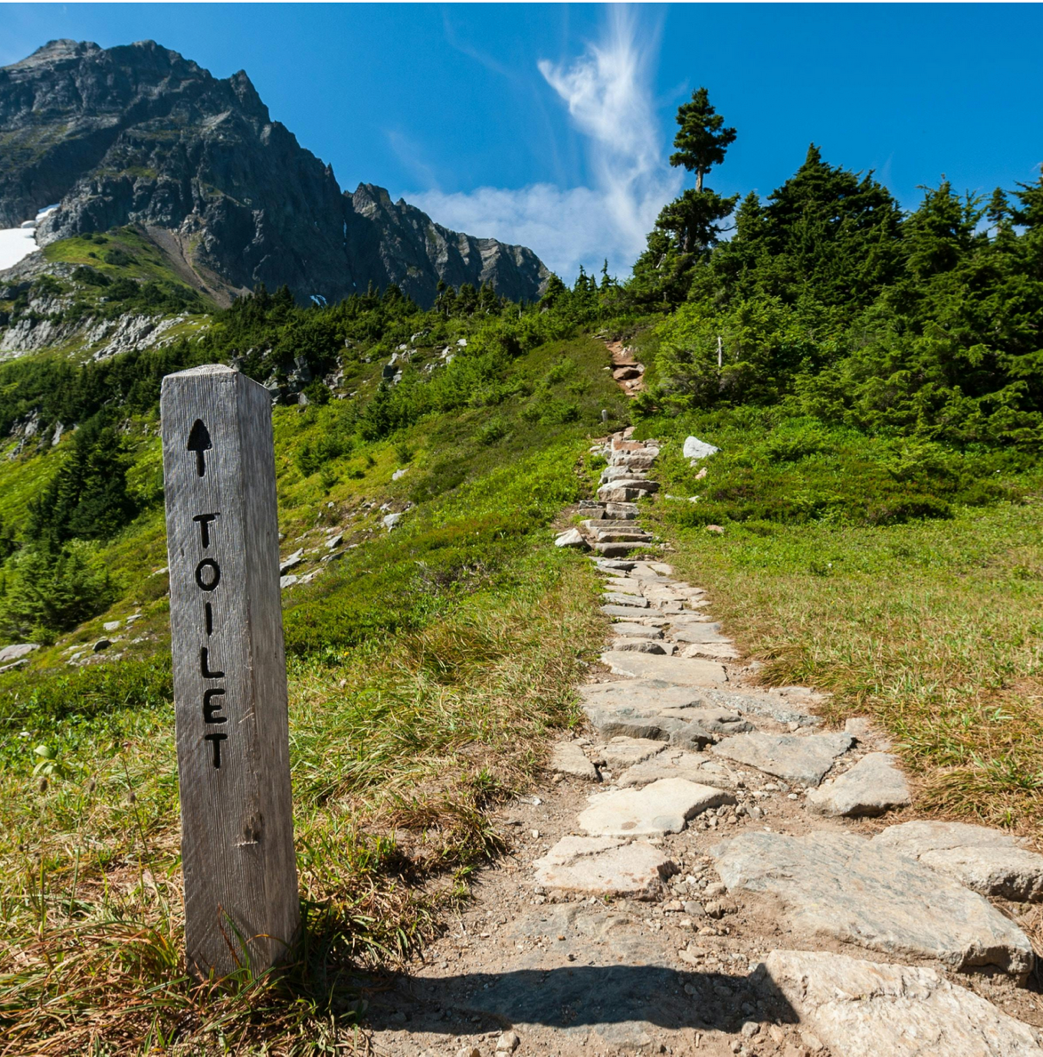

Climate-SMART sanitation
UPM Umwelt-Projekt-Management GmbH
June 2025

Slide 2
RECAP DAY 2
Training of Trainers on Climate-Sanitation Nexus – Climate-Sanitation Nexus
2
Notes:
What were your key insight or takeaway from yesterday?
What did you find most interesting or surprising?
How has your understanding of the topic evolved?
What would you like to explore further?
What part of the session was most valuable or engaging for you?
Is there something you would do differently in your work based on yesterday’s discussion?
What questions do you still have moving forward?

Slide 3
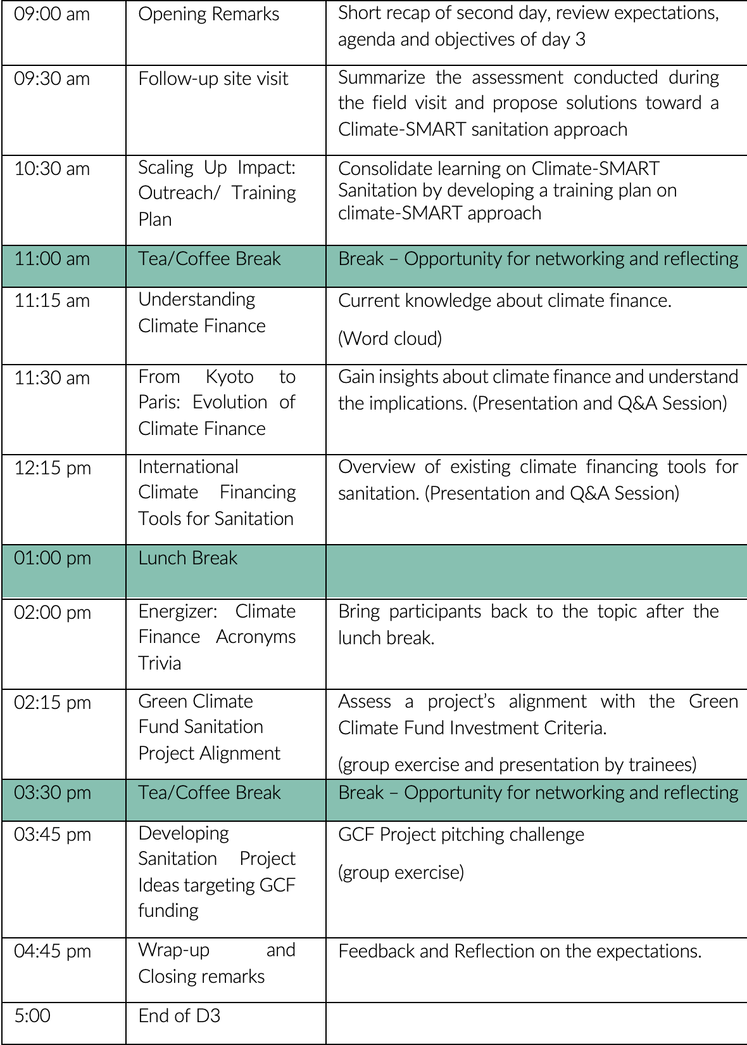
AGENDA
Training of Trainers on Climate-Sanitation Nexus – Climate-SMART Sanitation Approach
3

Slide 4

01
FOLLOW-UP FIELD VISIT

Slide 5
Follow-up of the field visit
Summarize the information and propose solutions to improve the limitations (one table group / one pillar)
Prepare a short presentation using ppt, flipchart or other support (20 minutes for 1 and 2)
Presentation to the whole group (5 min max. timed)
Training of Trainers on Climate-Sanitation Nexus – Climate-SMART Sanitation Approach
5

Slide 6
02
TRAINING/ADVOCACY PLAN

Slide 7

Scenario
“You are a trainer/advocate for climate-SMART sanitation. You want to convince a key stakeholder/decision-maker to consider applying Climate-SMART Sanitation Approach."
Training of Trainers on Climate-Sanitation Nexus – Climate-SMART Sanitation Approach
7

Slide 8



19th Floor Jeongdong Bldg. 21-15,
Jeongdong-gil, Jung-gu, Seoul,
Republic of Korea 04518
www.gggi.org
@gggi_hq
@GGGIHQ
@GGGIHQ
@gggi_hq
@GGGIMedia

