Slide 1


Exercise 2: “Pitch Your Project” Challenge
Developing Sanitation Project Ideas targeting GCF funding
UPM Umwelt-Projekt-Management GmbH
June 2025

Slide 2

Why this exercise?
Many sanitation projects may not qualify for Green Climate Fund (GCF) support due to differing focuses or misalignment in strategies.
Ensuring that projects ideas are communicated in a clear, compelling, and concise manner, whilst considering GCF’s approach and strategy to fund climate-resilient sanitation projects, can place projects in a strong position for approval and funding.
YOU – as trainers and advocates – can develop or review high-impact, fundable proposals in the climate and sanitation sectors, through the lens of the GCF’s investment criteria approach and its expected project outcomes, thus enhancing the development of aligned climate-resilient sanitation projects that will have higher chances of GCF approval.
Training of Trainers on Climate-Sanitation Nexus – The Climate-Sanitation Nexus
2

Slide 3
Learning objectives
Familiarize with the GCF’s Investment Criteria and Expected Outcomes, and how to develop sanitation projects accordingly.
Be able to clearly articulate and present the core problem, your proposed solution, and the expected project impacts to a broad audience.
Training of Trainers on Climate-Sanitation Nexus – The Climate-Sanitation Nexus
3

Slide 4
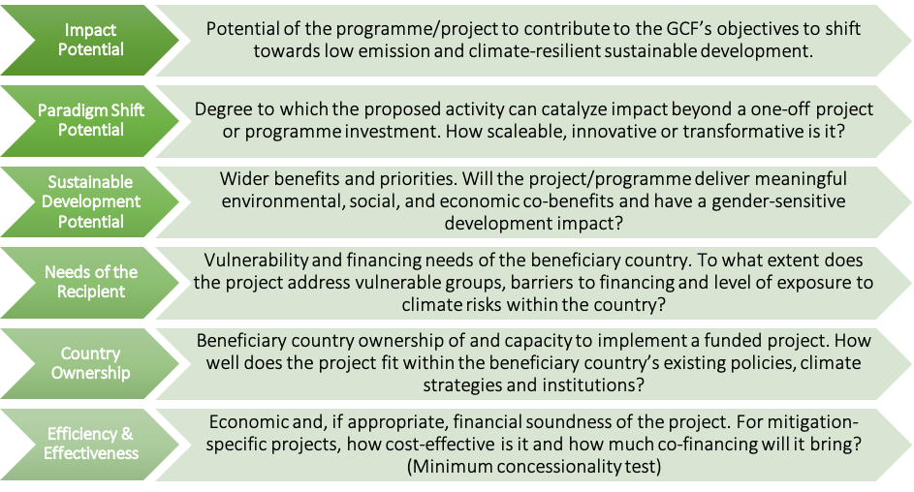
The GCF Investment Criteria for Climate-Resilient Sanitation Projects
Source: Multilateral Environmental Agreements (MEA) – Republic of Trinidad and Tobago
4

Slide 5

The GCF Expected Outcomes for Climate-Resilient Sanitation Projects
Additionally, the GCF has outlined in the Water Security Sectoral Guide, two key outcomes it expects from climate-resilient sanitation activities:
Climate-Resilient Infrastructure and Services: Building new or upgrading existing sanitation infrastructure, to achieve synergies between adaptation and mitigation, and withstand climate-related impacts along the entire sanitation chain.
Examples: Flood-resistant sanitation systems, decentralized climate-resilient sanitation
Circular Economy and Integrated Management: Integrating sanitation with broader health, water, food, and energy security to ensure protection of ecosystems.
Examples: Utilization of treated wastewater for potable, industrial, and agricultural uses in water-scare regions; biogas generation from sanitation systems
Training of Trainers on Climate-Sanitation Nexus – Climate Finance for Sanitation
5

Slide 6

THE EXERCISE

Slide 7
Scenario and structure of the exercise
“You are a project developer preparing a short pitch for a climate-resilient sanitation project targeting GCF funding ."
Form groups.
Familiarize yourself with the GCF Investment Criteria and the Expected Outcomes (please refer to supplementary checklists provided for Exercise 1 or section 4.4 of the Manual ) to help brainstorm sanitation project ideas that target GCF funding. (20 minutes)
Pitch your project to the room, discussing how the project fulfils the criteria and delivers the expected outcomes. How you pitch is entirely up to you. Participants in the audience are encouraged to ask questions as if they were part of the GCF project review committee. (20 minutes)
Training of Trainers on Climate-Sanitation Nexus – The Climate-Sanitation Nexus
7

Slide 8




19th Floor Jeongdong Bldg. 21-15,
Jeongdong-gil, Jung-gu, Seoul,
Republic of Korea 04518
www.gggi.org
@gggi_hq
@GGGIHQ
@GGGIHQ
@gggi_hq
@GGGIMedia

